Slide 1
JOHNSON CONTROLS
is a global diversified technology and industrial leader serving customers in more than 150 countries.

Slide 2
History of the company
In 1885, Warren Johnson inspired the future, launching an industry focused on energy efficiency and a company poised to explore new ideas and enter new fields
This foundation has ignited the customer-focused innovation of thousands of employees for more than 125 years.

Slide 3
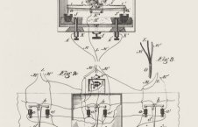
"The man who devised the thermostat…in my private opinion, was a hero comparable to Shakespeare, Michelangelo or Beethoven." -- H. L. Mencken (1880-1956), 20th century journalist

Slide 4
valuing diversity
We nurture an environment in which everyone understands and values the similarities and differences among their employees, customers and communities.
Johnson Controls is also dedicated to working collaboratively with historically underutilized suppliers to strengthen their supply chain and expand their business base.

Slide 5
Enabling their success
The success of Johnson Controls is enabled by the commitment and dedication of their 170,000 employees around the world. With their continued growth focus, we are a company where employees can express ideas, make a difference and build their future.
Their workplace emphasizes integrity and ethics. They are customer-focused, continually looking to innovate and enhance their products, service and solutions.
To help their employees grow, we believe it's vital to strengthen their engagement and develop their skills and leadership capabilities. This is done an environment that welcomes diversity of thought and experience.

Slide 6
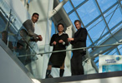
leader in markets THEY serve
Building Efficiency is a leading provider of equipment, controls and services for heating, ventilating, air-conditioning, refrigeration and security systems.
Global Work Place Solutions is a leading provider of facilities, corporate real estate and energy management for many of the world’s largest companies.

Slide 7
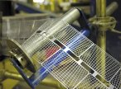
leader in markets they serve
Power Solutions is the global leader in lead-acid automotive batteries and advanced batteries for Start-Stop, hybrid and electric vehicles.
Automotive Experience is a global leader in automotive seating, overhead systems, floor consoles, door panels and instrument panels.

Slide 8
Thank you for your attention!
Team Light Yellow
By: Debby, Dori, Dia, Deea, Vendy, Moni, Lori

