Slide 1
High School of Economics Ljubljana
Prešernova 6
1000 Ljubljana

Slide 2
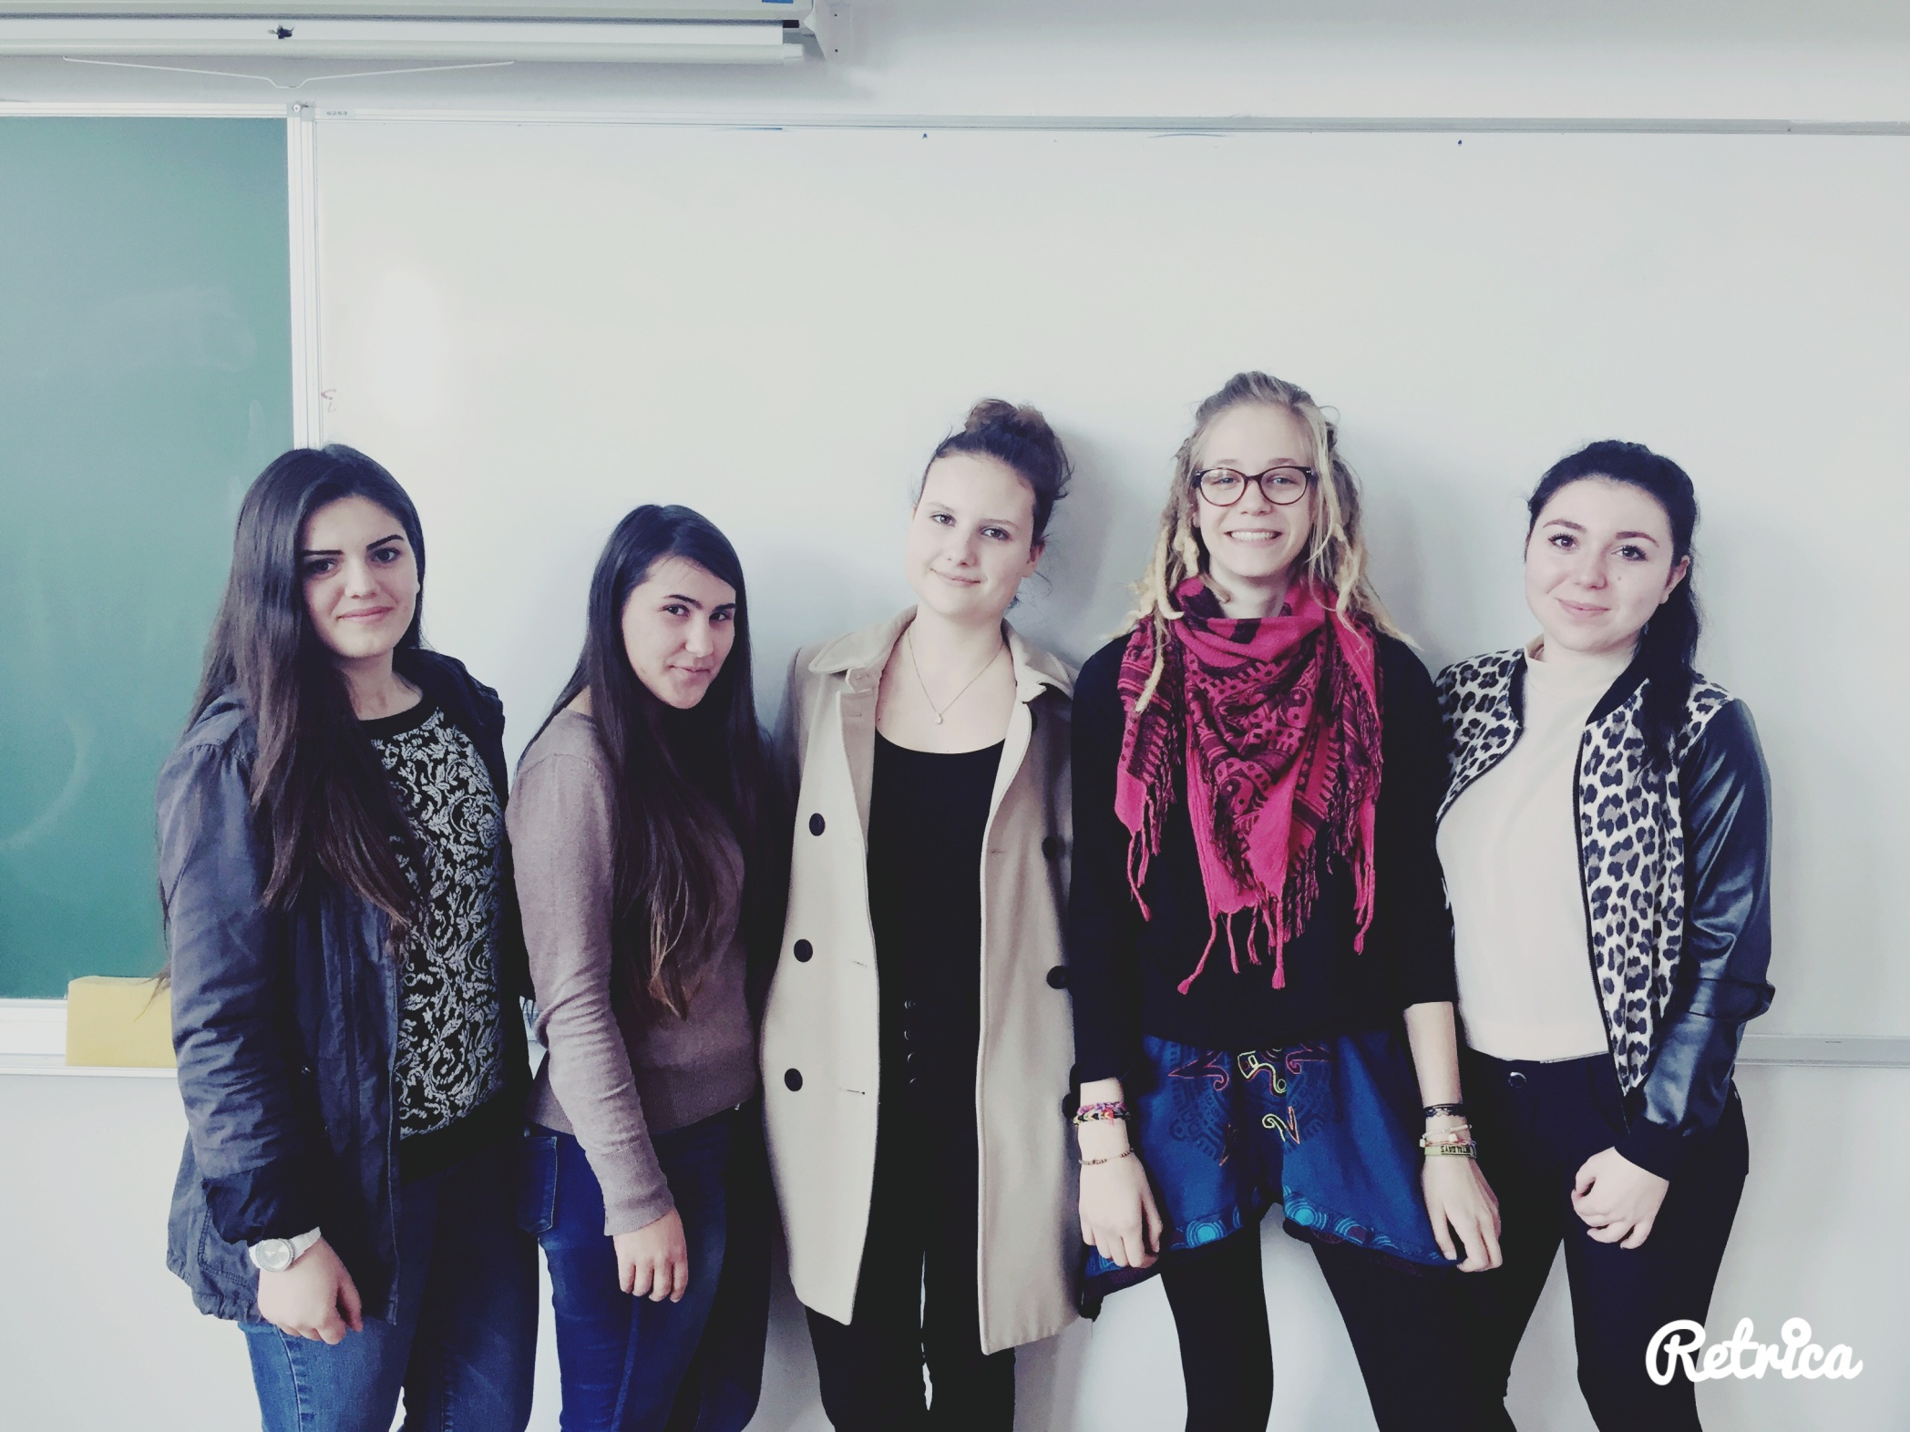

Slide 4
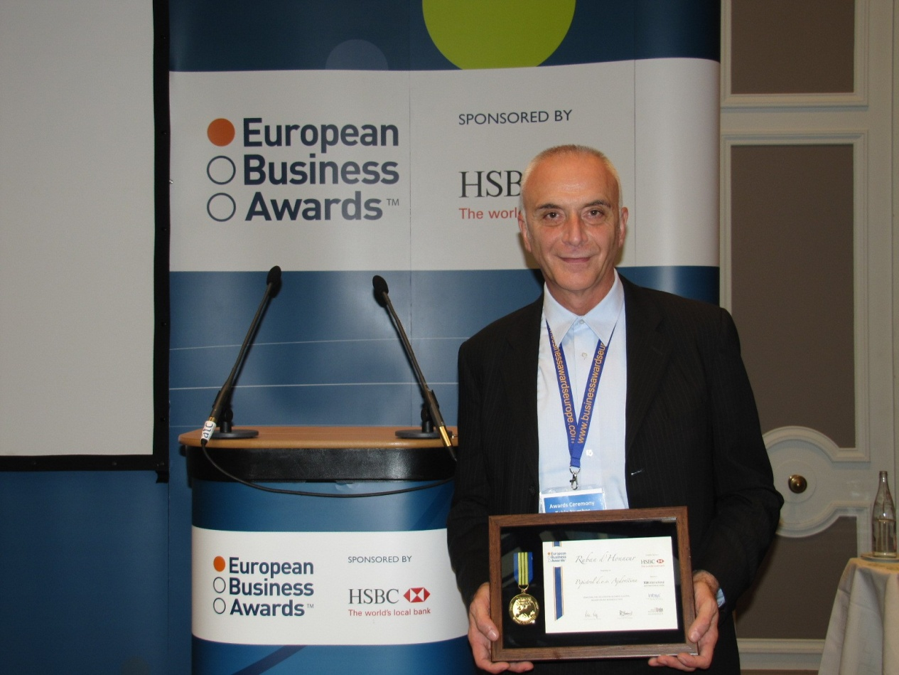
“If I had to be an avarage man tomorrow I would rather have a heartattack today “.

Slide 5
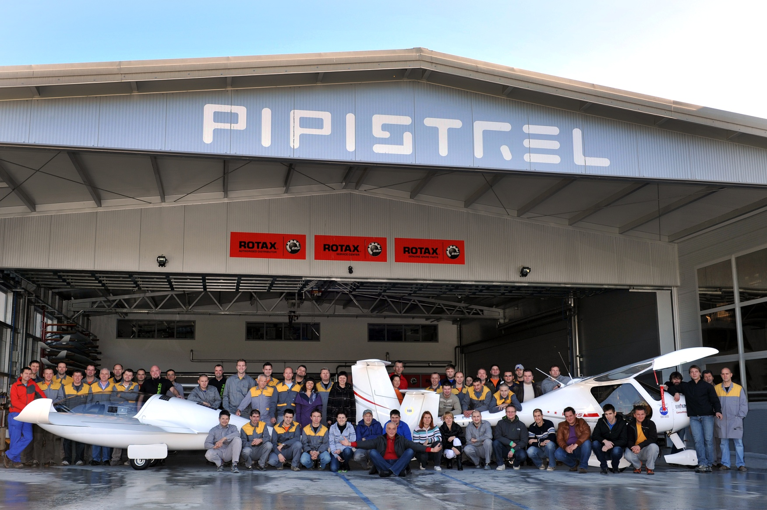

Slide 6
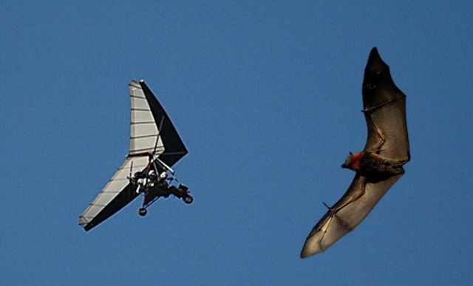
Pipistrel - the freedom of flight
The widest range of advanced light aircrafts in the world.

Slide 7
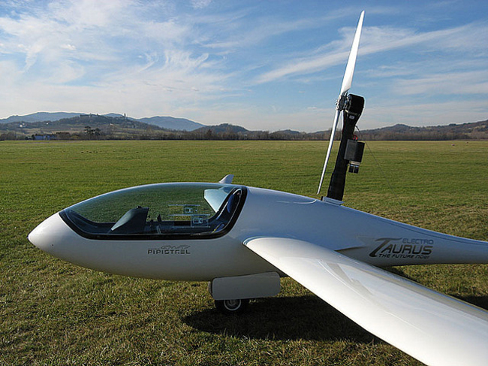
1995
Electric powered Taurus (electro)

Slide 8
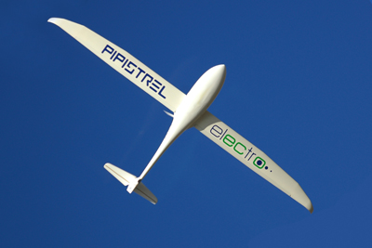
85 kw
14kg

Slide 9
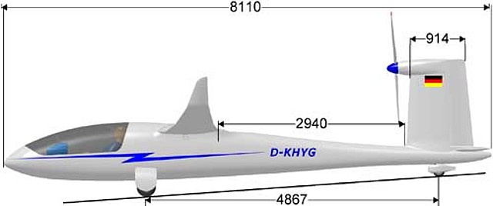
FUTURE OF FLYING!
Project Hydrogenius

Slide 11
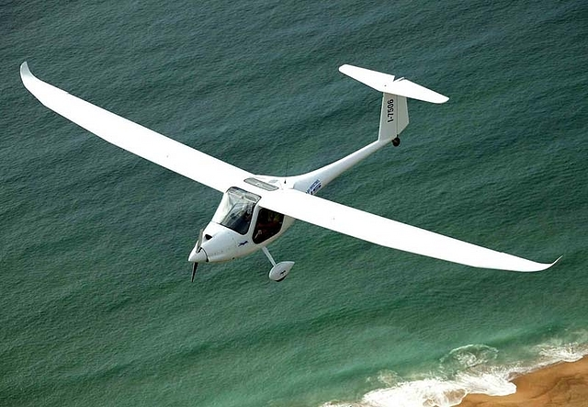
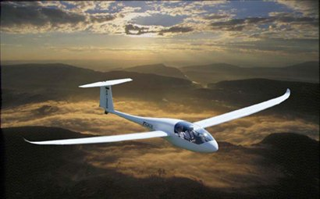
WANT TO LEARN HOW TO FLY?
Learning to fly with Pipistrel is cheaper!

Slide 12
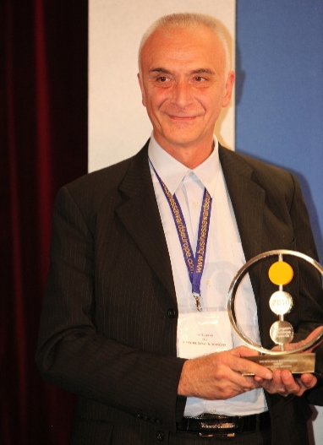
AWARDS
FAI - five world record
2007 - Pipistrel virus s-wing won a Nasa award for best personal plane of the future
2008 - Nasa award for ????
FAI- diploma for contributions for evolution of aircraft
2011 - Pipistrel USA won a Nasa cafe Nasa green flight challenge
2011- Danilo Turk (the then president of Slovenia) awarded Ivo Boscorol The Order for Exceptional Services

Slide 13
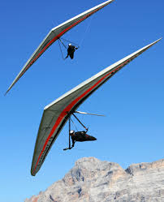
UNTIL NOW…
500 hang gliders
1000 aircrafts
……in 80 countries

Slide 14
‘’For the pilots a plane is not a dead object but a living friend who is by you in sickness and in health.’’-Ivo Boscorol

