Slide 1
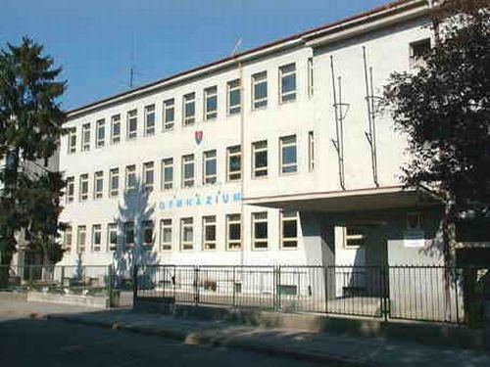
Information Communication Technology
Erasmus + ESCAPE project Team: Slovakia Štúrovo

Slide 2
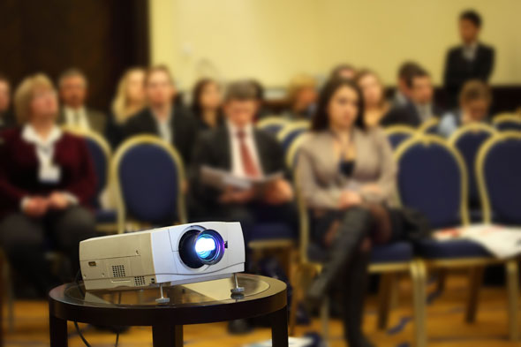
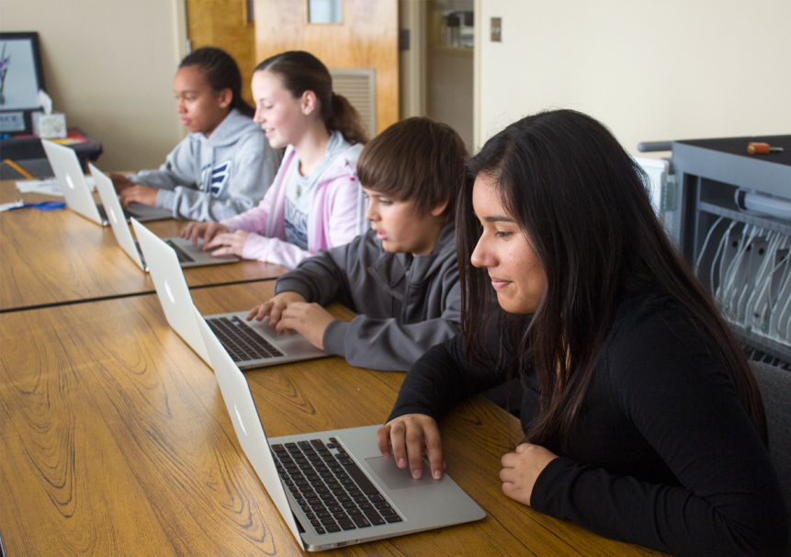
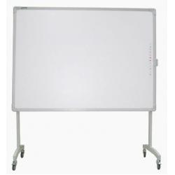
What should the room look like?
Stable Internet connection
Fast PCs
Pre installed programs for the lesson
Table
Projector

Slide 3
Basic facts
Information and communication technology (ICT) has become, within a very short time, one of the basic building blocks of modern society
Information and communication technology, or ICT, is defined as the combination of informatics technology with other, related technologies, specifically communication technology

Slide 4
Starting with the basics
Learning about the history of IT.
Gaining basic knowledge in using Microsoft Office.
Word, Excel, Power Point.
Gaining basic knowledge in programming.
Basic programming language: Turbo Pascal

Slide 5
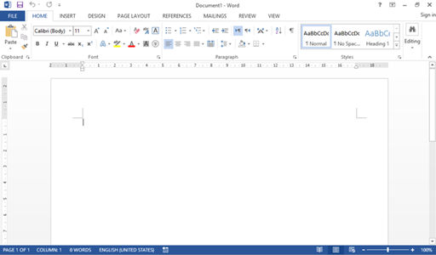
Microsoft Word
Developed in the 1980s.
Most popular word processor.
Known for reliability and compatibility.
Easy to use.

Slide 6
Microsoft Power Point
Presentating should be learnt as well.
Most common programme for ppt. Format is the M. Power Point.

Slide 7
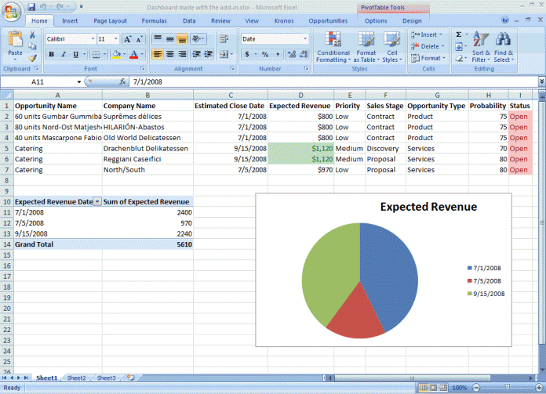
Microsoft Excel
Most popular spreadsheet for PC
It features calculations, graphic tools and tables.

Slide 8
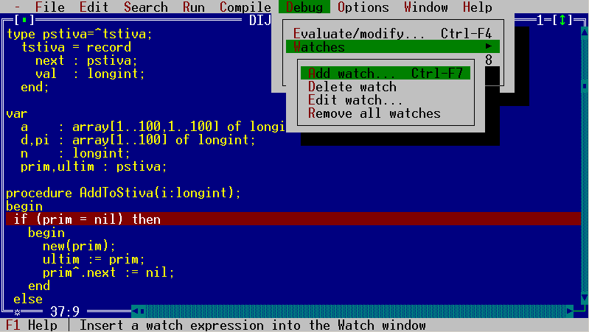
Turbo Pascal
One of the first programming langugages.
The basic of all newer programming languages.
Can make simple programms and algorithms.

Slide 9
Making project
IT is the lesson, where children learn how to write and format correctly word processors.
They also learn how to make presentations.
IT lessons give the basic knowledge for those, who want to become IT specialists.

Slide 10
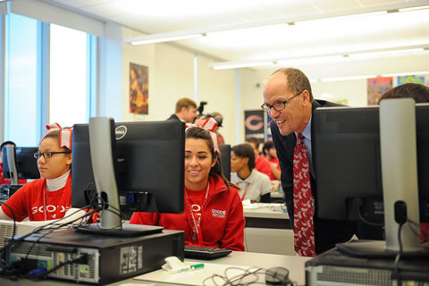
The attitude of the teacher
The teacher should be:
Helpful
Positive
Intelligent
Communicative
Interesting, not boring
Fair, rightful

Slide 11
Thank you for your attention
eTwinning ESCAPE project Team: Slovakia štúrovo

