Slide 1
Salt
From sea to market

Slide 2
What is salt, actually?
NaCl - sodium chloride
Na - sodium (40 %)
Cl - chlorine (60 %)
Sodium chloride or salt is one of the most abundant minerals on earth.

Slide 3
What is salt like?
translucent
colorless
odorless
characteristic taste

Slide 4
What is salt used for?
What is the number one usage of salt?

Slide 5
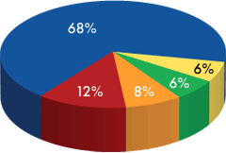
What is salt used for?
■ Industrial Chemicals
■ Water Conditioning
■ Highway Deicing
■ Agriculture
■ Food Grade Salt

Slide 6
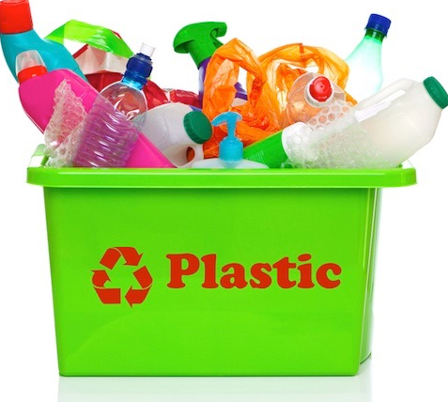
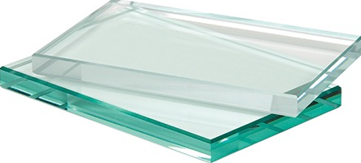
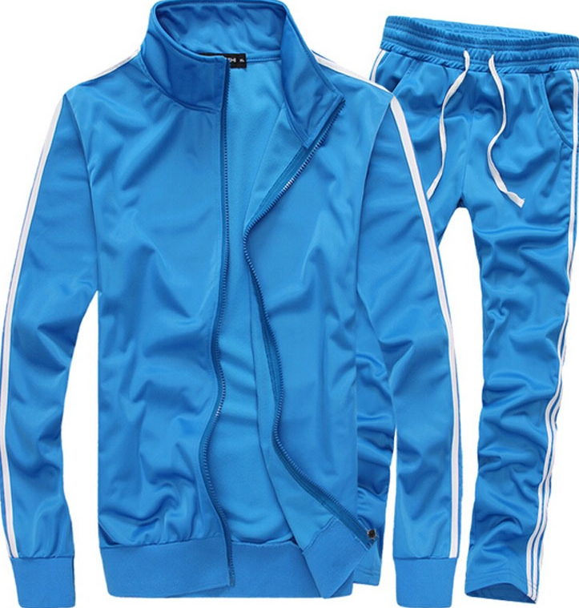
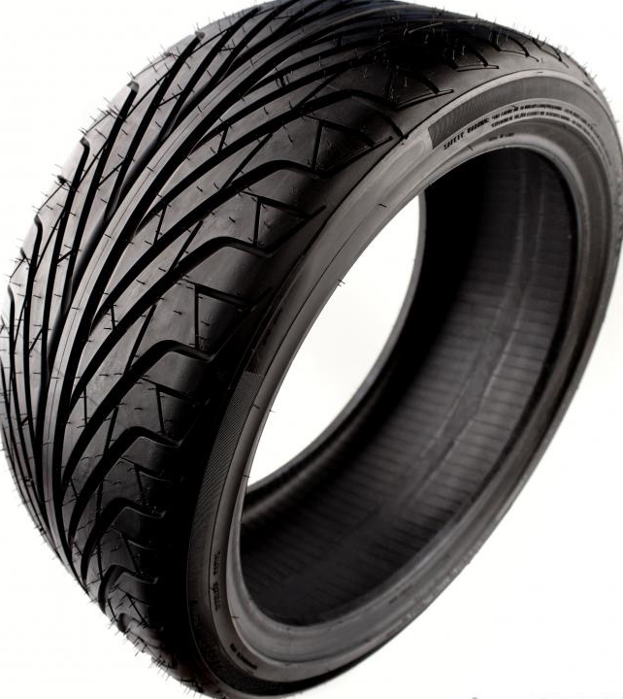
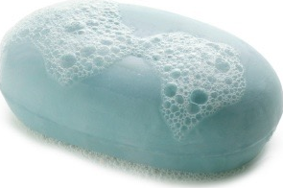
Salt in industry?
plastic paper glass polyester rubber soaps

Slide 7
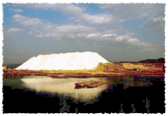
History of salt
10.000 BCE: perservative to make bacon, ham, and salted fish
6000 BCE: Oldest saltworks by the Xiechi Lake
2800 BCE: Egyptians traded salt fish for Phoenician products

Slide 8
History of salt
Roman name for salt was sal which is close to Salus - the goddes of health.
2500 BCE: Roman soldiers: salt money → salarium argentum → salary
2250 BCE: The first written reference in the Book of Job
800 BCE: Salt production began in China by the formation of salt crystals

Slide 9
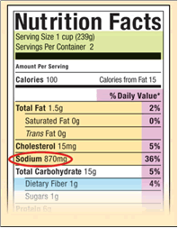
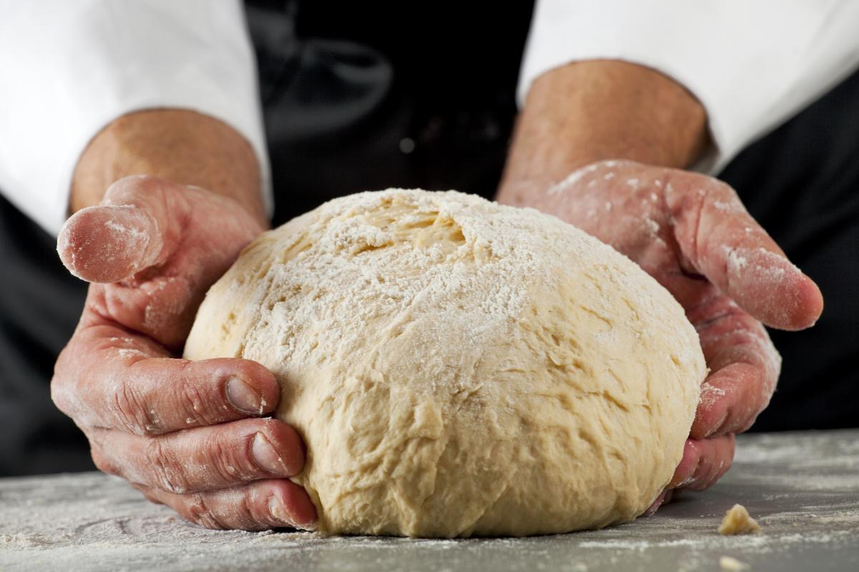
Why is salt so important?
Salt is biological necessity of human life!
Most of our food already has salt added to it.
But … if you bake your own bread or cook your own soup - it’s immediately obvious if you forget it.

Slide 10
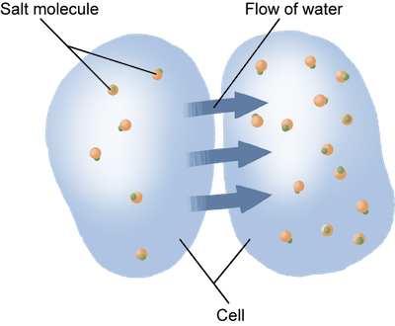
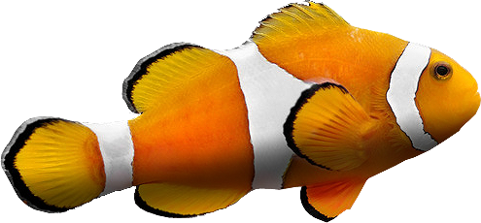
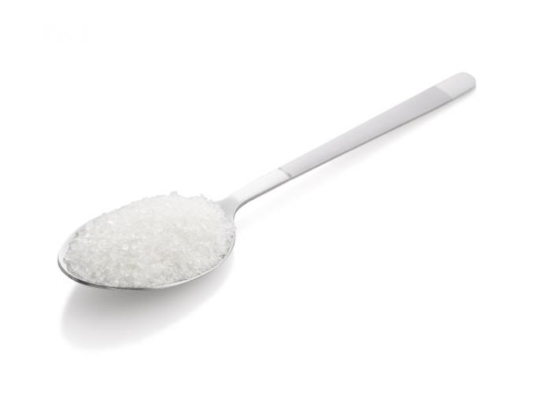
Essential for life
Our body can’t produce salt.
Without it - we become chemically unbalanced. Our muscles and nervous system cease to function!
All our body fluids - blood, sweat, tears, saliva - are salty.
Recommended: up to 6 grams/day.
Osmosis

Slide 11
Geopolitical importance
As important as oil or water.
Rome and Venice started as salt trading center.
Salt was taxed → Napoleon’s wars, Columbus’ voyages.
Food storage: Europe’s North → increased consumption of beer!
Soldiers and horses in warfare.

Slide 12
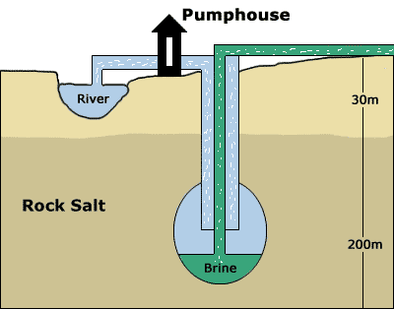
Sources of salt
Solar evaporation seawater: 35 grams / 1 kg of water
Deep-shaft mining similar to mining of other minerals - salt exists as deposits in ancient underground sea beds.
Solution mining wells are erected around salt beds → fresh water is injected to dissolve salt → salt solution is pumped out to a plant for evaporation

Slide 14
Sečovlje salt-pans
traditional production of salt with classical tools and methods → 14th century
1960 abandoned, but revived
special taste and characteristics of salt
650 ha protected as cultural monument and nature park

Slide 16
Acquired by Telekom
… which helped them turn the business around and make it profitable!
Their salt is sold across Europe, USA, Japan, Australia …
… used even by Jamie Oliver.

Slide 17
How to market salt?
The majority of sold salt is a commodity.
Mass production lowered the prices of salt.
The question:
How should such small butique salt pans market their salt?
www.streznik.biz/escape/salt.pdf

Slide 18
Quick quiz
www.streznik.biz/escape/quiz.php

