Slide 1
Bulgarian and imported fruit and vegetables
PREPARED by:
Kristian, Ivailo and Teodor
Profesionalna gimnazia Asen Zlatarov - Vidin

Slide 2
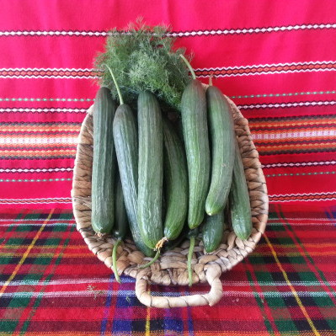
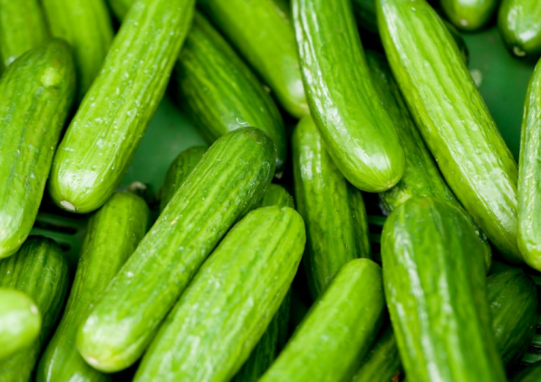
Cucumbers
Local-The price for one kg: 2,60 lv
Imported from Greece-
The price for one kg: 1,80 lv

Slide 3
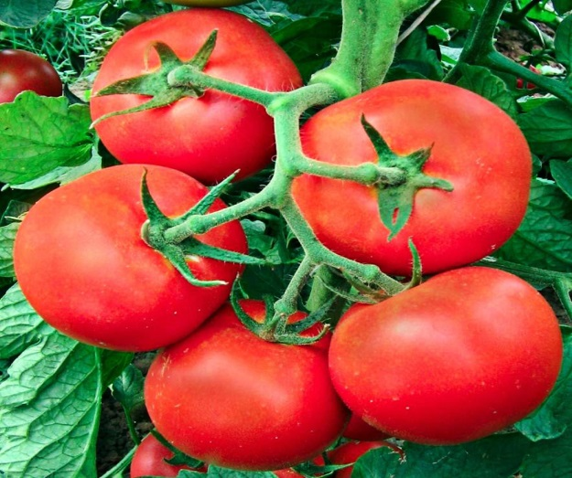
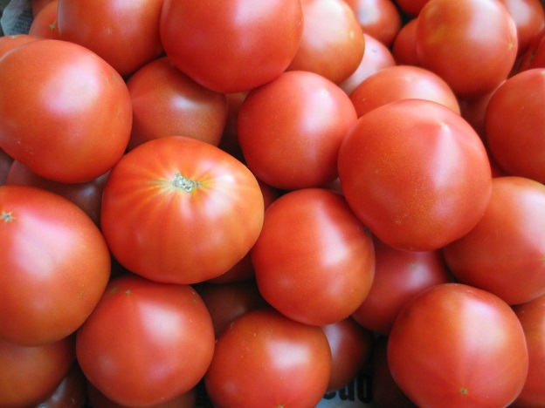
Tomatoes
Local-The price for one kg: 2,80 lv
Imported from Macedonia -
The price for one kg: 1,80 lv

Slide 4
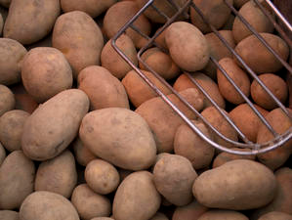
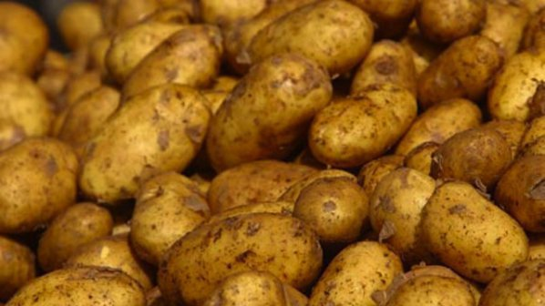
Potatoes
Local-The price for one kg: 1,10 lv
Imported from Germany-
The price for one kg: 0,89 lv

Slide 5
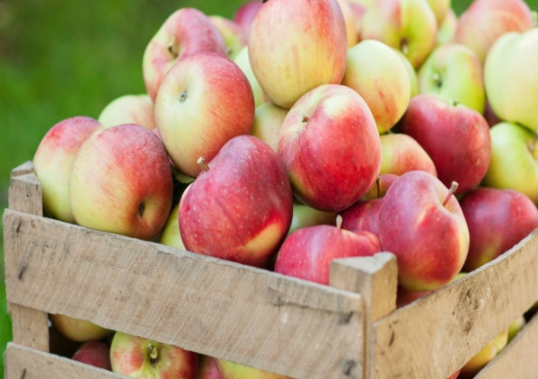
Apples
Local - The price for one kg: 1,40 lv
Imported from Greece-
The price for one kg: 1,20 lv

Slide 6
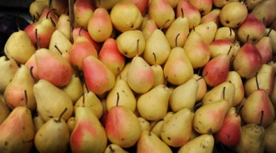
Pears
Local - The price for one kg: 4,00 lv
Imported from Greece-
The price for one kg: 2,80 lv

Slide 7
On Bulgarian market there are:
Tomatoes from Spain -
0.75 – 0.89 euros ,
Cabbage from Macedonia -
0.24 euros ,
Red peppers from Albania –
0.89 euros,
Pumpkins from Serbia –
0.17 euros,
Apples from Poland –
between 0.23 or 0.35 euros per kg.

Slide 8
Bulgarians buy imported fruit and vegetables that are grown artificially, but at this point Bulgarian production is naturally grown and environmentally friendly.

Slide 9
Actual prices of Bulgarian Stock Exchange:
http://novataborsa.com/borsa/market

Slide 10
THANK YOU FOR YOUR ATTENTION

