Slide 1
Monday
Colourful dividing into groups
Teamwork in the school yard
Meeting the mayor

Slide 2
Colourful dividing into groups
Divided into: economists, secretaries, cashiers, accountants, PR experts, editors;
We are the:
Economists
An economist is an expert who studies the relationship between a society's resources and its production or output.

Slide 3
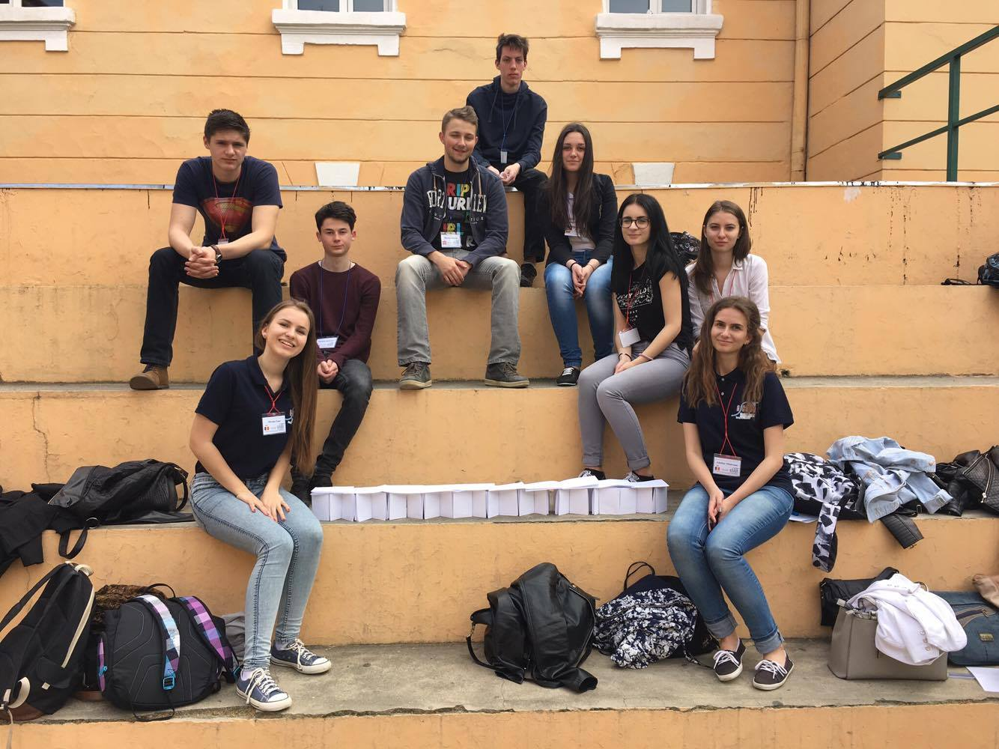
Teamwork in the school yard
Getting to know each other through games
Human bingo
Building Britney Bridge * Filip’s idea * [we managed to make it hold a glass full of water *yeyyyy*]

Slide 4
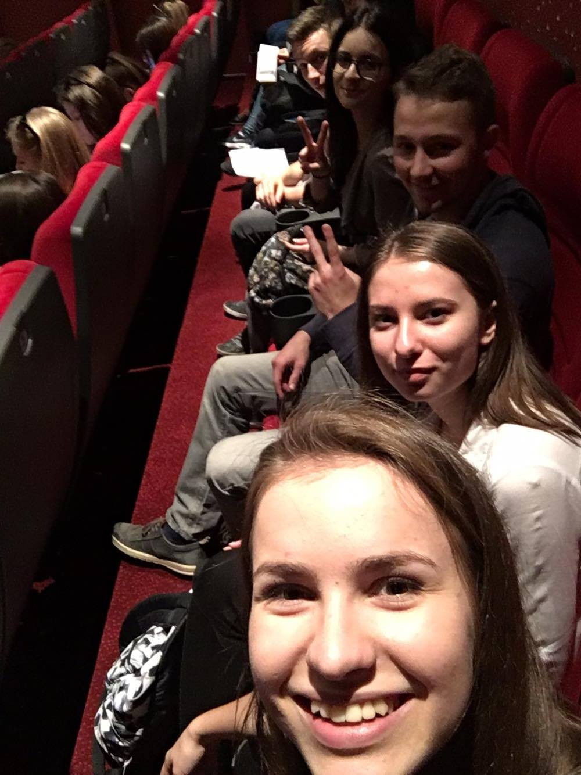
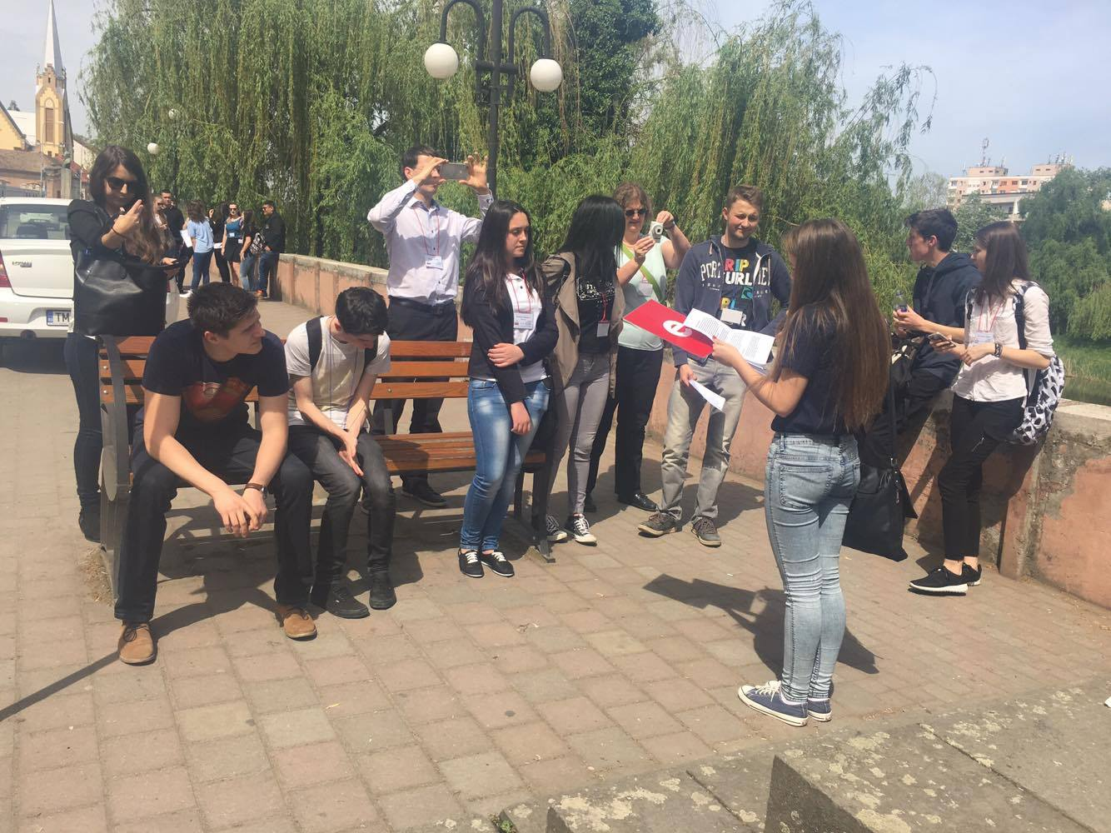
Meeting the mayor
Getting to know Lugoj better
Being Happy in Lugoj

Slide 5
Thank you for your attention!
Eszter - Hungary
Desislava – Bulgaria
Tamara – Austria
Markus – Austria
Miriam – Romania
Filip – Slovakia
Antonin – Czech Republic
Nejc - Slovenia

