Slide 1
Danube region

Slide 2
Why are we here?

Slide 3
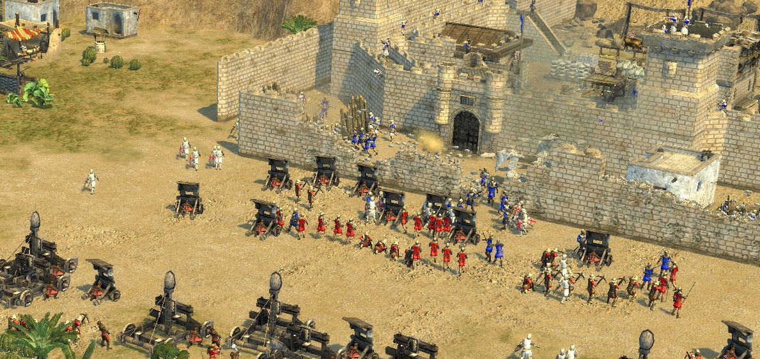
Divided and united - several times
Europe has been divided too many times throughout the history …
… but it never paid off.

Slide 4
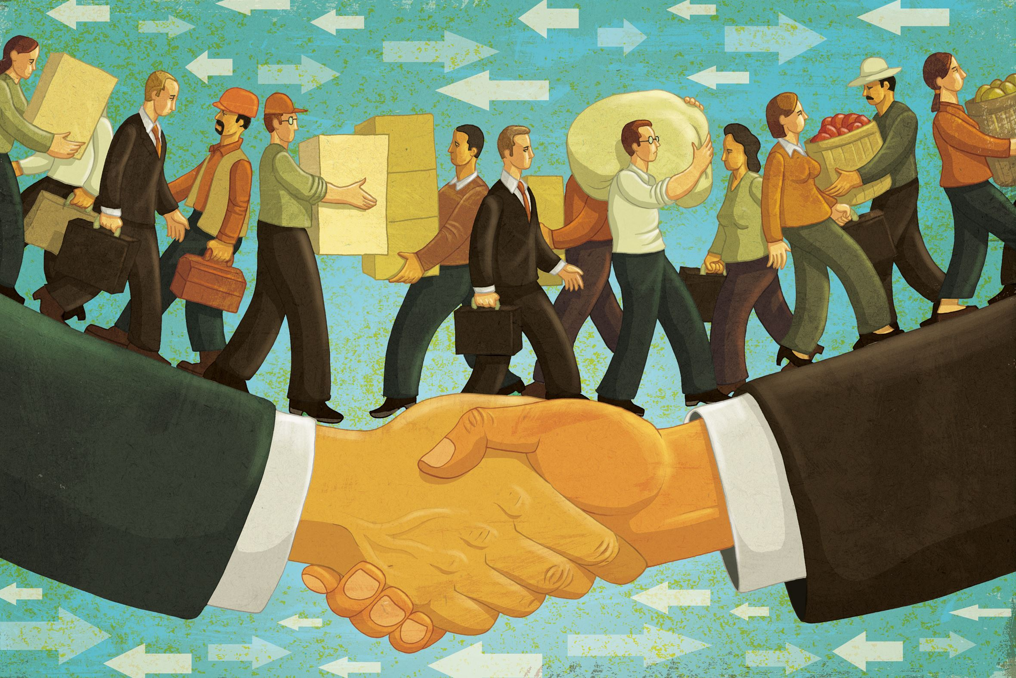
Why is free trade better alternative?
Because free trade fosters:
lower prices,
increase of exports,
economies of scale,
increased competition.

Slide 5
But it does not happen by itself ...
The more you know about your neighbours the more are you inclined to cooperate with them.
Familiarity
Cooperation
Partnership

Slide 6
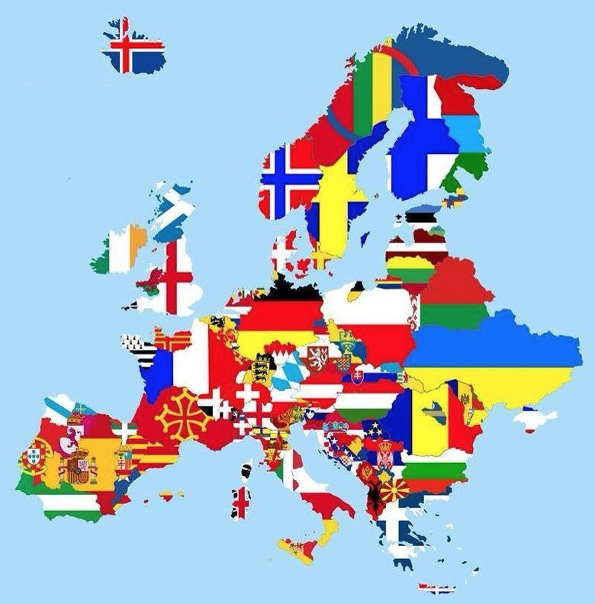
Who are our competitors?
They are coming from all over the world.
Not other countries, but other regions.
And this is why we are here!
To enhance familiarity, cooperation and partnership - that will make our region and EU stronger and more prosperous.

Slide 7
Who knows the most?
Let’s see how well do we know each other, and let’s get to know us a bit more!
www.kvizi.si

