Slide 1
Sightseeing Pápa
Made by : The Red Group

Slide 2
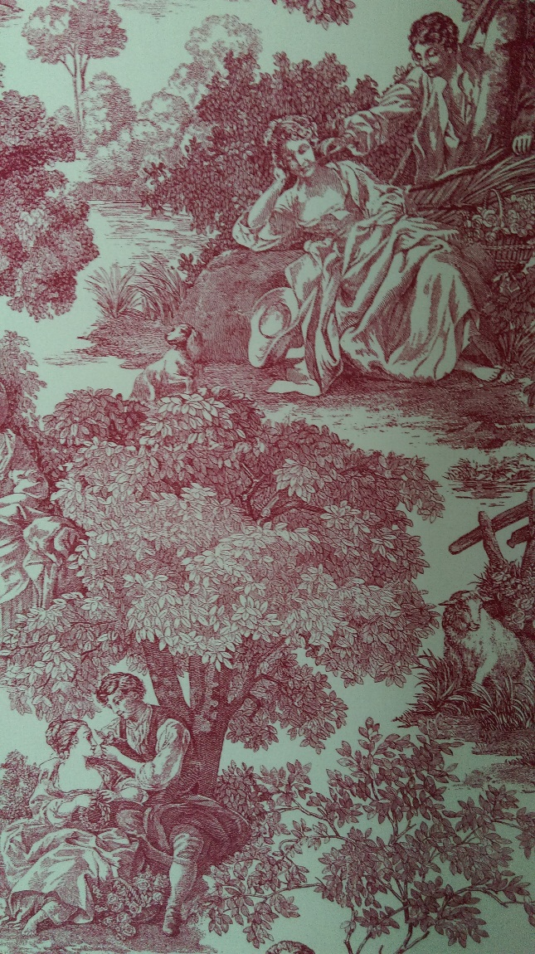
Eszterházy palace
-The palace of Eszterházy family
- Regenarated last year

Slide 3
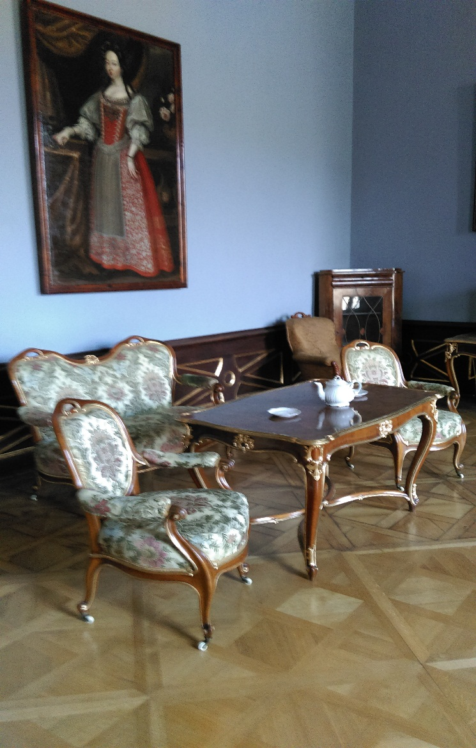

Slide 4
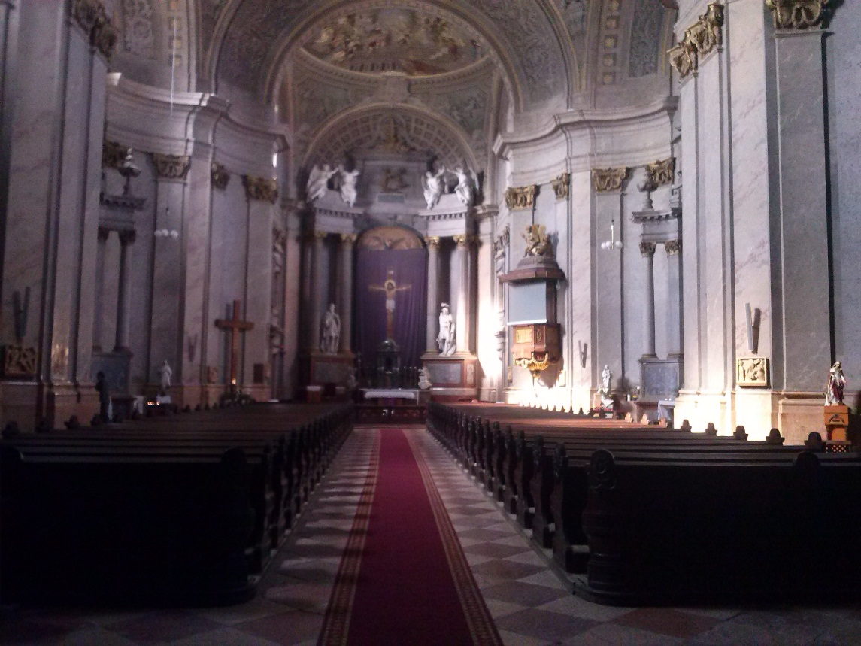
The Big Church
built in baroq style
The most beautiful building in central Europe

Slide 5
The fountain in the Main Square

Slide 6
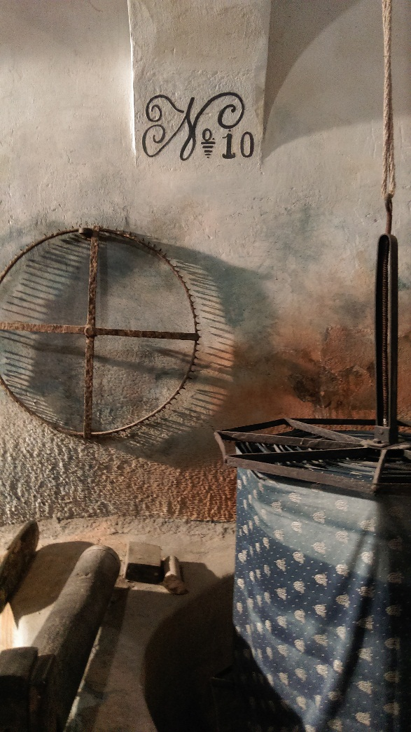
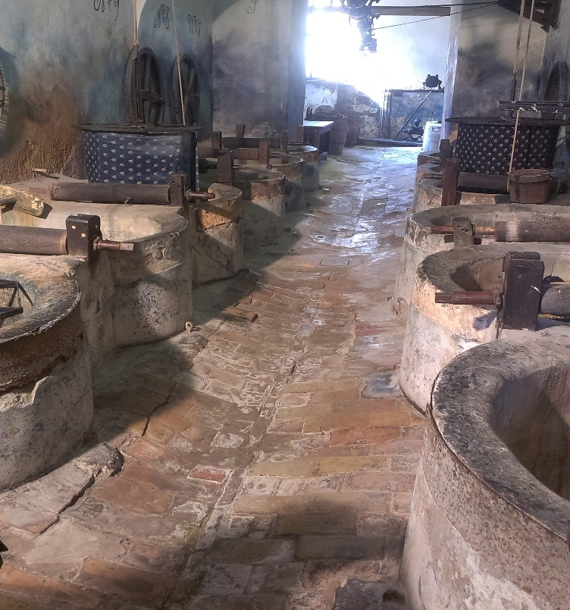
The Museum of Blue dyeing
Győry Endréné’s exhibition
The Indigo plant

