Slide 1
Commercial High School Tábor, Czech Republic
Jiří Macháček and Filip Adamovský

Slide 2
Commercial High School in Tábor

Slide 3
The content of this presentation
History
Infrastructure of our school
Timetable of our class
Marks
Our class
Canteen and school hostel
Projects and trips

Slide 4
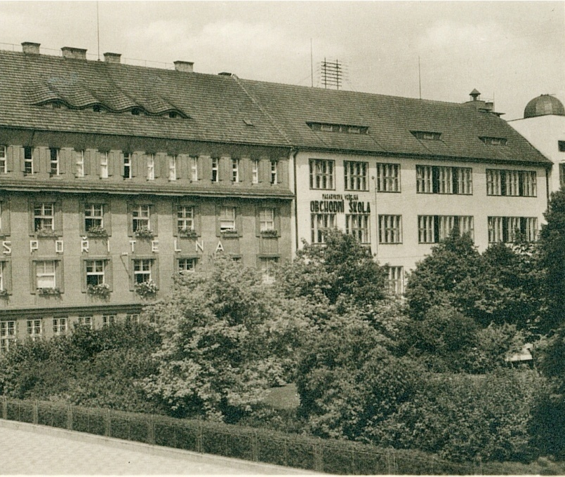
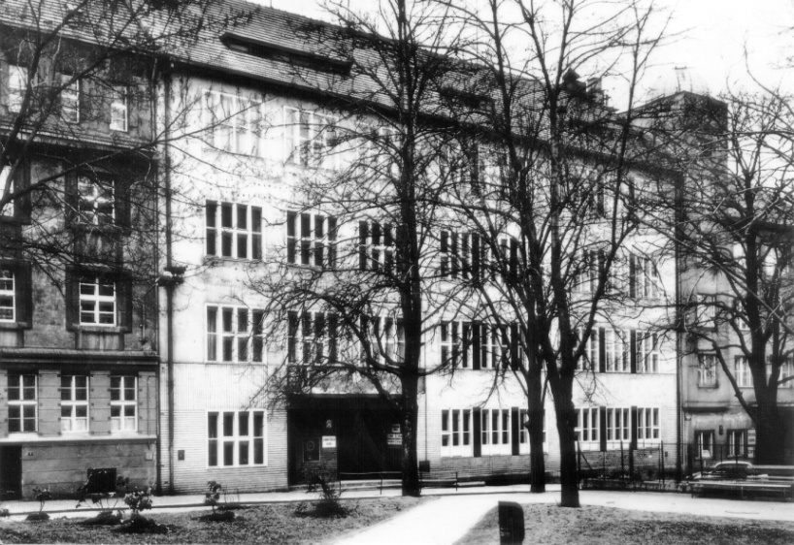
History
School started teaching on 1st October 1919
The building where is school today was builtt in 1930
During Second World War – five teachers were killed by Gestapo
During the German occupation school interrupted teaching
When German soldiers left school, it was used by the Red Army
In 1946 school started teaching again

Slide 5
Commercial High School in Tábor
Three parts: Economical lycée, Business academy and Higher professional school of economics
16 classes
36 teachers
360 pupils
287 girl (80%) and 73 boys (20%)

Slide 6
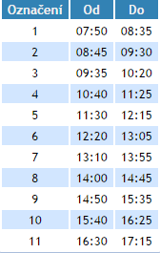
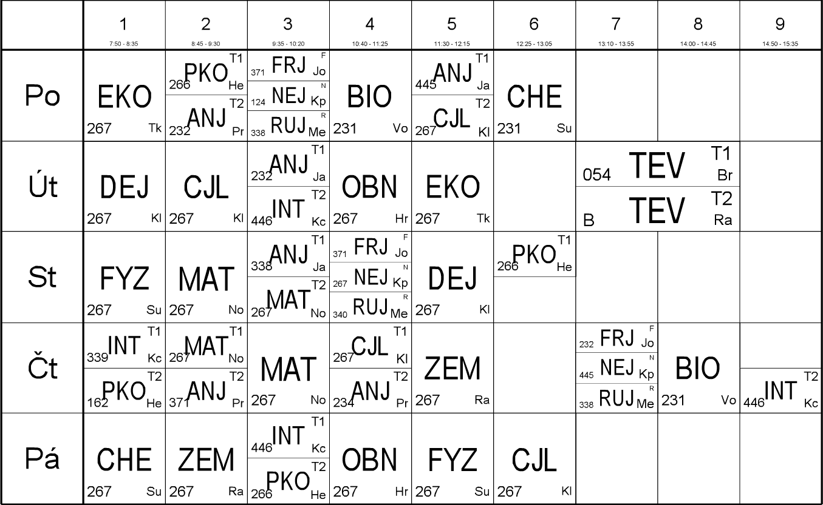
Timetable of our class

Slide 7
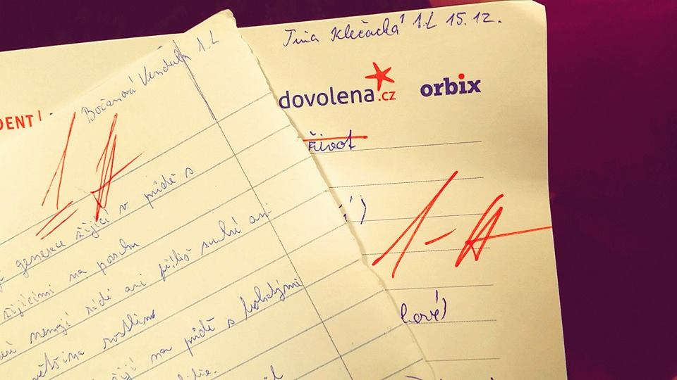
Marks
We have this scale of marks:
1 – the best mark you can get
5 – the worst one you can get

Slide 8
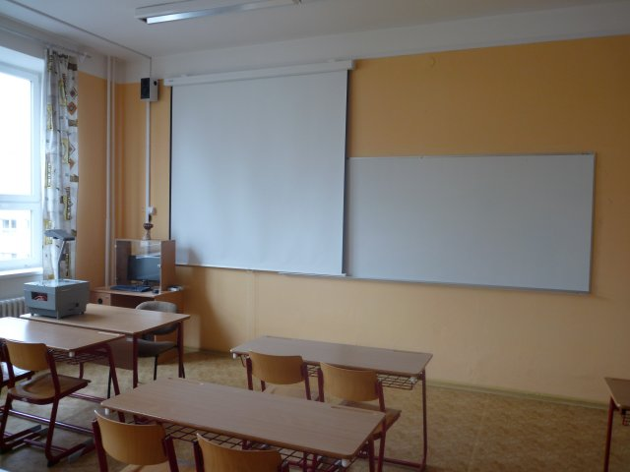
Our classroom
Our class is located on the second floor
Number 267 (2 – second floor)

Slide 9
Canteen, school hostel
School doesn´t have its own canteen
We go to the canteen of a nearby school (it belongs to another school, which is across the street)
If students don´t live near the school, they can stay in a school hostel (50 metres away)

Slide 10
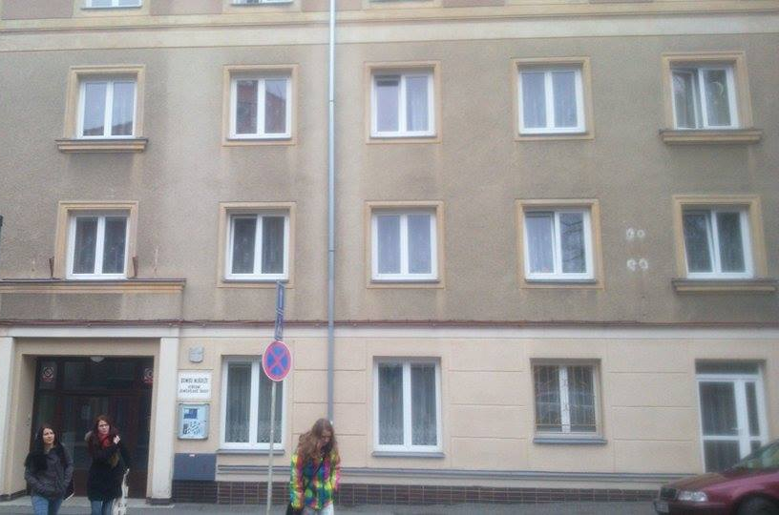
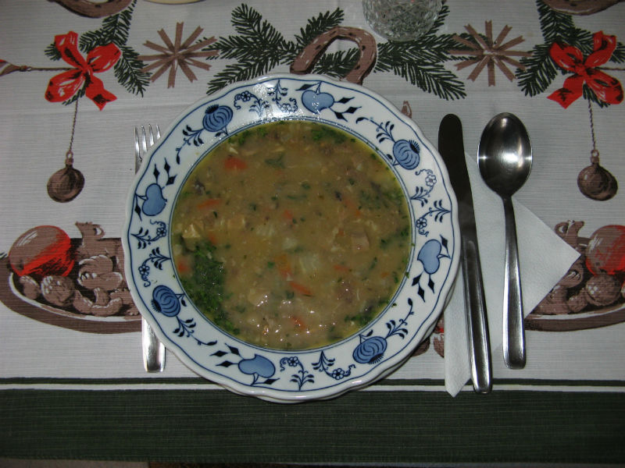
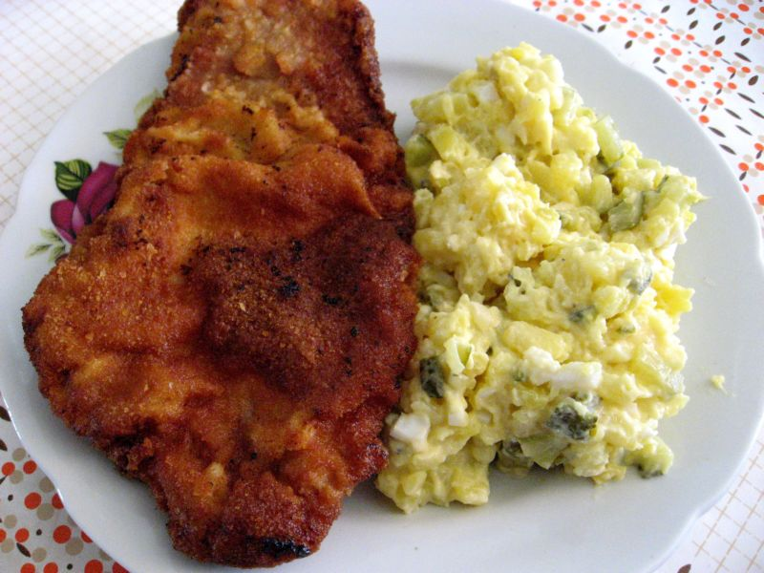
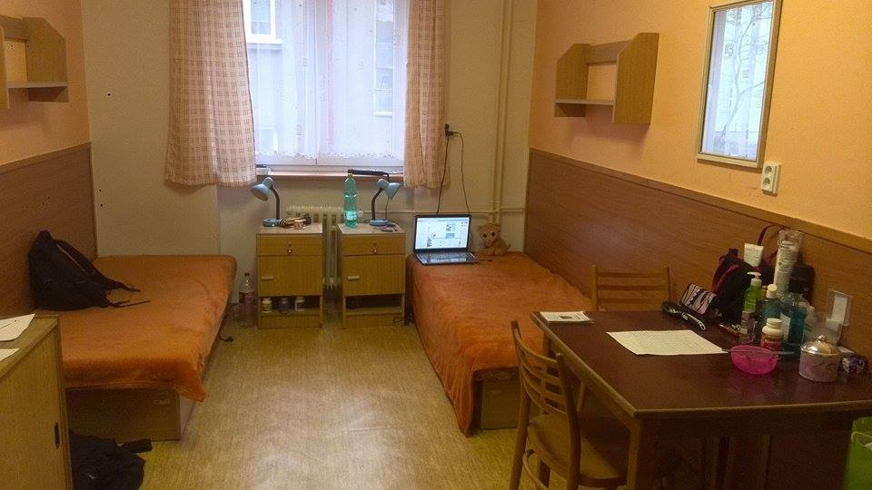

Slide 11
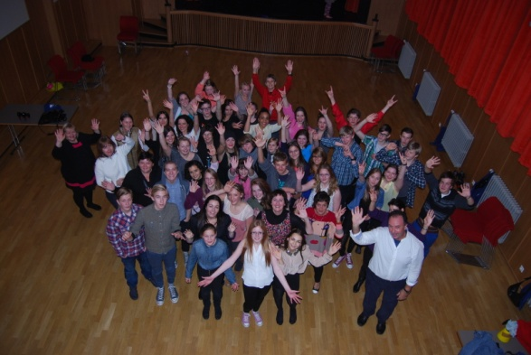
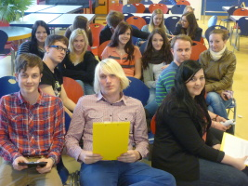
Trips, projects
School organizes many trips to different countries (England, Austria, Hungary, Germany) and excursions (concentration camps, companies, museums, galleries )
Projects: ACES, Comenius, Leonardo, eTwinning

Slide 12
THANK YOU FOR YOUR ATTENTION

Slide 13
This project has been funded with support from the European Commission. This publication [communication] reflects the views only of the author, and the Commission cannot be held responsible for any use which may be made of the information contained therein.
ESCAPE - 2014-1-AT01-KA201-000905_1

