Slide 1
Local Dairy Products
Vs
Imported Dairy Products
In Bulgaria
PREPARED by:
Lyubomira, Ralitsa and Desislava
Profesionalna gimnazia Asen Zlatarov - Vidin

Slide 2
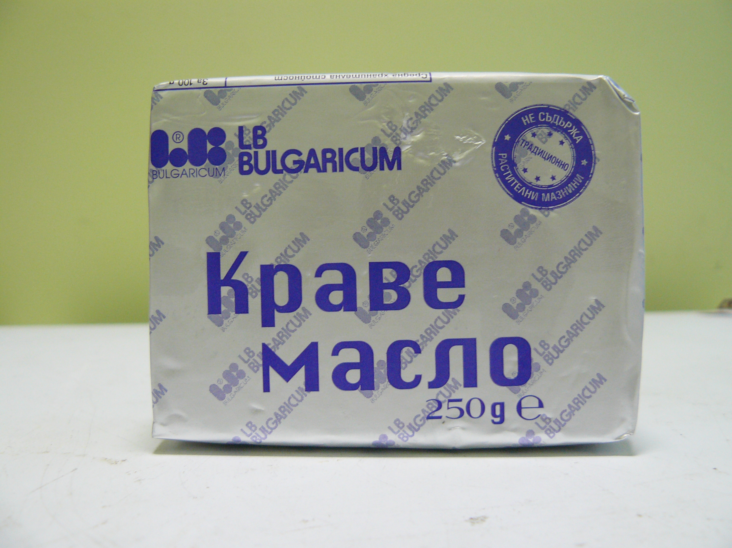
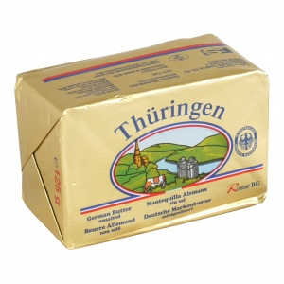
Butter
Name of the Product:
„ElBi” Butter
Name of the Product:
Thüringen Butter
Quantity: 125 g
Quantity: 125 g
Price: 0,92 lv.
Price: 1,35 lv.
VS
Imported from:
Germany
Our product is cheaper and because of that more people buy it.
But there are people who buy the German product, too.

Slide 3
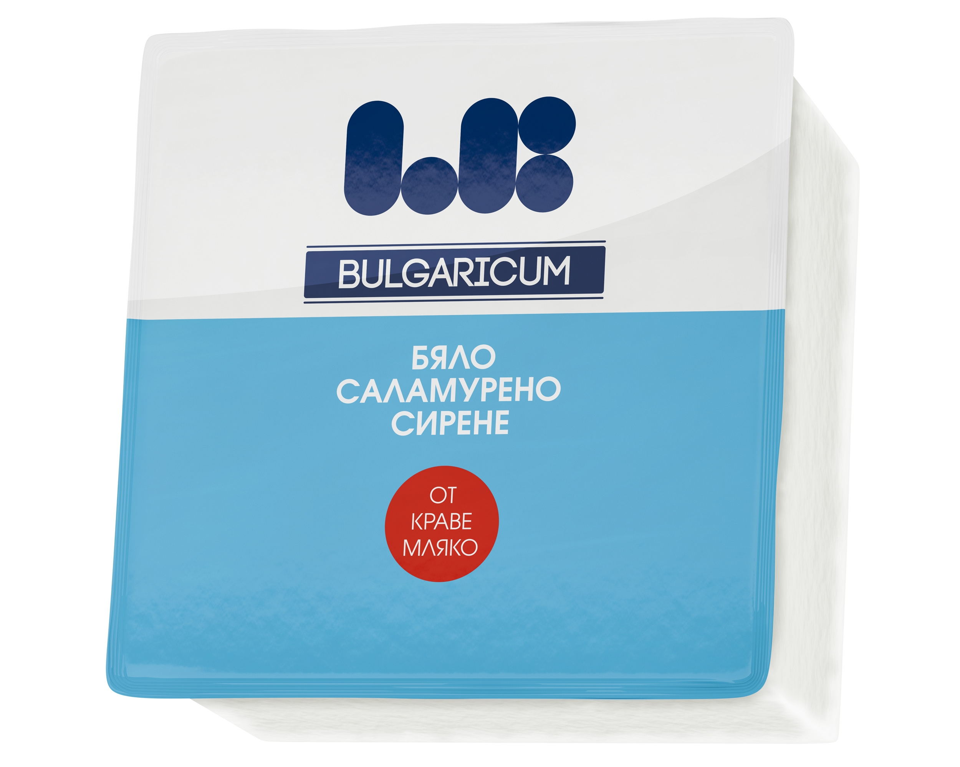
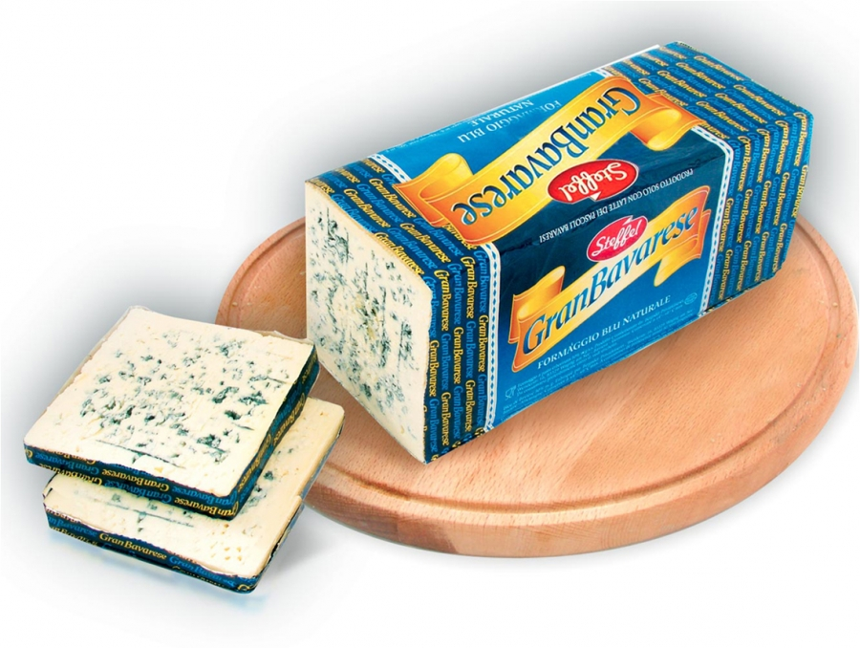
Cheese
Name of the Product:
„ElBi” Cheese
Name of the Product:
„Gran Bavarese” Blue Cheese
Quantity: 500 g
Price: 7,65 lv.
VS
Quantity: 500 g
Price: 13,00 lv.
Our product is cheaper but it tastes as good as the imported product.
Imported from:
Germany

Slide 4
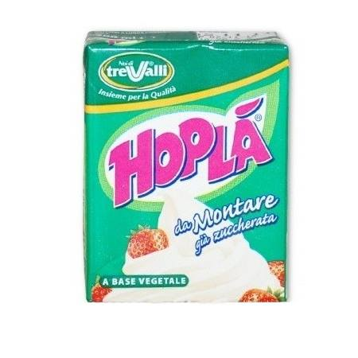
Cream
Name of the Product:
„ElBi” Sour Cream
Name of the Product:
„Hopla” Cream
Quantity: 200 g
Quantity: 200 g
VS
Price: 1,98 lv.
Price: 1,05 lv.
Imported from:
Italy
Our product cheaper but it tastes
as good as the imported product.

Slide 5
Yellow cheese
Name of the Product:
„ElBi” Vitosha yellow cheese
Quantity: 300 g
Price: 3,65 lv.
Name of the Product :
Bluedino yellow cheese
Quantity: 300 g
Price: 4,50 lv.
Imported from Poland
VS

Slide 6
Processed cheese
„Bluedino”
processed cheese
Quantity: 300 g
Price: 2,95 lv.
Imported
from Poland
„ElBi” processed cheese
Quantity: 300 g
Price: 2,35 lv.
VS

Slide 7
Yoghurt - Unique Bulgarian product
„ElBi” yoghurt
Yoghurt
It looks like a yogurt, but differs in acidic taste, which is due to lactic acid starter laktus bacillus bulgaricus;
There is no benchmark price because it is a unique product!
Exported to Japan, Thailand, Taiwan and other countries.

Slide 8
Packaging for dairy products - environmentally friendly and pleasing to the eye design
Old:
New:

Slide 9
Bulgarian and imported dairy products:
Bulgarian:
Imported:

Slide 10
Trends in prices of milk and dairy products:
The average milk price in world markets fell below 26 cents per kilogram in June, said Torsten Heme, Director General of the organization for research dairy System International comparisons in agriculture (IFCN). "This means that we are witnessing a third crisis in the last eight years. It affects production worldwide, "said Hemel;
The most discussed topic on the market today is a record low price of milk. The main reason for such a significant lowering its highlights wide gap between demand and supply of the product;
Economic conditions in 2014 were favorable for the dairy industry. Milk prices were high and the products - low. But the profitability of the dairy business in 2015 declined, according to the data..
According to statistics, the number of dairy farms in the world is currently 118 million. Each farm has an average of 2.9 cows with an average yield of 2.2 tonnes of milk annually. During the period 1996-2013, the number of dairy farms grew steadily, but now the situation has changed. It can be maintained only by increasing the number of cows and milking quantities, "explained Anders Fagerberg, Chairman of the Board of Directors of the International System of comparisons in agriculture (IFCN)..

