Slide 1
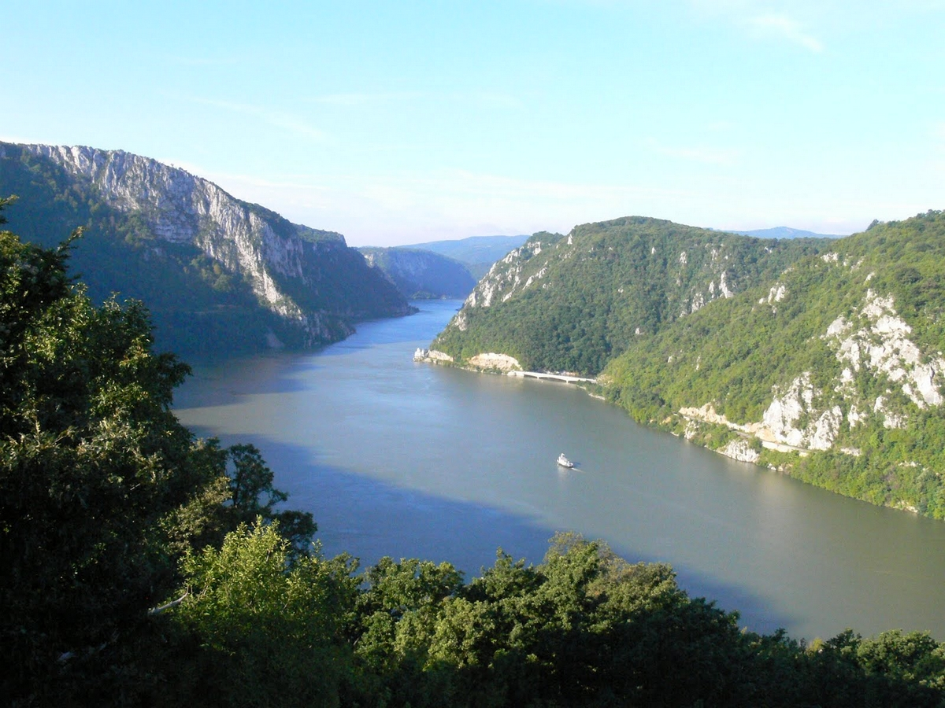
Trip to the Danube

Slide 2
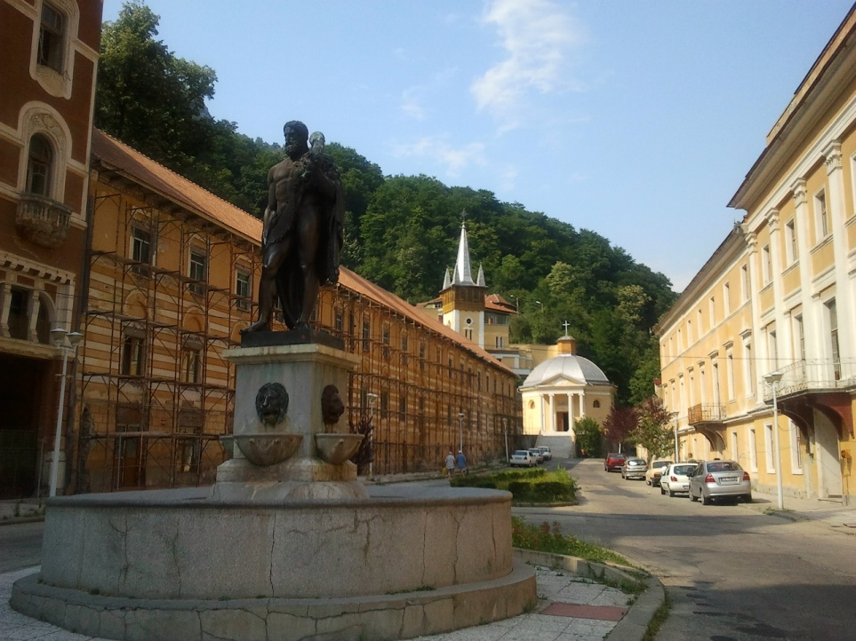
Herculane
is a town in Romanian Banat, in Caraş-Severin County

Slide 3
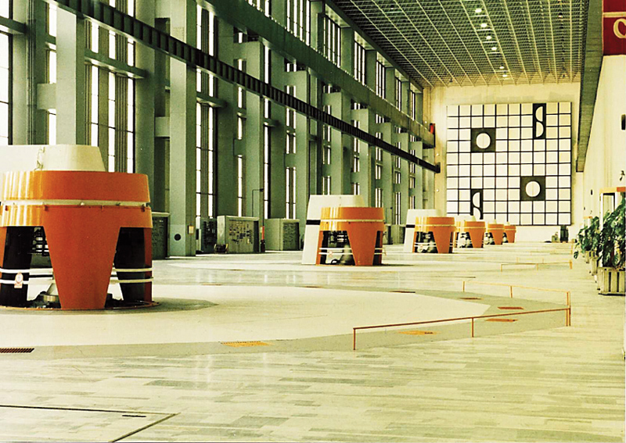
Iron Gates
is located on the Iron Gate gorge, between Romania and Serbia.
Two big Iron Gates
Six turbines

Slide 4
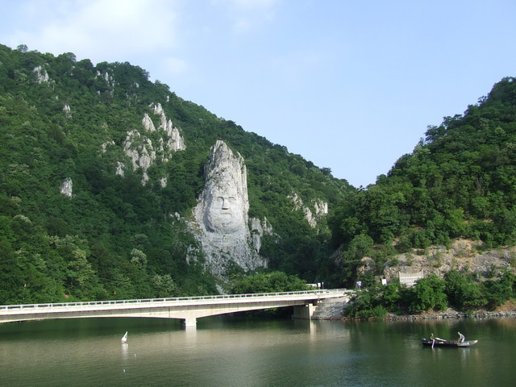
The rock sculpture of Decebalus
40-m high carving in rock of the face of Decebalus
The sculpture was made between 1994 and 2004, on a rocky outcrop on the river Danube, at the Iron Gates

Slide 5
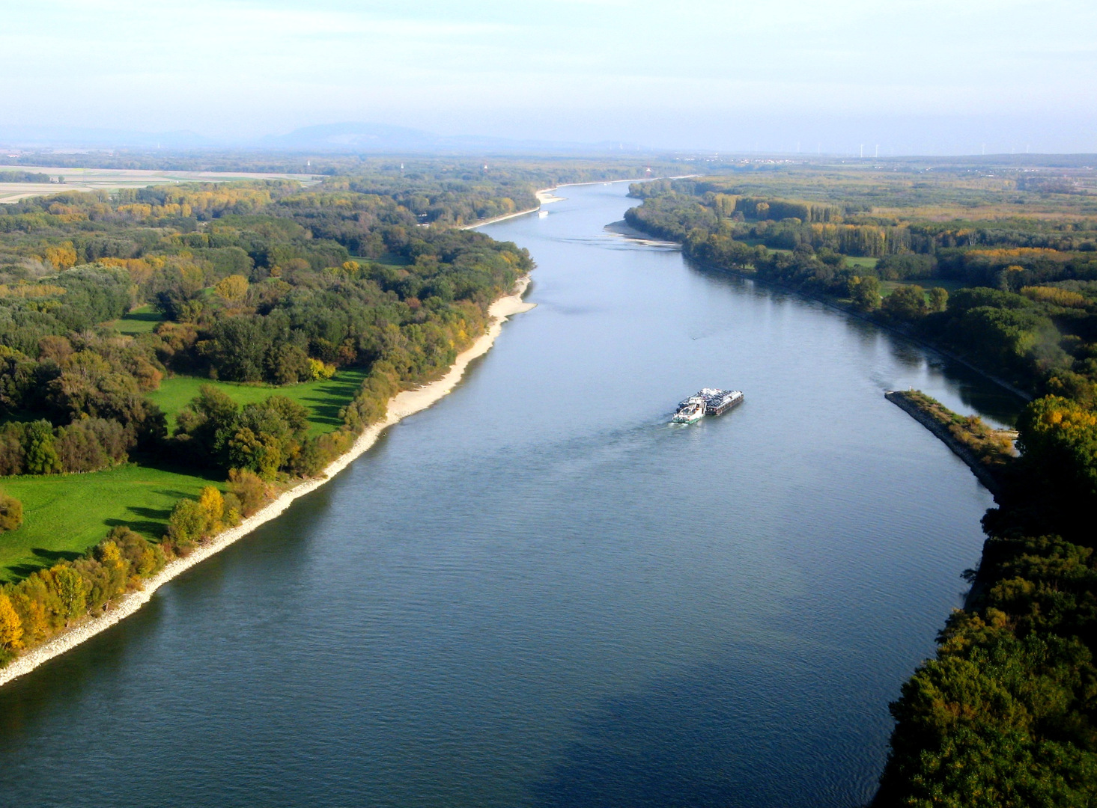
Thank you for your attention !

