Slide 1
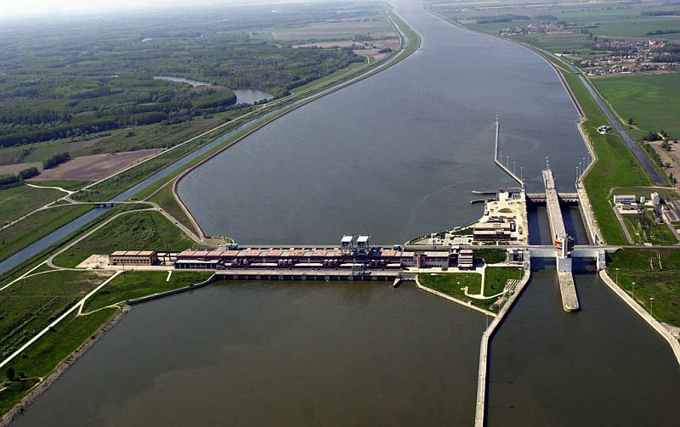
Gabčíkovo Dam

Slide 2
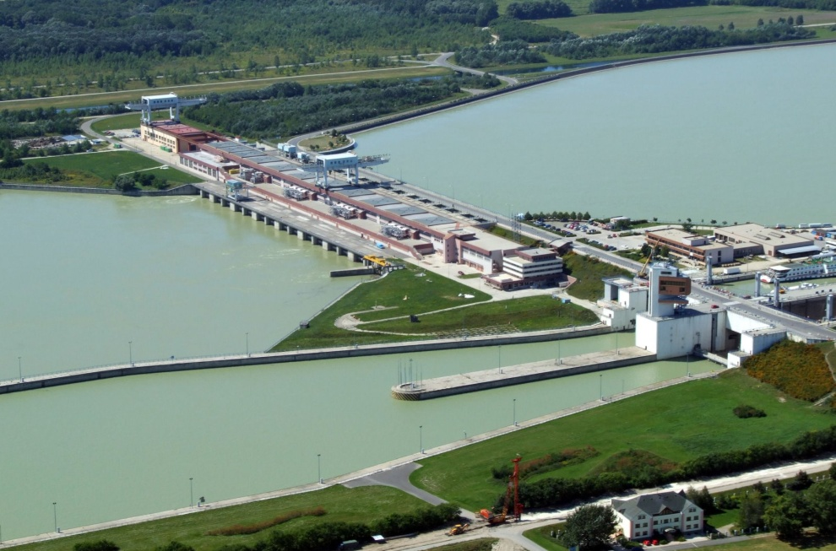
Gabčíkovo Waterwork
a large barrage project on the Danube near to Bratislava
initiated by the Budapest Treaty in 1977 between Chechoslovak Socialist Republic and the Republic of Hungary
still unresolved international dispute – the International Court of Justice in the Hague involved for rulling

Slide 3
The project aimed at:
preventing catastrophic floods
improving river navigability
producing clean electricity

Slide 4
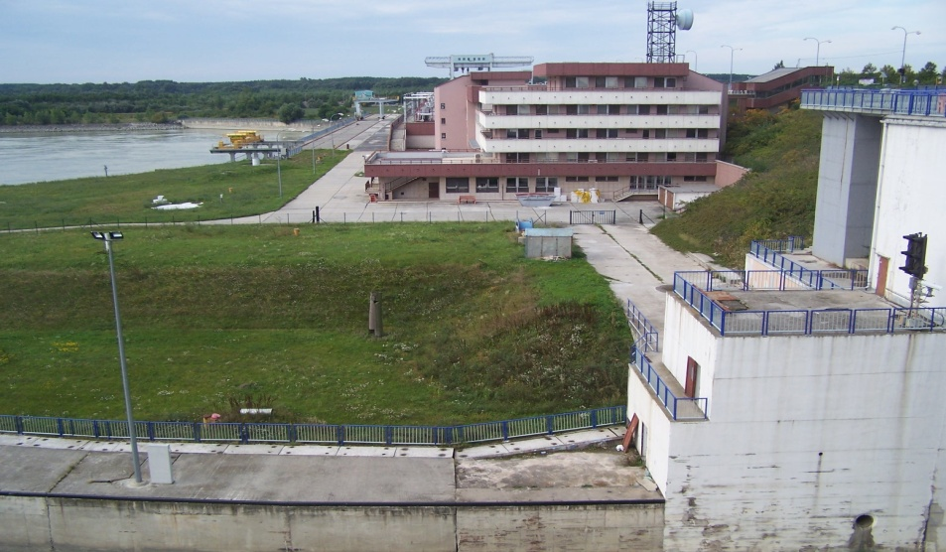
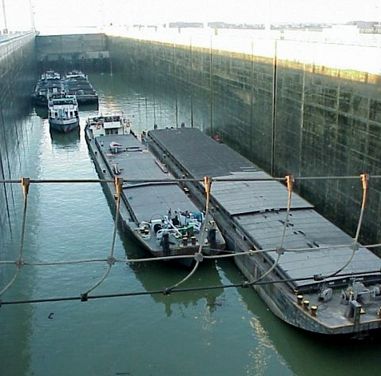
Main parts of the Dam:
Control tower
Hydroelectric power station
Sluice

Slide 5
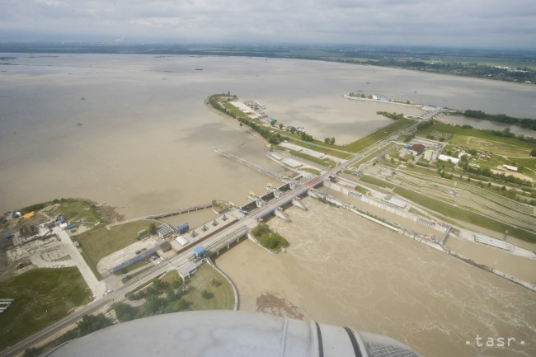
Other parts of the Waterwork:
Supply channel for Čunovo Dam conveys water from Bratislava (10 km)
Čunovo dam is the first level of the waterworks with the small additional power plant with 1 MW power output. It includes also Čunovo Water Sports Centre, a site of world championship in water slalom and rafting.

Slide 6
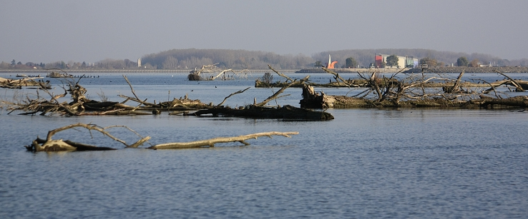
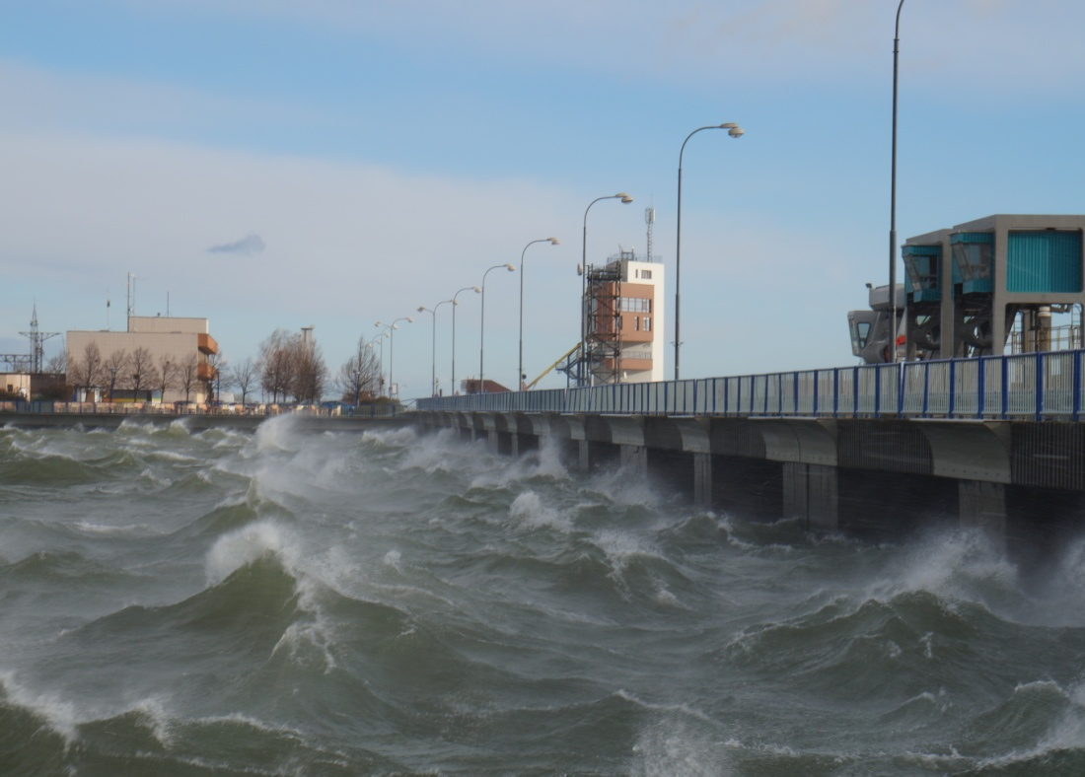
Hrušov reservoir accumulates water for the main power plant in Gabčíkovo and also regulates the water level. It is 16 km long and 4 km wide, separated from Hungarian territory by an embankment.
Gabčíkovo Dam consists of a hydroelectric power plant (on the right side of the river) and two lock chambers (on the left side of the Danube). This level uses differential water levels (20 metres) to produce electricity, to allow ships pass safely through locks and to divert flood water. Operation of the power plant is fully automated.

Slide 7
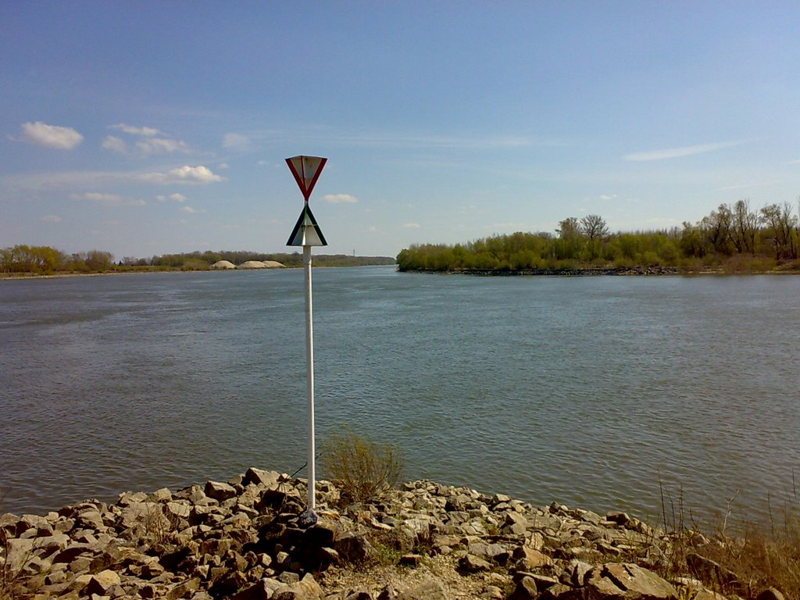
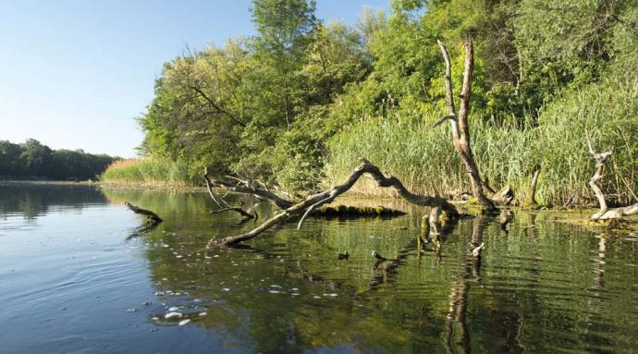
Outlet channel leads water back to the old riverbed and also helps against floods.
This channel re-enteres the Danube at Sap.
Regulations in the old Danube riverbed.

Slide 8
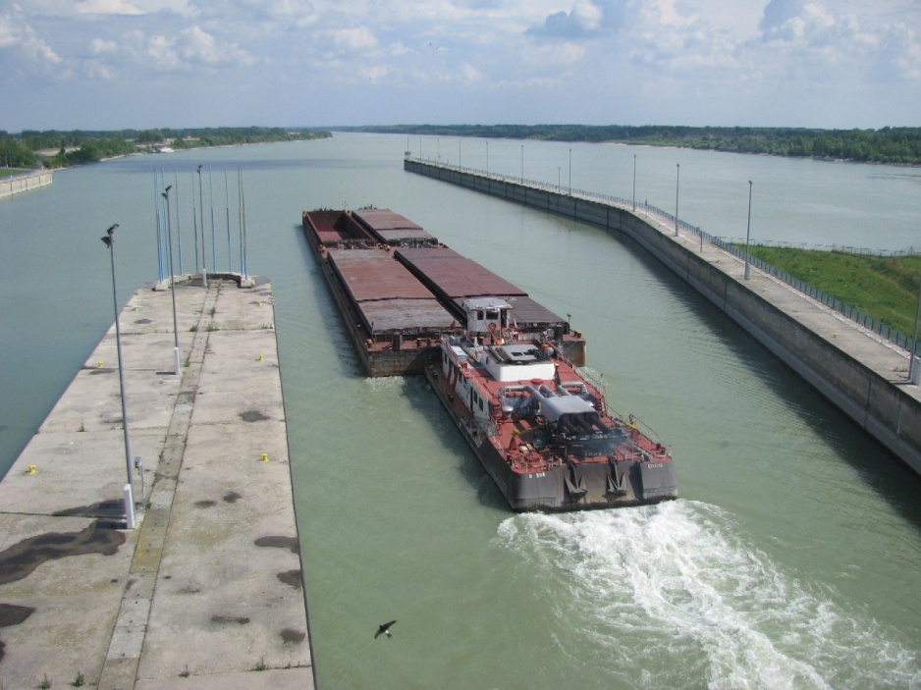
Technical parametres
The power station has eight vertical Kaplan turbines
It produces 2600 GWh of electricity annually, making it the largest hydroelectric power plant in Slovakia, it supplies around 8% of the country´s electricity consumption

Slide 9
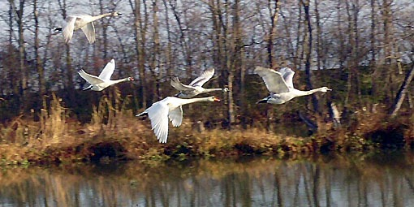
Environmental consequences
Intensive degradation of the Danube riverbed downstream
Decreased water level
Increased sediment supply
Reduced flood capacity
Decreased channel capacity

Slide 10
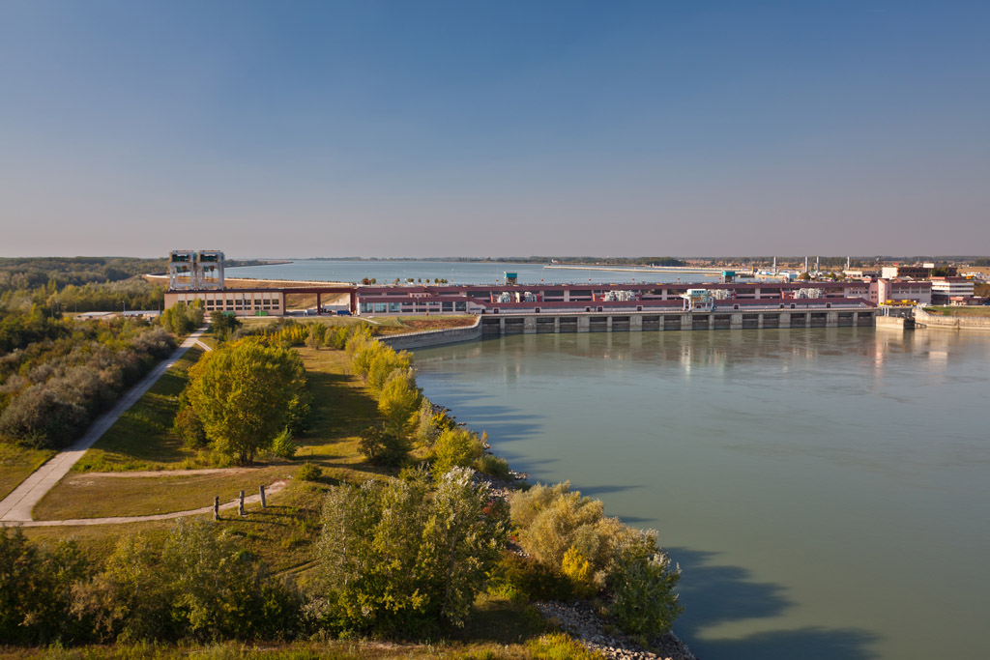
Thank you for your attention !

