Slide 1
What do people need to live?
must have
want
need

Slide 2
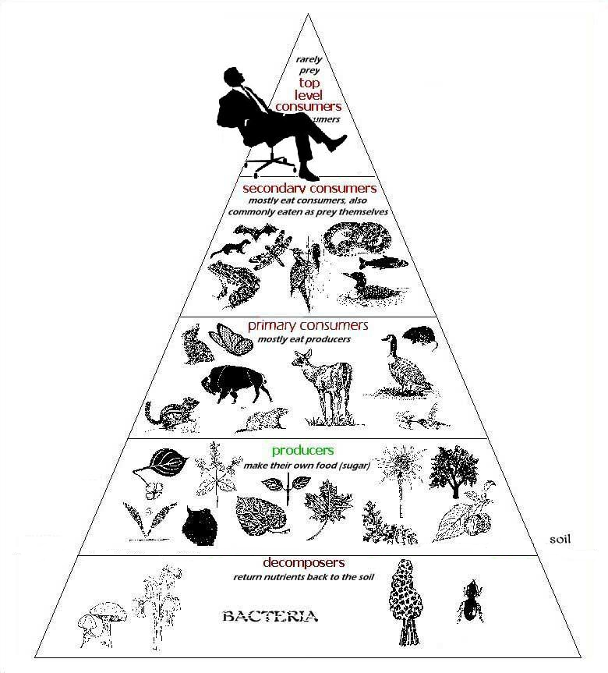
How do we get food? Where from?
What do plants/ animals need to grow?
Who are producers? Who are consumers?
Have you ever heard about a food chain?
Why can´t we grow bananas, oranges, pine apples,
and things like that in our fields?

Slide 3
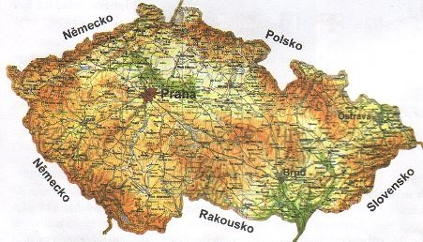
From the field to the market

Slide 4
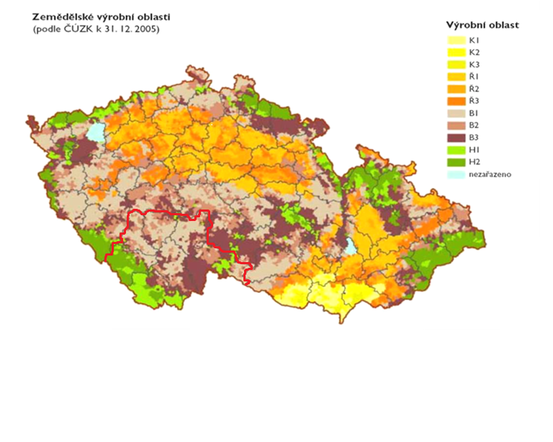
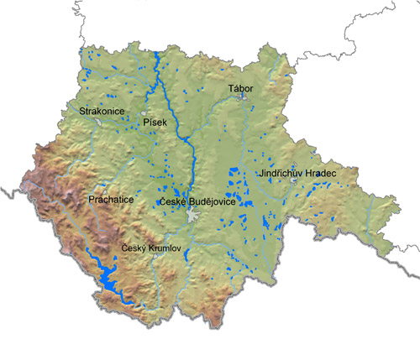
Agricultural regions in CR
Southern Bohemia
Maiz region K1, K2,K3 + corn
Sugar beet Ř1, Ř2, Ř3 + corn
Potatoe region B1, B2 a B3
Highlands reg. – fodder H1 a H2

Slide 5
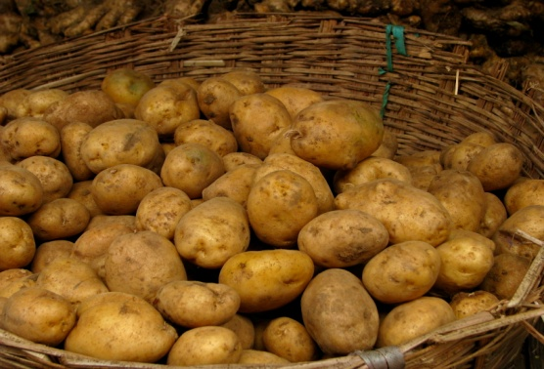
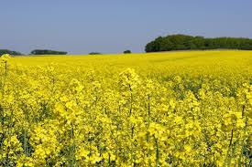
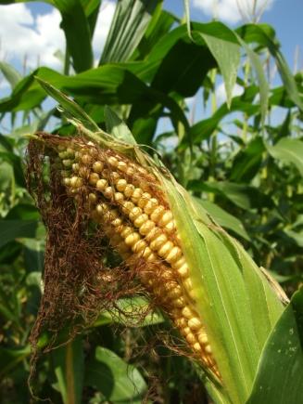
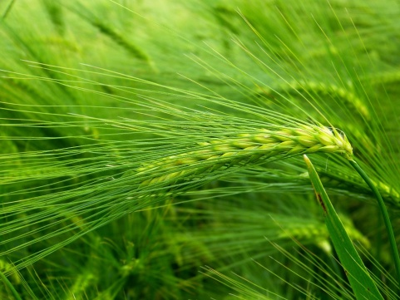
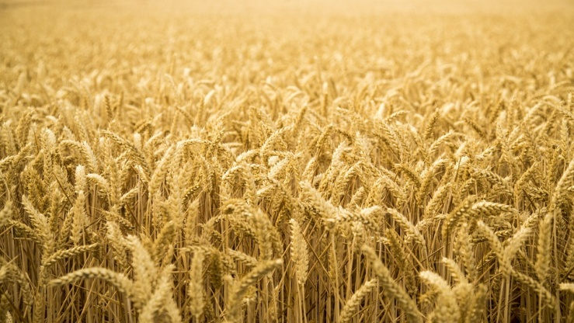
Main crops in Southern Bohemia
potatoes
rapeseed/colza
maize
corn: barley
corn: wheat

Slide 6
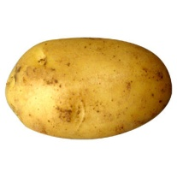
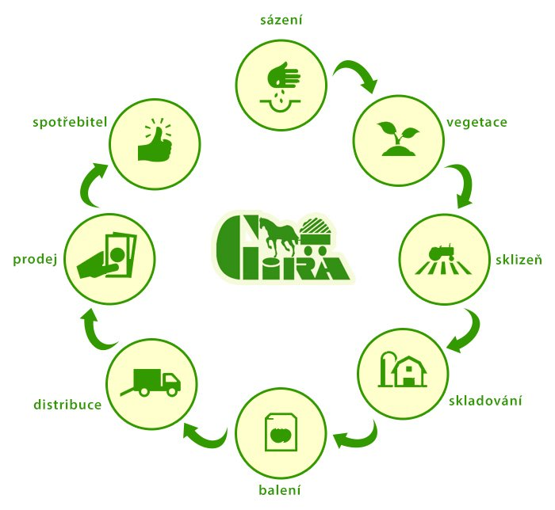
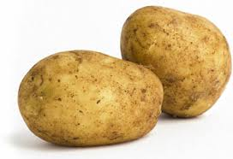
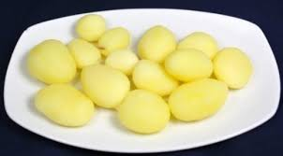
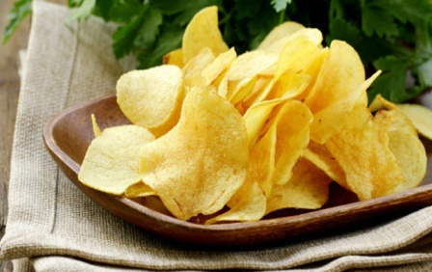
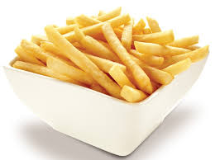
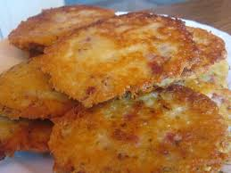
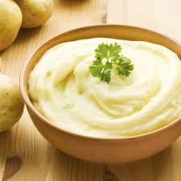
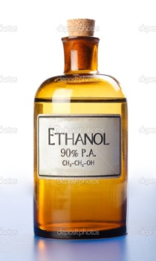
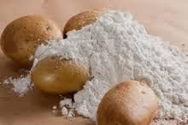
Potatoes
How potatoes are grown:
Watch the video carefully. Then work in pairs and try to describe the process
of growing potatoes until they get to our plate.
planting
What is made from potatoes?
vegetation
consumer
harvest
sale
storage
distribution
packing

Slide 7
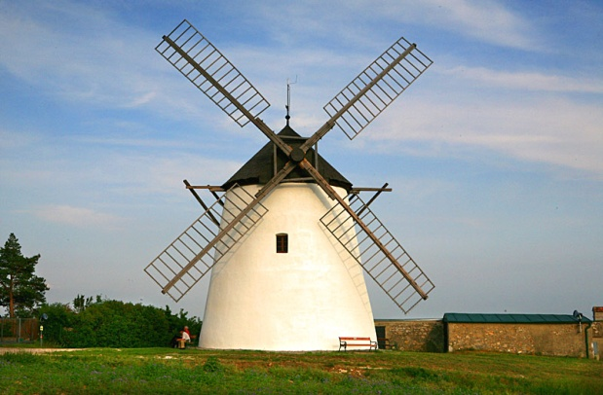
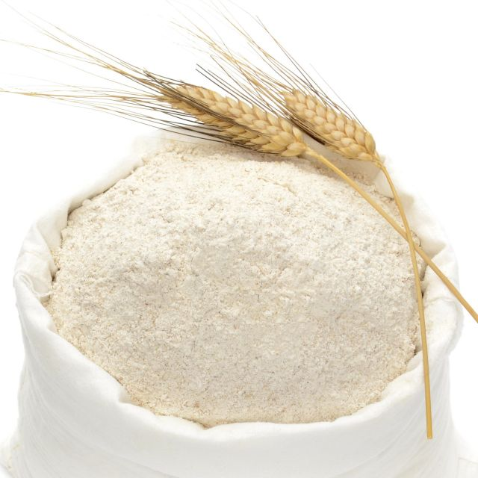
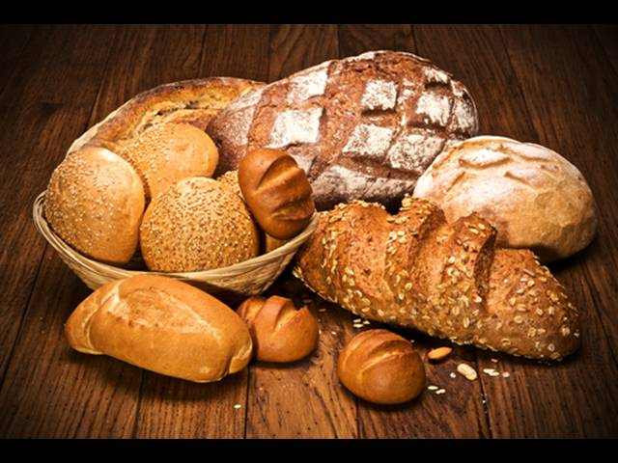
Corn: wheat
mill
pastry
flour

Slide 8
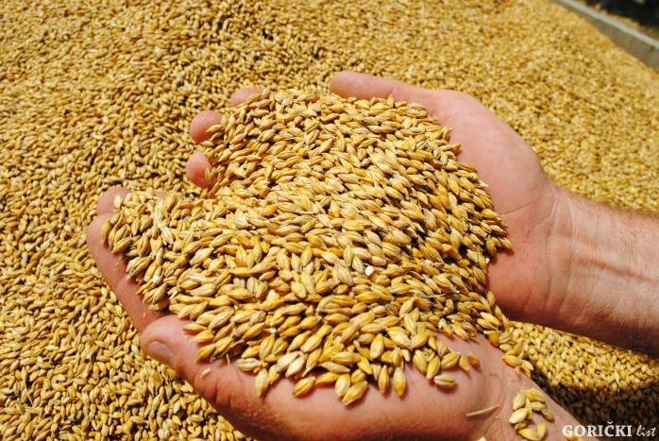
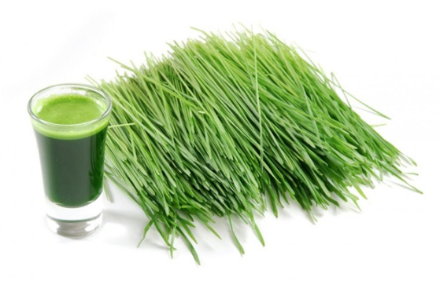
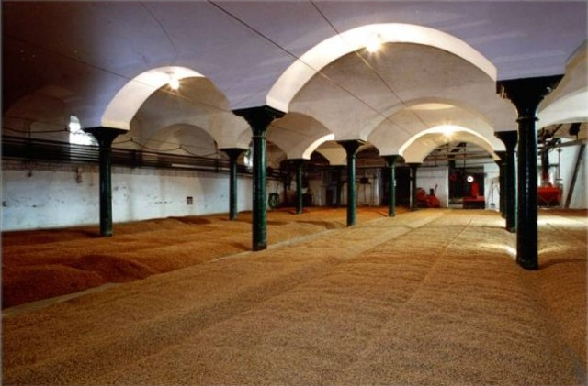
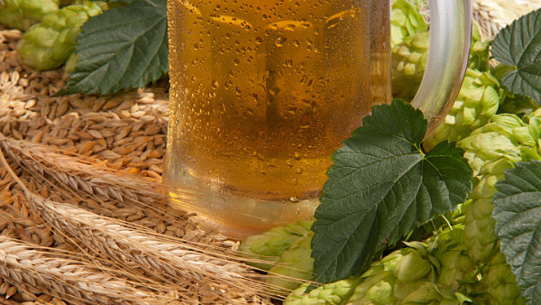
Corn: barley
dietary supplement:
green barley
malt

Slide 9
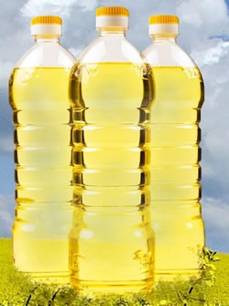
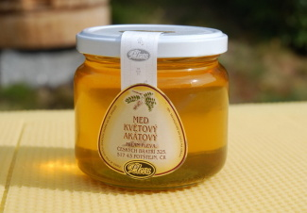
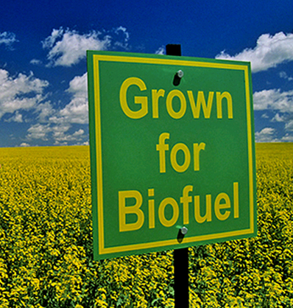
Colza = rapessed
bees pollinate
oil

Slide 10
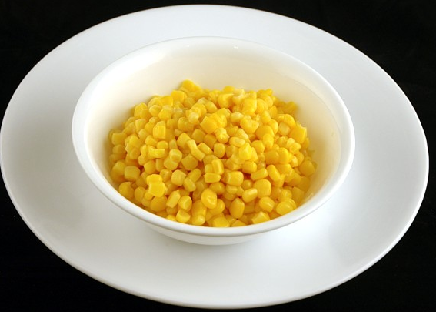
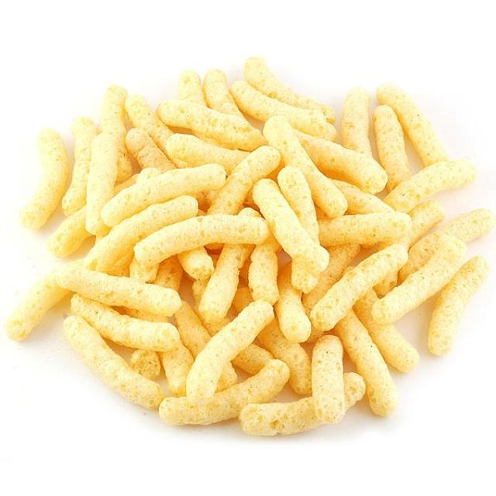
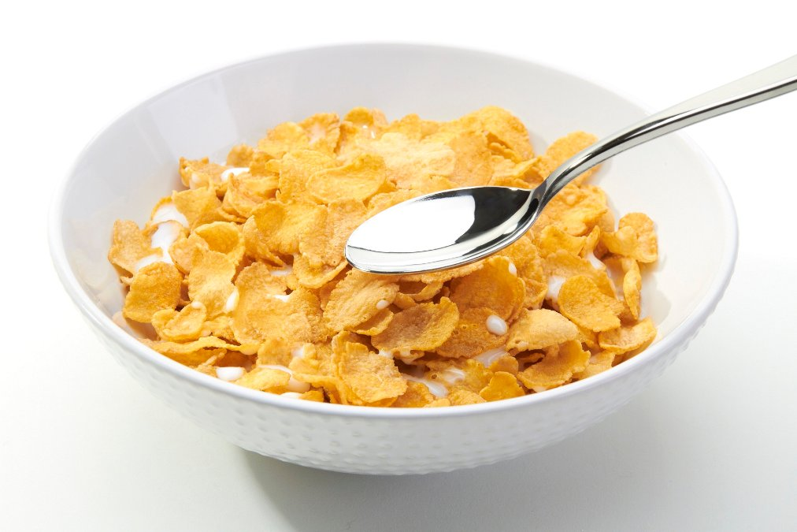
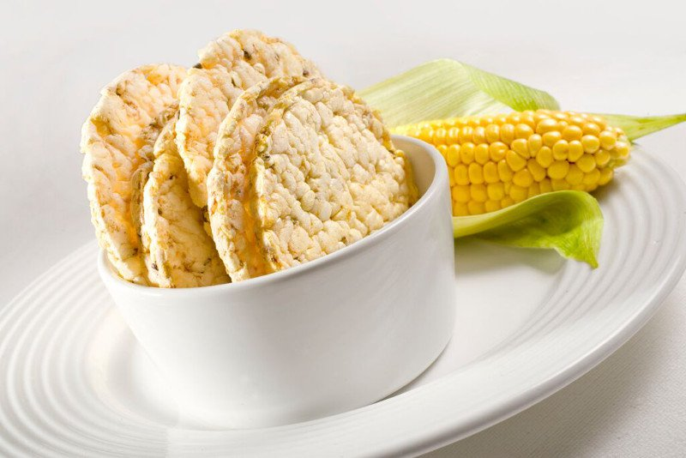
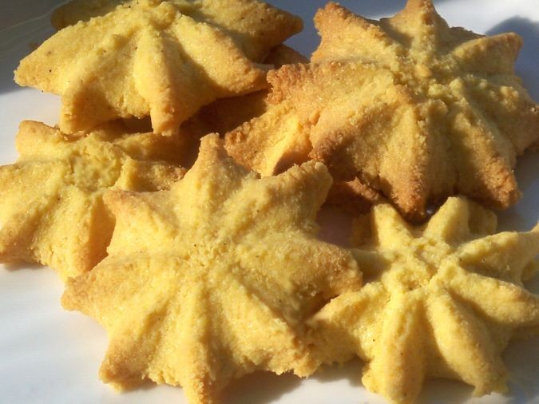
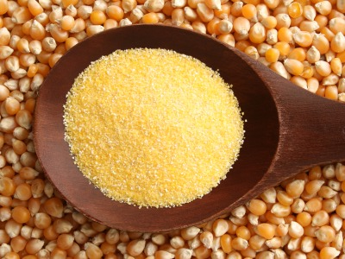
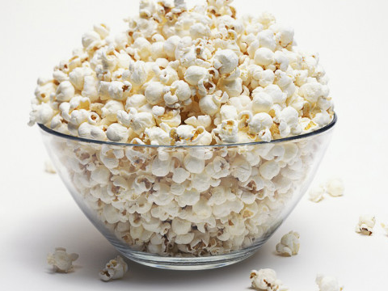
Maize

Slide 11
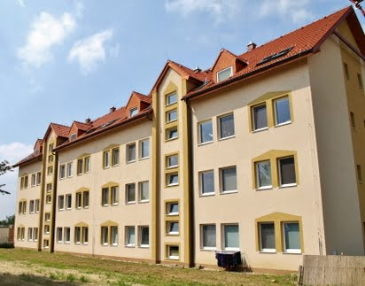
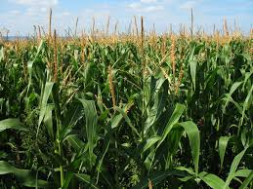
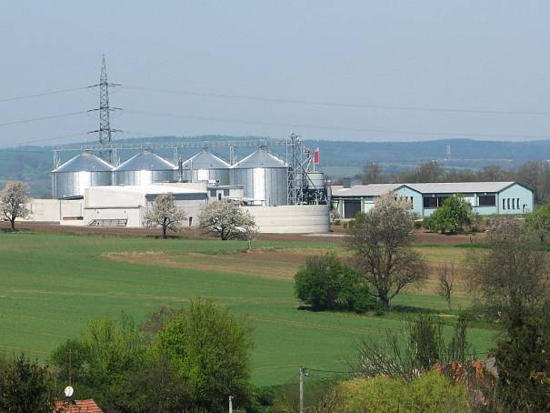
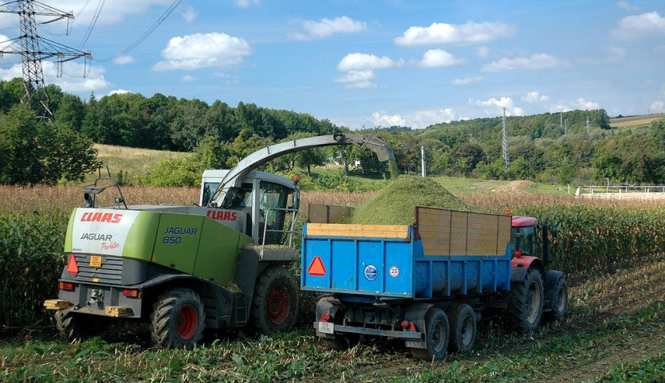
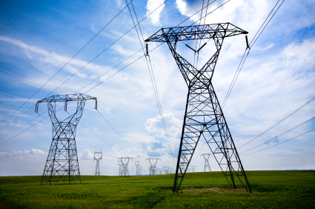
Bio gas from maize

Slide 12
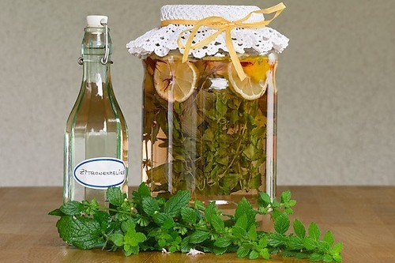
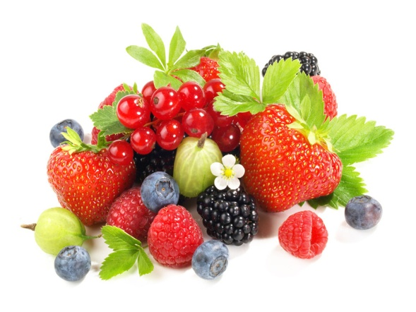
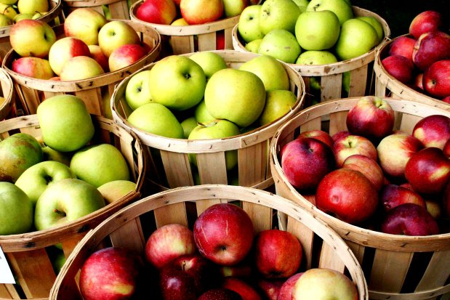
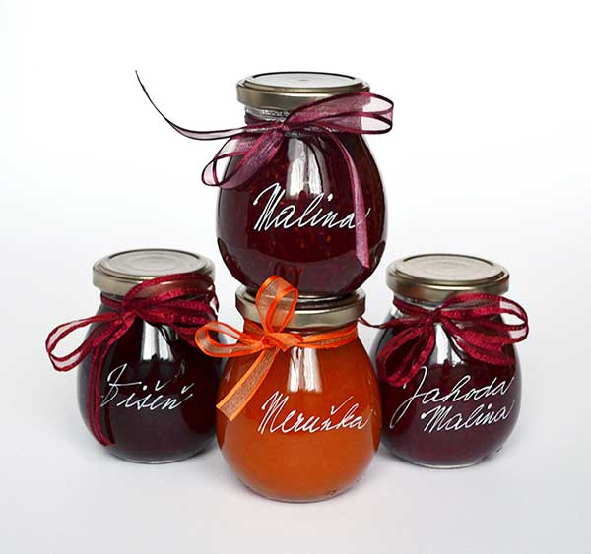
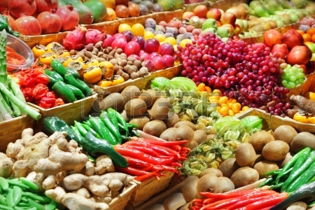
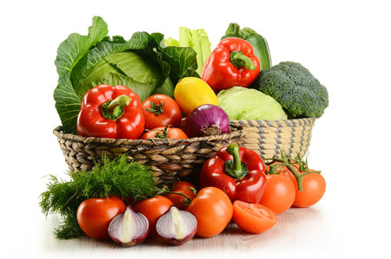
From the garden to the market

Slide 13
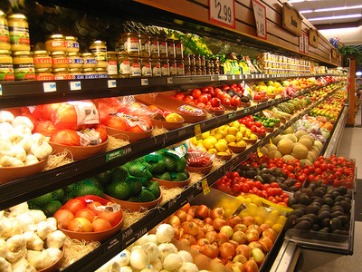
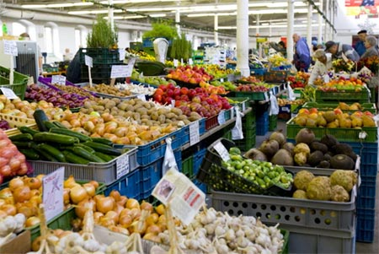
Supermarket ? or Farm market?

Slide 14
Interesting information about the crops and products made from them
Answer the following questions:
1 Where do potatoes come from?
2 When were they first brought to Europe?
3 Where does maize come from?
4 When did people start growing maize?
5 When did it get to Europe?
6 People also call chips:
7 Chips first appeared in Belgium in the 19th century. Do you know why?

Slide 15
Answers
1 Where do potatoes come from? Peru
2 When were they first brought to Europe? 16th century
3 Where does maize come from? Middle America
4 When did people start growing maize? 7,000 – 10,000 years B.C.
5 When did it get to Europe? 16 – 17th centuries
6 People also call chips: pommesfrites, French Fries
7 Chips first appeared in Belgium in the 19th century. Do you know why?
People by the river used to eat fried small fish. In winter, when the river was
frozen, they didn´t have any fish so they replaced it by fried potatoes cut in pieces.

Slide 16
Thank you for your attention

