Slide 1
Local products vs imported products in Bulgaria
PREPARED by:
Daniela, Maria and Simona
Profesionalna gimnazia Asen Zlatarov - Vidin

Slide 2
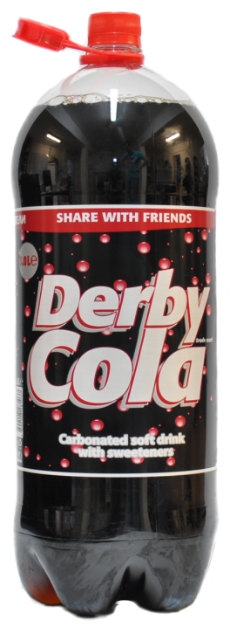
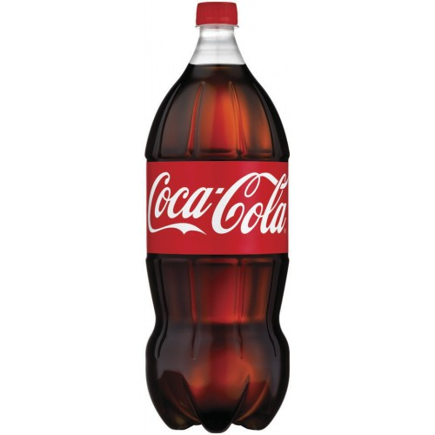
Cola
Local product
Name: Derby Cola
Price: 0.85 lv.
Quantity: 2 l
Imported product
Name: Coca – Cola
Price: 1.99 lv.
Quantity: 2 l
Imported form: USA
Our local product is cheaper, but most prefer
the imported Coca – Cola because it’s with better quality and of course because
it’s more famous than ours.

Slide 3
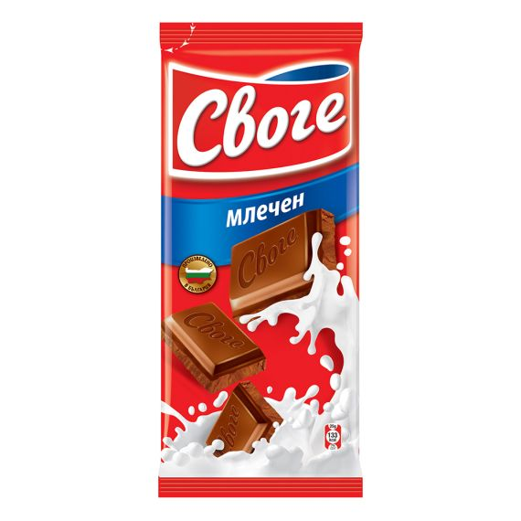
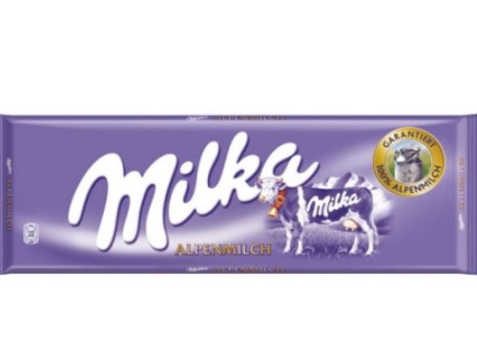
Milk chocolate Our local product is cheaper, but some prefer the imported Milka chocolate because it’s famous worldwide.
Local product
Imported product
Name: Milka milk chocolate
Price: 1.79 lv.
Quantity: 100 g.
Imported from:
Germany
Name : Svoge milk chocolate
Price: 1.65 lv.
Quantity : 100 g.

Slide 4
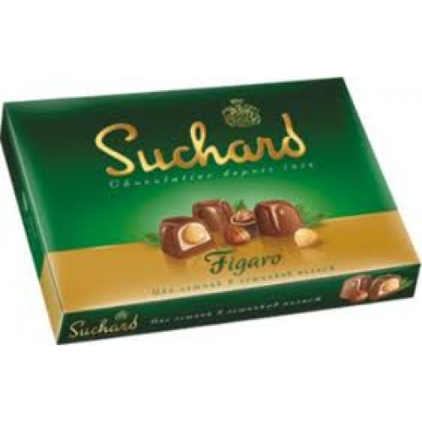
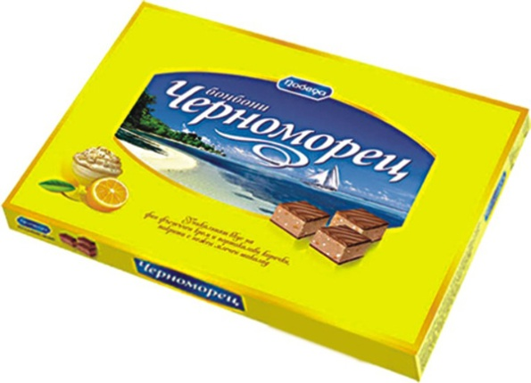
Chocolates ( sweets) The imported product is cheaper, but for us our, local chocolates are with better quality and they are more delicious.
Local product
Imported product
Name: Chernomorec
Price: 3.86 lv.
Quantity: 187 g.
Name: Suchard
Price: 3.70 lv.
Quantity: 187 g.
Imported from:
Switzerland

Slide 5
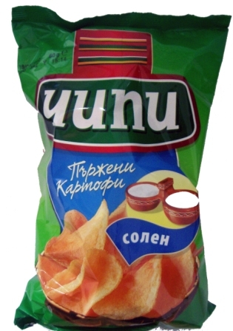
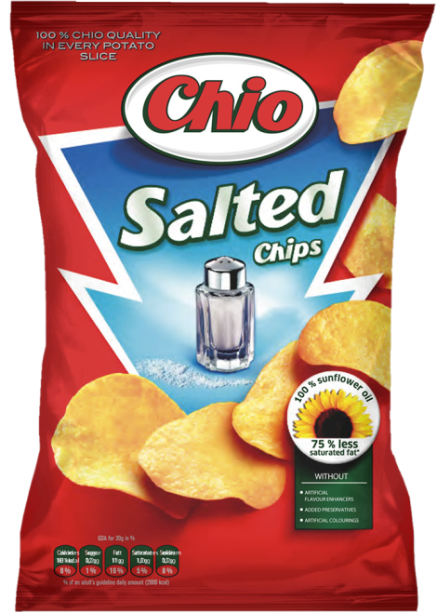
Crisps The price of our, local product is cheaper but we think most people prefer the Chio chips because it has more different flavors.
Local product
Imported product
Name: Chippy
Price: 1,15 lv.
Quantity: 65 g.
Name: Chio
Price: 1,90 lv.
Quantity: 65 g.
Imported from:
Germany

Slide 6
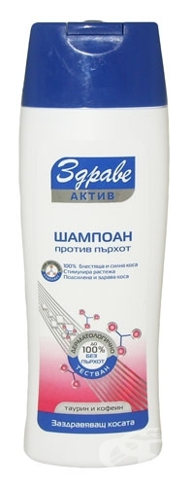
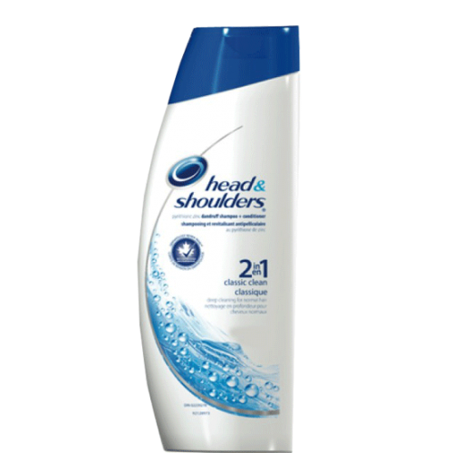
Shampoo
Local product
Name: Zdrave shampoo
Price: 4.99 lv.
Quantity: 400 ml
Imported product
Name: Head & shoulders
Price: 7.55 lv.
Quantity: 400 ml
Imported form:
USA
Our local product is cheaper , but some prefer the imported, Head & shoulders.

Slide 7
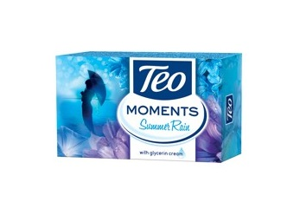
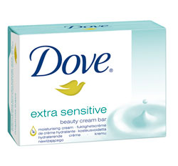
Soaps Our local product is cheaper, but some prefer the imported, Dove soap.
Local product
Imported product
Name: Teo
Price: 0,95 lv.
Quantity: 140 g.
Name:Dove
Price: 1,10 lv.
Quantity: 140 g.
Imported from:
Germany

