Slide 1
ENDENGERED AND PROTECTED ANIMALS IN BULGARIA
LESSON PREPARED by:
VERGINIYA KRASTEVA PETROVA - KAMENOVA
Profesionalna gimnazia
Asen Zlatarov - Vidin

Slide 2
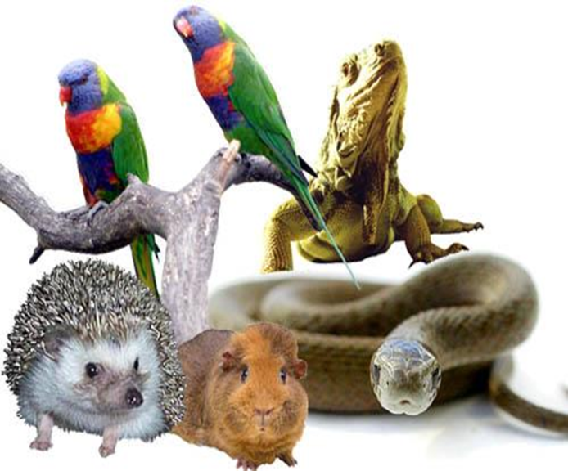
4 October is World Animal Day

Slide 3
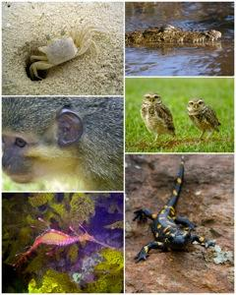
These 24 hours are the chance to give back and celebrate animal life in all its shapes and sizes, from mice to elephants, and recognise the positive influence they have on our lives.

Slide 4
BROWN BEAR
Brown bear lives in woodlands. Although it seems clumsy, on short distances it can run at a speed of 45 km. per hour. It feeds with roots, acorns and young grasses. Also loves: strawberries, raspberries and blueberries, wild apples, plums, pears, watermelons and ants. During the summer, the brown bear spent considerable time in eating, it needed 14 kilograms of food a day. The majority of the winter spent in sleep in their lairs.

Slide 5
LEOPARD SNAKE
The body of the leopard snake reaches a length of 110 cm. In Bulgaria meets the valley of the Struma to Kresna Gorge to the north and near Sozopol. Leopard snake inhabits overgrown with grasses and shrubs dry and warm rocky areas. In summer it is mainly active at night and during the day is hiding under rocks or bushes. It feeds mainly on small rodents and insectivores, rarely lizards, small birds and others.

Slide 6
PINK PELICAN
In Bulgaria the only nesting site is reserve "Srebarna" where there is a small colony. Pelicans eat mostly fish and rarely amphibians. Nests and their youngs are among the reeds in lakes, marshes and deltas of rivers

Slide 7
GREAT WHITE PELICANS
Great white pelicans are elegant and high-stamina gliders. They are sociable birds, which mate in large colonies of up to 3000 animals, and hunt in groups. They prefer extensive swamps with open waters on lakes, landlocked seas, lagoons and large river deltas. The bodies of water should have plenty of fish and aquatic plant life.

Slide 8
EUROPEAN POND TURTLE
The European pond turtle is a timid but skilled swimmer and diver. It prefers to spend most of the winter at the bottom of muddy water bodies. Yet in the summer, it likes to bask in the sun, for which pond turtles need floating branches or vegetation, such as detritus from trees cut down by beavers. Pond turtles prefer a habitat on still or slow flowing bodies of water, with a muddy bed and an abundance of aquatic plants, i.e. vegetation rich bayous in alluvial forests.

Slide 9
EUROPEAN MINK
It inhabited most of northeast Bulgaria, mostly loves humid climates as the river. River. The mink fur is valuable because that has been a victim of poaching. Males reach a length of 28-43 cm, and 12-19 cm tail and weigh 740 grams. Females 32-40 cm, the tail is 12-18 cm and weigh 440 g. They live in ponds, rivers and shores of lakes, rarely found in swamps bear from 2 to 7 small. Live 8-10 years.

Slide 10
BLACK STORK
Black Stork (Ciconia nigra) is a large migratory wading bird of the Stork family. Body length: 95-100 cm Wingspan: 185-205 cm Weight: about 3 kg live in quiet ancient forests by building its nest of a large tree. In our black stork can be seen in the Nikopol plateau on the outskirts of Lovech, on the outskirts of the village of Sennik Sevlievo, on the outskirts above the town. Asenovgrad with. Tabachka (Rousse), as well as with. Biser (Haskovo), and end with . D. Belotintsi (Montana).

Slide 11
GOLDEN EAGLE
The golden eagle (Aquila chrysaetos) is one of the largest diurnal raptors occurring on our lands. The body length is 80-95 cm, spread of the wings - 195-220 cm, and weight - 2,8 6,5 kg. The Golden Eagle lives a secluded life. It is a bird of prey, hunt, chasing a flying prey if it fails to capture a few hundred meters abandon her. He prefers medium to relatively large sized mammals such as deer, wild goats and others.

Slide 12
SEAL MONK
By the beginning of XX century. It was present on Dobrudzha coast and entered Danube river near Rousse.

Slide 13
STURGEON
Sturgeons have been of economic importance for their meat and eggs (caviar) for centuries. The Danube river system was originally home to six types of sturgeon, two of which now appear to be extinct.
turgeons can become very old and are sexually mature at a late age; the Beluga reaches sexually maturity at the age of 15. During the spawning season, from spring to summer, sticky, brownish-green eggs are laid. After 2 weeks, the young sturgeon are ready to feed, and they migrate to the ocean between their 1st and 3rd years.

