Slide 1
Wine-making in Slovakia

Slide 2
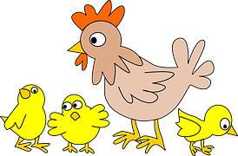
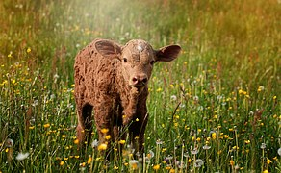
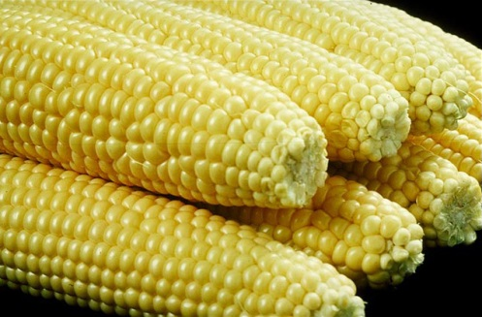
Agriculture in Slovakia
Cultivation of plants:wheat, rape, sunflower, corn, barley, sugar-beet, pumpkin seed, peas, beans, rye, poppy
Cultivation of fruits and vegetables
Livestock farming: poultry, cattle, pigs, sheep

Slide 3
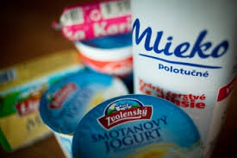
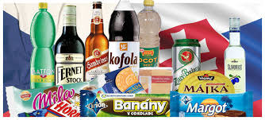
Products to consume for the inhabitants of Slovakia
Dairy products(milk, yoghurt, cheese, cottage cheese, cream, sour cream, etc.), processed meat(ham, sausage, pâté, bacon, beef, pork, lamb etc. ), eggs

Slide 4
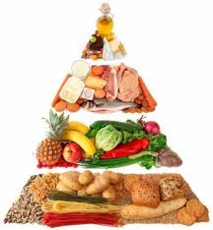
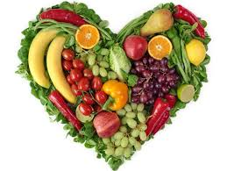
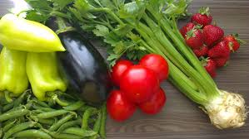
Fruit and vegetable growing
Seasonal fruits from the region: apple, plums apricot, peach, raspberry, strawberry, blackberry, grapes, pear
Seasonal vegetables: cabbage, carrot, parsley,
green pepper, tomatoes, potatoes, cucumber

Slide 5
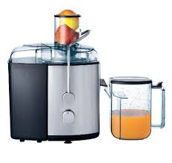
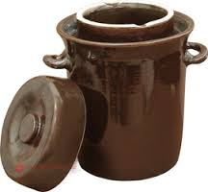
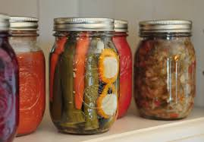
Processed fruit and vegetables
Frozen fruit and vegetables, canned fruit and vegetables, pickled vegetables, fruit juices, alcoholic drinks(vodka, wine)

Slide 6
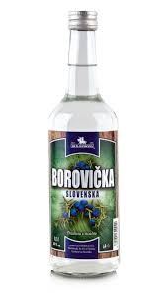
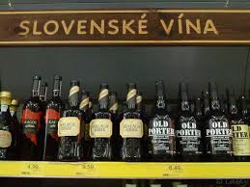
Drinks from Slovakia
Borovička (spirit from juniper berries)
Beer (made from local barley)
Wine (made from local grapes)

Slide 7
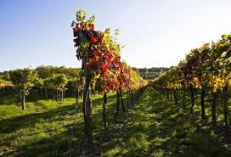
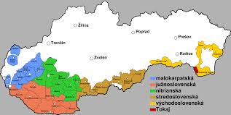
Wine regions of Slovakia
Location:on the south
The climate and the soil

Slide 8
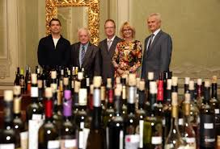
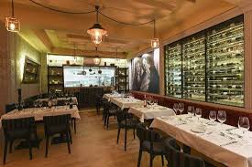
The benefits
Important part of agriculture
Give work opportunities for the locals
Health benefits
Is connected with tourism

Slide 9
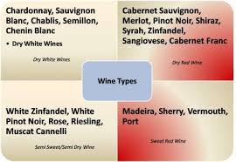
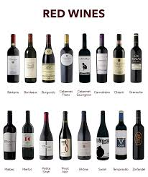
Types of wine
White wines,red wines, rose
Red wines:

Slide 10
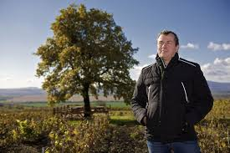
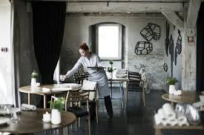
The big business
Famous wine-makers in Slovakia
Slovak wines in Michelin-star restaurants in Europe(Noma, Onyx)

Slide 11
Thank you for your attention!
Gymnázium-Gimnázium, Štúrovo, Adyho 7
Slovakia
Prepared by: Adriana Góra

