Slide 1
The Best Hungarian Product
Schindler Fanni, Pintér Mercédesz

Slide 2
Most of the countries do not know about Túró Rudi. This is a very popular dairy product in Hungary.

Slide 3
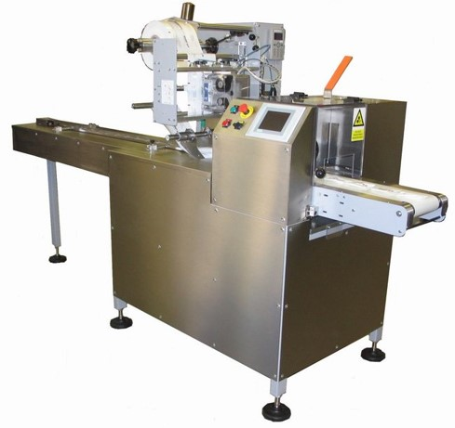
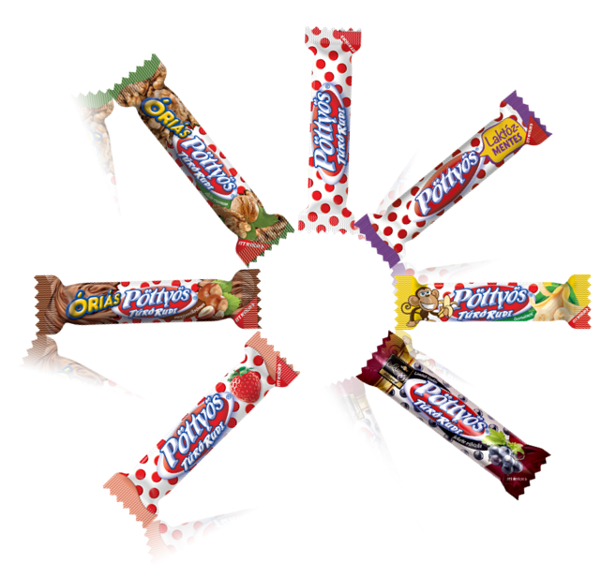
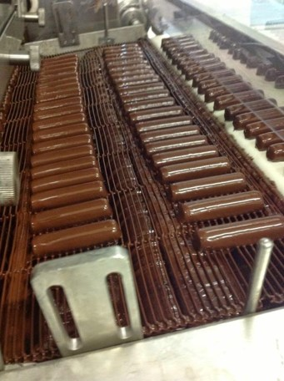
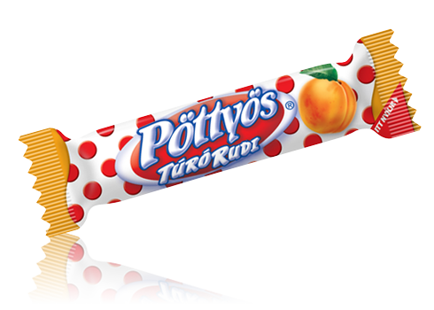
How it’s make? What's it made from?

Slide 4
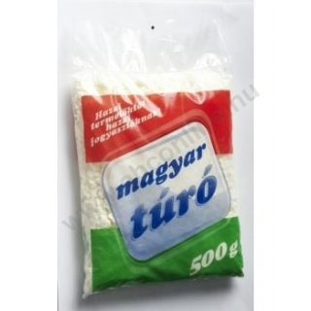
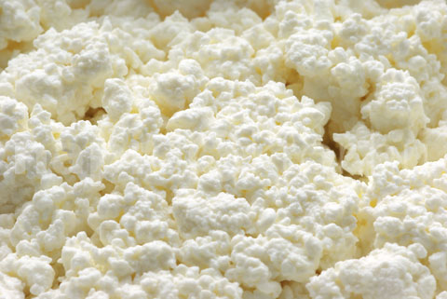
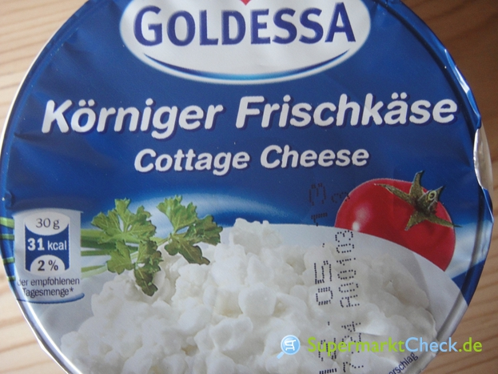
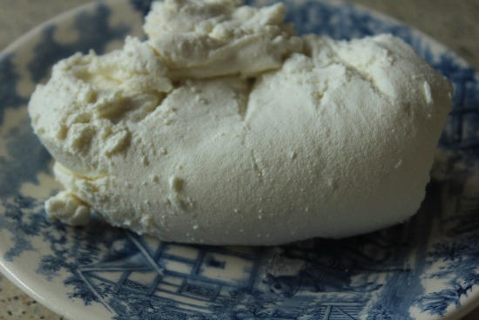
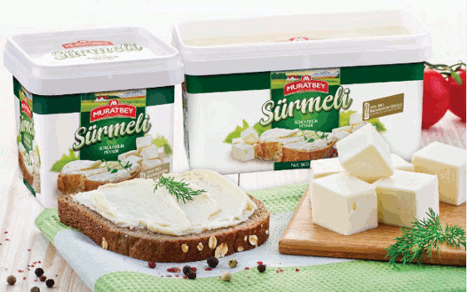
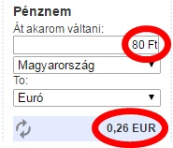
Cottage cheese in other countries
Hungarian
German
Transylvanian
Turkish

Slide 5
Thank you for your attention!☺

