Slide 1
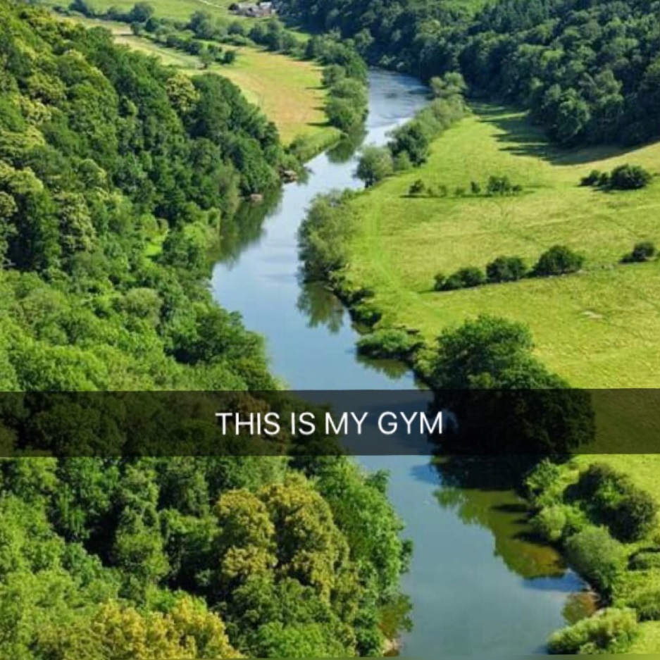
Outdoor fitness by the river

Slide 2
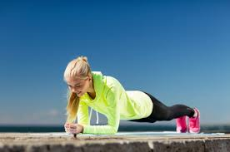
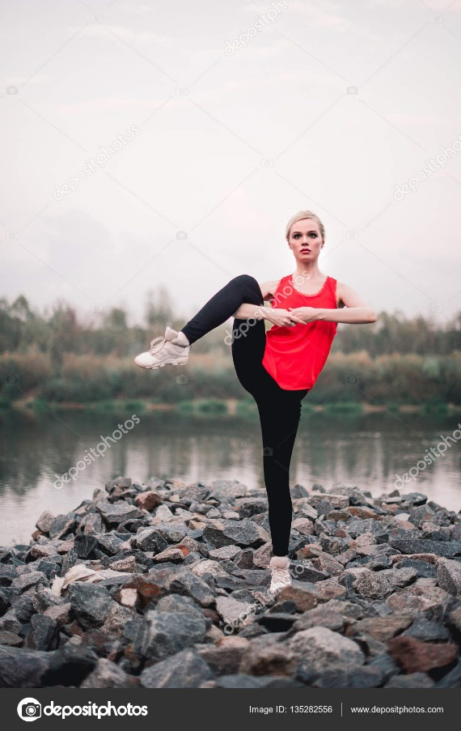
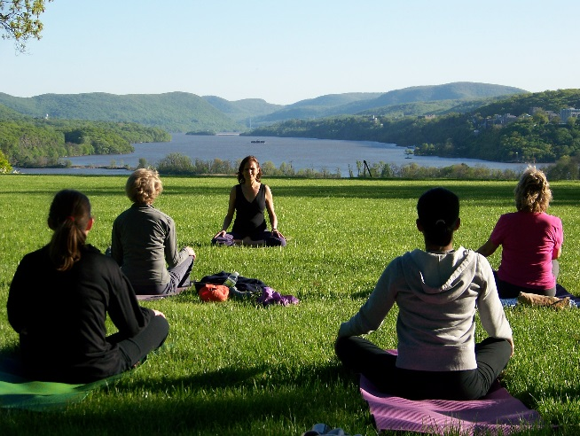
Having an outdoor fitness center is a great way to offer young and healthy people more job opportunities and help people who have health problems (overweight, etc.)

Slide 3
Diffuse the healthy lifestyle to young people
Work like an instructor
Be healthy
Learn people how to do sports
Improve your life

Slide 4
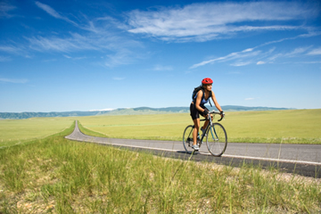
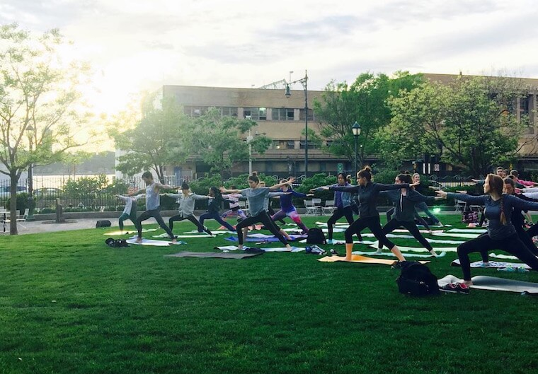
We are looking for…
15-24 years old people
Both of the genders
People who are interested in sport
Fit and healthy people
Communicative people
Outgoing people

Slide 5
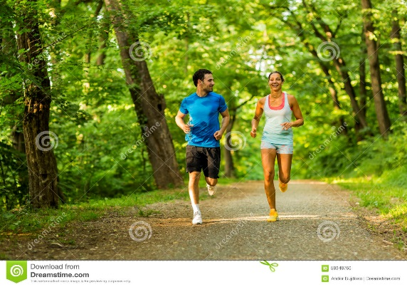
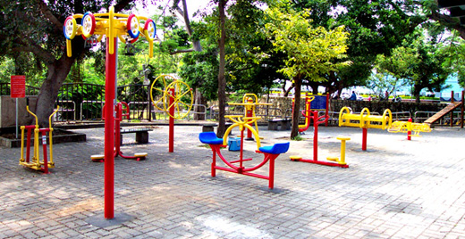
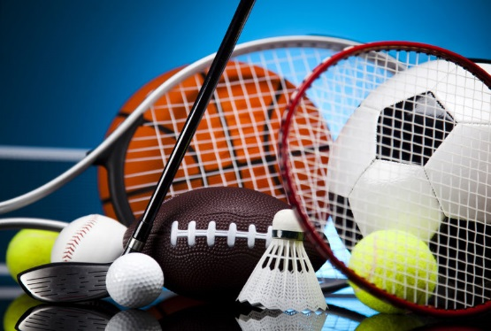
What we offer to the employees…
Courses in different types of sport
Good paid salary
We offer the equipment for all the sports
2 days off per week
Possibility for part time job

Slide 6
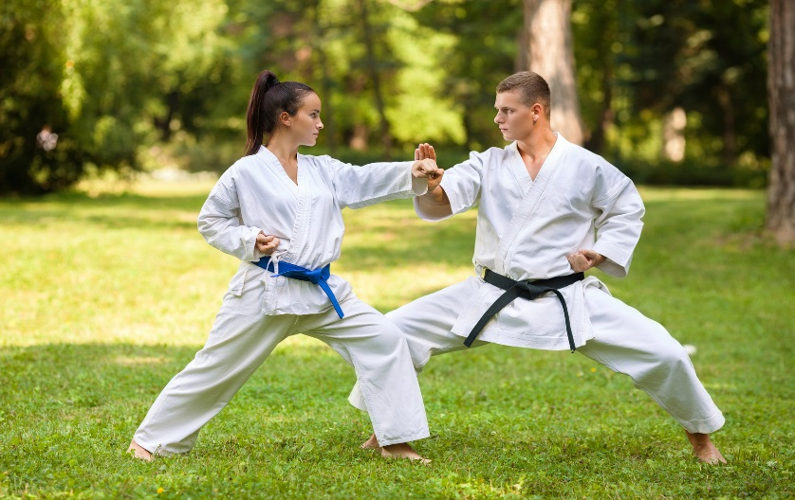
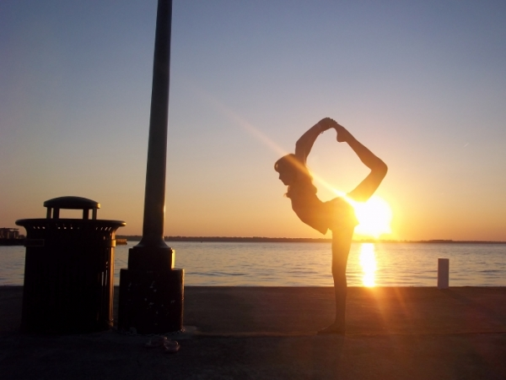
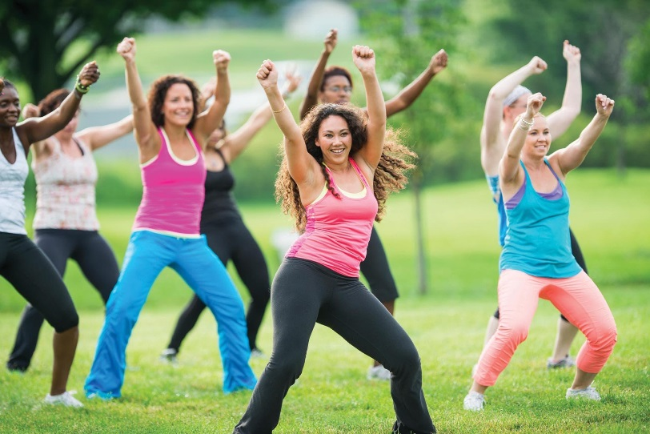
We will offer to the customers…
Street workout
Yoga
Gymnastics
Zumba
Karate
Aerobic
Cycling
Running
Stretching

Slide 7
Thank you for your attention

