Slide 1
Comparison of regional and international products
Nejc, Timon, Nika, Monika, Karin

Slide 2
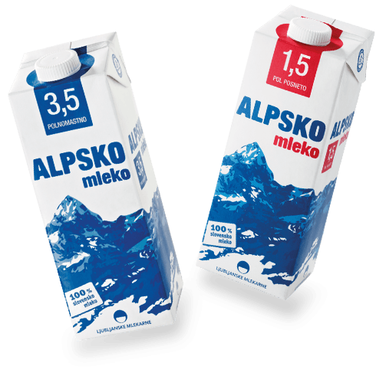
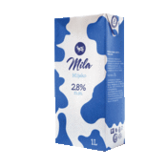
Dairy products
Local:
Imported:
Alpine milk: 0,99 €
homogenized
it contains Austrian, Italian and Switzerland milk
Planika milk: 1,08 €
not-homogenized → healtier
100% Slovenian milk
organic also available : 1,69€
Mila milk: 0,57 € (from Italy)
homogenized

Slide 3
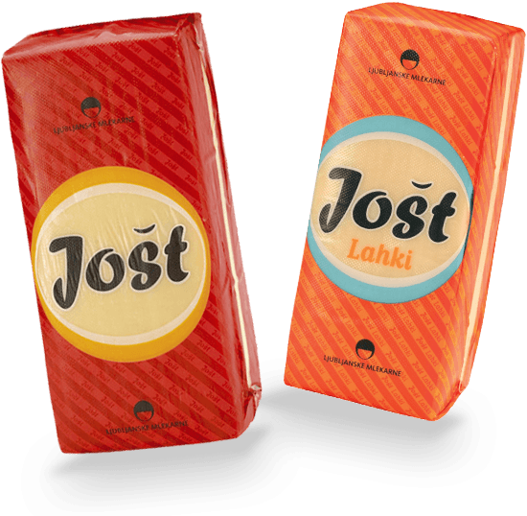
Dairy products
Local:
Imported:
Cheese Jošt: 8,60 €/kg Ljubljanske Mlekarne
Cheese Ementalec: 8,42 €/330 g Pomurske Mlekarne
Organic cheese is also
available from smaller,
local daries: 8,60 €/kg
Italian Cheese : 11,24 €/kg (from Italy)

Slide 4
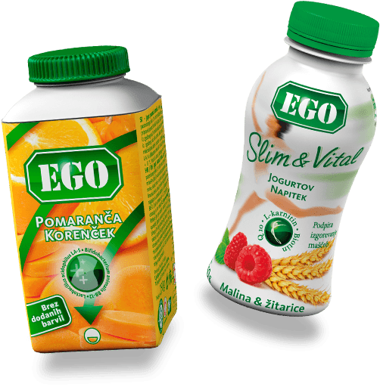
Dairy products
Local:
Imported:
Yogurt Ego: 0,67 €/150 g Ljubljanske Mlekarne
Yogurt Maxxi: 0,49 €/150 g Zelene Doline
Greek yogurt: 0,89 €/150 g Ljubljanske Mlekarne
Yogurt: 1,79 €/l (from Italy)
Planika produces organic yogurts: 1,30 €/150 g
Export to Italy, Bosnia, Macedonia and Austria

Slide 5
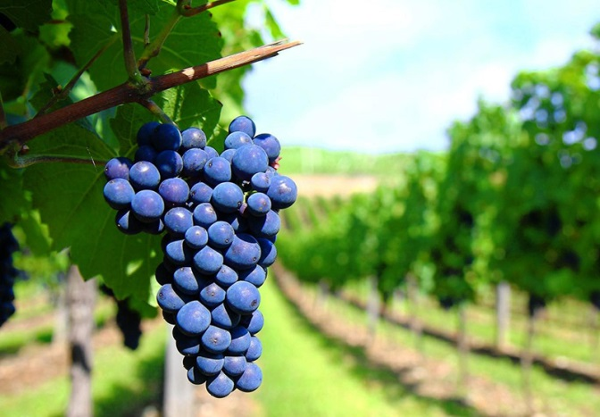
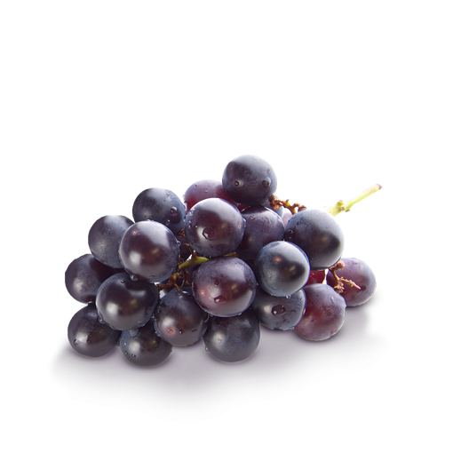
Fruit and vegetables
Local:
Imported:
Red grapes: 3,59 €/kg Sadje Zelenjava
White grapes: 2,79 €/kg Sadje Zelenjava
White grapes: 2,38 €/kg (from Italy)
Organic grapes also available: 1,70 – 2,00 €/kg
Imported grapes are not organic

Slide 6
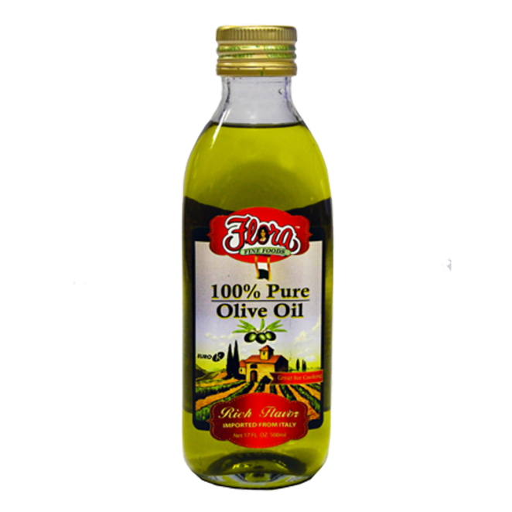
Fruit and vegetables
Local:
Imported:
Olive oil: 14,00 €/l Gea
Virgin olive oil: 8,99 €/l (from Italy)
Olive oil: 5,49 €/l (from Croatia)
Quality of imported and local oil is comparable;
Organic Slovenian oil is also available: 10 - 18 €/l

Slide 7
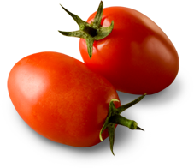
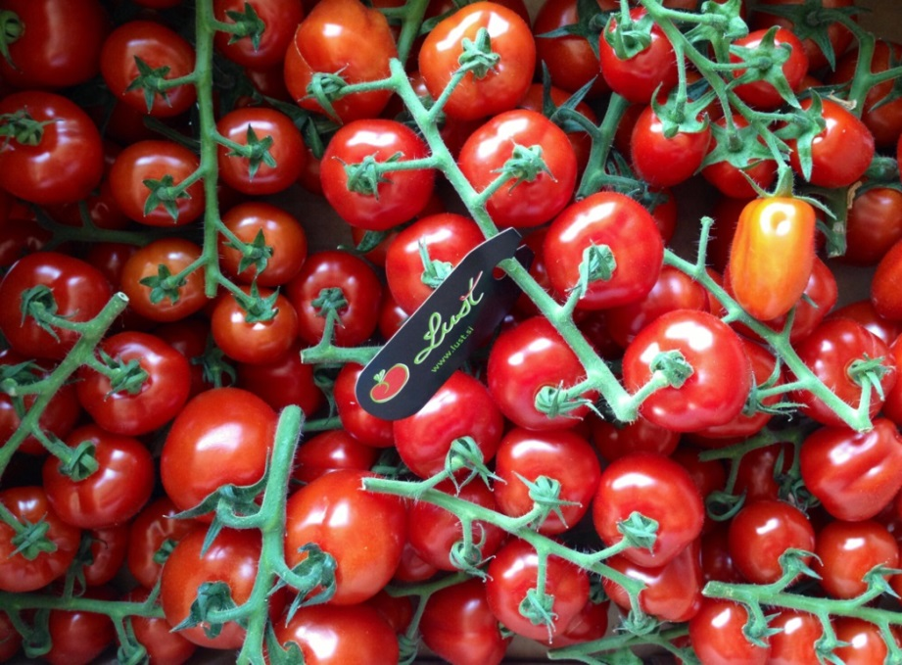
Fruit and vegetables
Local:
Imported:
Lušt tomato: 4,00 €/kg Lušt
Tomato: 2,09 €/kg Grade d.o.o.
Tomato cluster: 2,09 €/kg (from Italy)
Slovenian organic tomato prices: 5,50 €/kg – 6,00 €/kg

Slide 8
Products of free choice
Local:
Imported:
Refosco: 3,59 €/l Vinakoper
Gold Ribolla: 2,69 €/l Goriška Brda-Vino
Vranac: 5,59 €/l (from Croatia)
Slovenian wines recieved many awards.

Slide 9
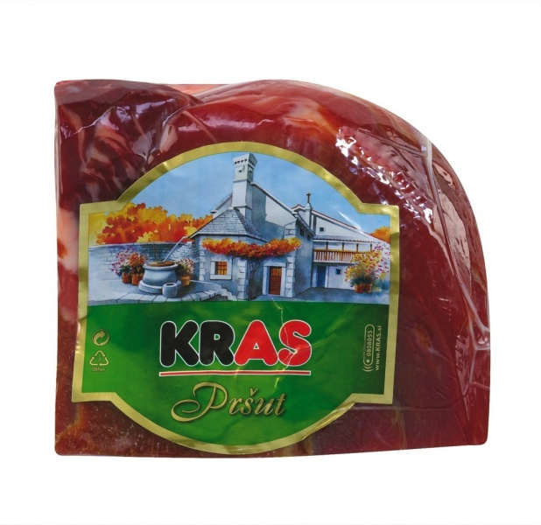
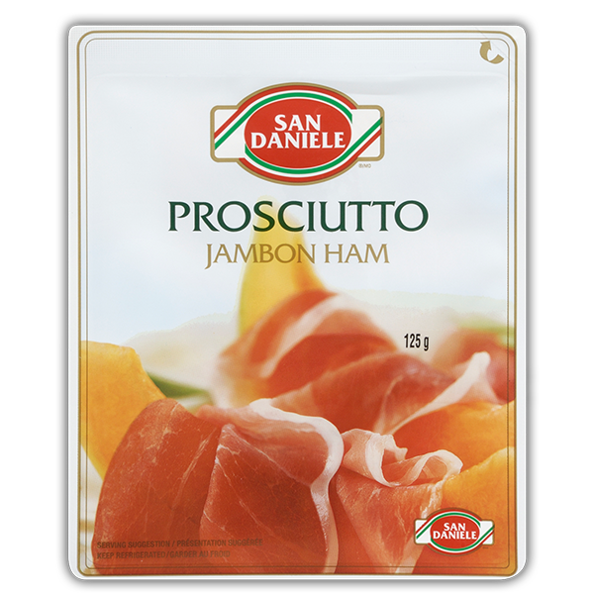
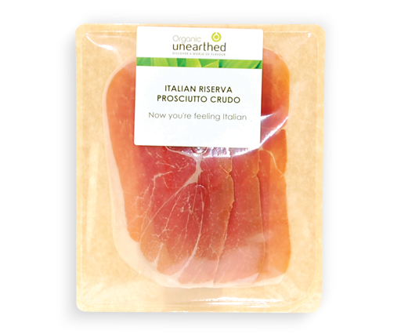
Products of free choice
Local:
Imported:
Prosciutto: 3,60 €/100 g Kras
Prosciutto S'Daniele: 4,29 €/70 g (from Italy)
Prosciutto from Croatia: 3,60 €/100 g

Slide 10
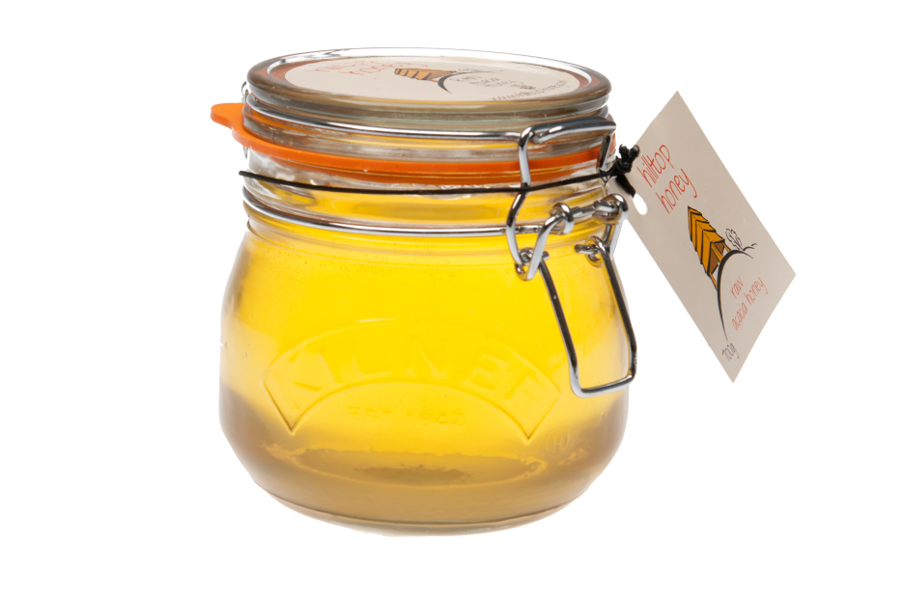
Products of free choice
Local:
Imported:
Bio Honey : 6,98 €/450 g Medex
Acacia honey: 14,75 €/kg (from Italy)
Croatia: 12,00 €/kg
Acacia honey: 9,00 €/900 g Medex → ecological

