Slide 1
“Coriolan Brediceanu” National College
Curriculum

Slide 2
About our High School
Prestigious Romanian Theoretical High School
Over 150 years old(Founded in 1837)
Average of classes/week: 30
Ages of students: 11-19 years old
Engaged in more than a few national and international projects and partnerships

Slide 3
Curriculum Areas
Sciences :
Humanities:
Mathematics
Computer Programming
‘Earth Studies’
Social Studies
Languages

Slide 4
Chances After Graduation
The choice of high school curriculum does not limit the choices for university
High chances of entering top universities around the globe
Getting a good university scholarship
Enter the job market by relying upon The Computer Programming , English or German Certificates

Slide 5
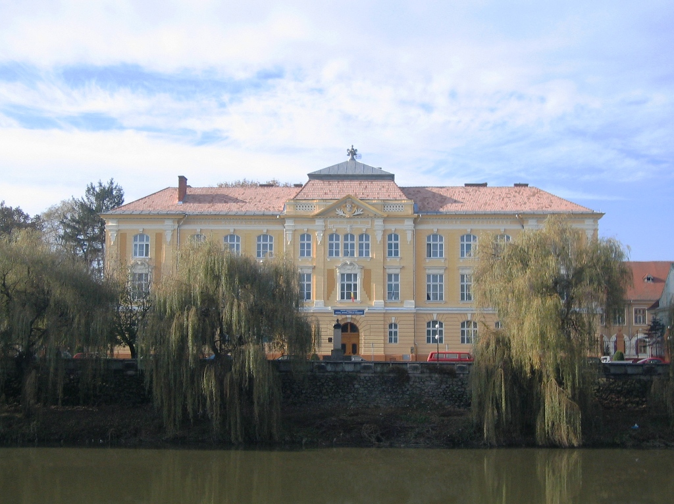
Thank you for your time!

