Slide 1
Collecting trash
How to employ young people
PREPARED by: Klaudia Cseke, Lucie Rytirova, Alessia, Maria

Slide 2
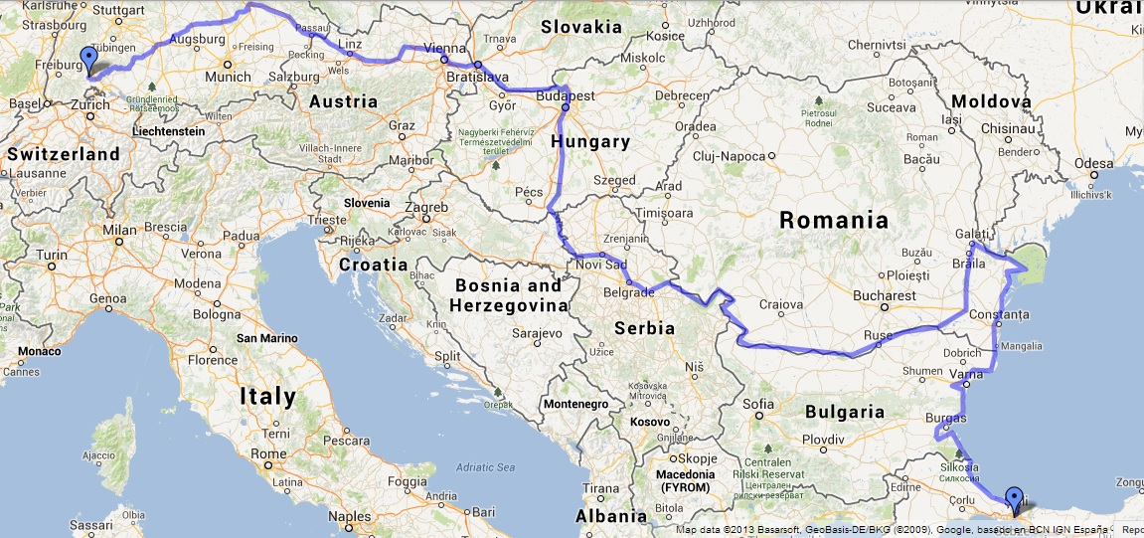

Slide 3
Plan
It could be near the river Danube or anywhere else
People would collect the trash around the river [or anywhere else], the water would be cleaner, there could be more kinds of fish, the environment would be nicer and it would make the tourist come to the cities around the Danube. This would be advantage not only for us, but also for city, because they will spend money..
There could be nets in the river which would catch the trash

Slide 4
The way how to get money for the project
1] water power station on the river, we would make electricity, we would be paid by the people
2]donations from people who want to have their city nicer
3] money from the state

Slide 5
Advantages
This can be almost for everyone – it is not hard work
increase youth employment
cleaner environment
more tourists probably
people who will do this job would be more considerate against the environment in the future

