Slide 1
Formal and informal letters

Slide 2
Informal letters
Who am I writing to?
Why am I writing?
What do I need to tell them?
What do I want them to do?

Slide 3
Formal letters
Who am I writing to?
Why am I writing?
What do I need to tell them?
What do I want them to do?

Slide 4
Differences of formal and informal letters
Formal letters
Informal letters
are letters, written in formal language, for official purpose.
for professional communication
They are written in prescribed format only.
Business, college/institute, employer, organizations...
are written in a friendly manner, to someone you are familiar with
For personal communication
No prescribed format
Friends, family, acquaintances

Slide 5
Differences
Formal letters
Informal letters
Long and complex sentences
Contractions and abbreviations avoided
Short and simple sentences
Contractions and abbreviations used

Slide 6
Useful phrases when writing
Formal letters
Informal letters
Dear Mr. Brown, Dear Sir/Madam
Awaiting your reply/look forward to hearing from you
Yours Faithfully, yours sincerely, Regards
Hi Mike, Dear Mike
Write soon, all the best, bets wishes,
Bye

Slide 7
Differences in format
Formal letters
Informal letters
Two addresses (the sender and the recipient)
Date
Opening and closing
Name and signature
No address
Date
Opening and closing
Name

Slide 8
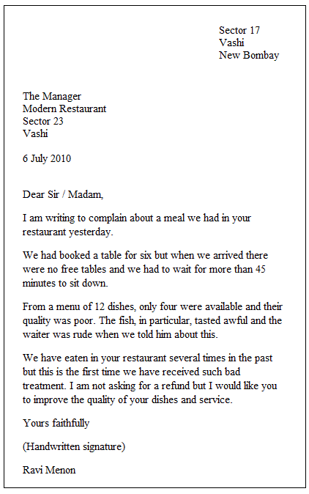
Example of a formal letter

Slide 9
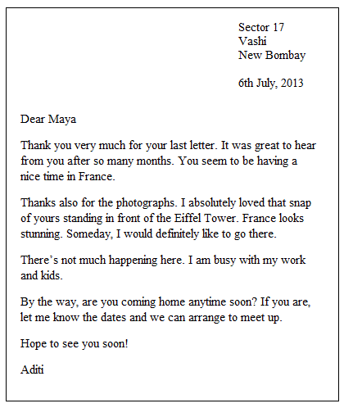
Example of an informal letter

Slide 10
Worksheet for students
It´s your turn! It´s always good to make a plan for a letter before you write it. One way to plan is to use sticky notes. This helps you to check that you´ve included everything you want to say. You can also move the sticky notes around into the order you want.

Slide 11
Read the task!
Mona saw an advertisement for a learning support assistant in a local school. She wrote a letter to the secretary of the school enclosing her curriculum vitae (CV). First she wrote down on a sticky note each point she wanted to include in her letter:

Slide 12
Thank you for your attention!
Author: Adriana Góra
Teacher at Gymnázium-Gimnázium Štúrovo, Adyho 7, Slovakia

