Slide 1
Our towns
Linz, Papa, Lugoj

Slide 2
Linz – Austria
AEC
Hauptplatz

Slide 3
Linz – Austria
Musik Theater
Schlossmuseum Linz

Slide 4
Papa – Hungary
Kossuth Street
Spa Bath

Slide 5
Papa – Hungary
Main Square

Slide 6
Lugoj – Rumania
Lugoj City Townhall
River side view

Slide 7
Festivals - Linz
Urfahranermarkt
Kronefest

Slide 8
Festivals – Papa
NEJ
Wine Festival

Slide 9
Festivals - Lugoj
Summer fair
Folk Festival

Slide 10
Facilities
Plus City – near Linz
Main Street in Linz

Slide 11
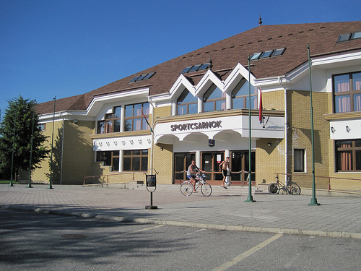
Facilities - Papa
Cinema - Petofi
Sports Hall
Located in Deak Street
Many young people
New cinema
Only cinema
Matches:
Football
Basketball
Handball
Near the school (PE lessons)

Slide 12
Facilities - Lugoj
Lugoj City Cinema
Traian Grozavescu Theater

Slide 13
HAK – Linz International Business School

Slide 14
Papa Secondary School of Economics

Slide 15
“Coriolan Brediceanu“ National College

Slide 16
Our towns
Linz, Papa, Lugoj

