Slide 1
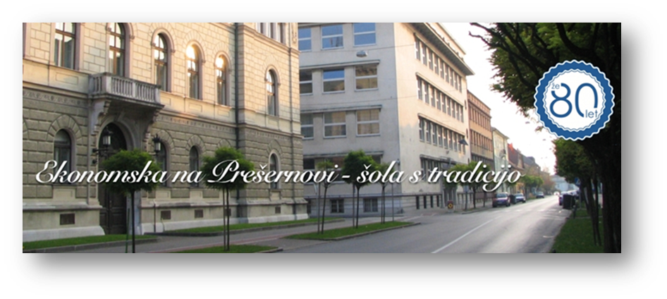
SCHOOL AND SURROUNDINGS
A SCHOOL WITH TRADItION
Ekonomska šola Ljubljana
SCHOOL OF ECONOMICS LJUBLJANA

Slide 2
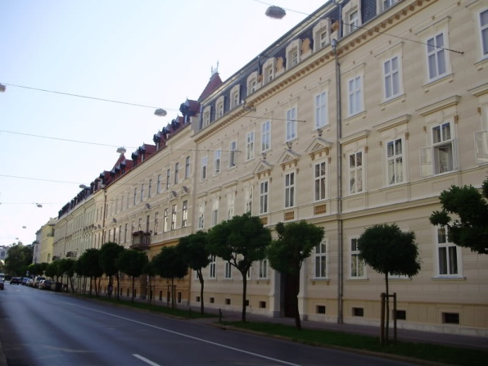
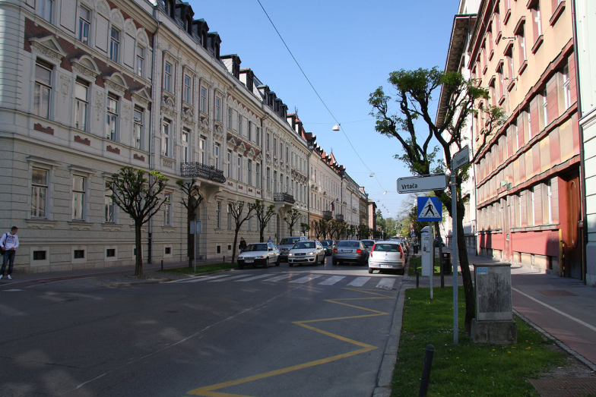
ABOUT THE SCHOOL:
It was built in 1934 and in 2014 celebrated its 80th birthday
EVEN DURING WWII, classes were held in slovene language
It is a cultural monument
LOCATED ON prešernova st.
BUILT BY A FAMOUS ARCHITECT VLADiMIR ŠUBIC

Slide 3
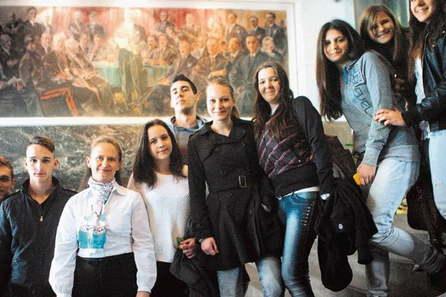
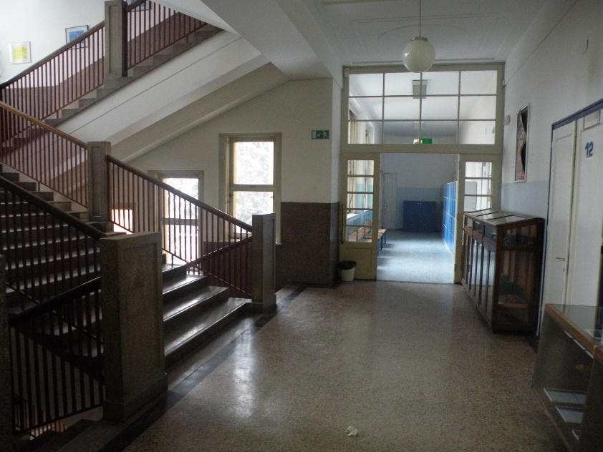
INSIDE:
NO gym - have to walk to the nearest one
We have a canteen and we order LUNCH online and usually eat in classrooms. There are 5 FLOORS
There are two enormous paintings on both sides of the entrance hall
a RENOVATED library

Slide 4
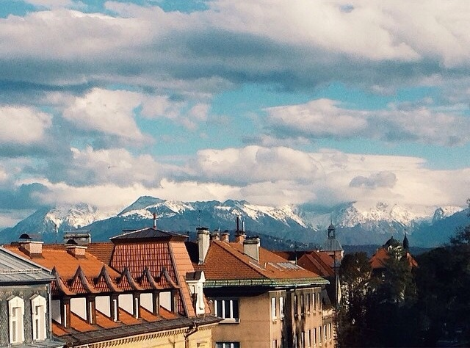
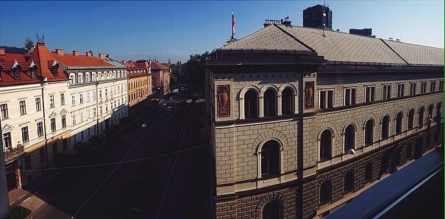
SURROUNDINGS:
MAGNIFICENT view, you can see the alps
On the right: the president’s headquarters, government BUILDING NEXT DOOR, PARLIAMENT IN THE VICINITY
Nearby are cafes, shops and banks, AS WELL AS a primary school AND A THEATRE
Famous zvezda park and triple bridge not far away
Lots of embassies ON THE SAME STREET (American, Austrian, …)

Slide 5
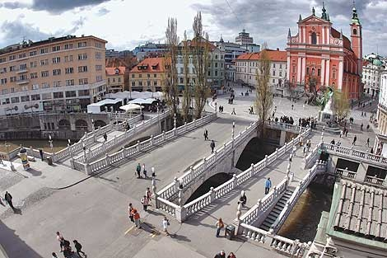
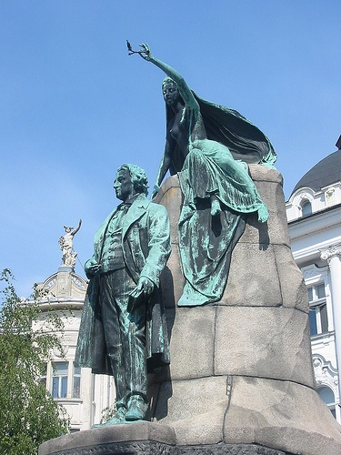
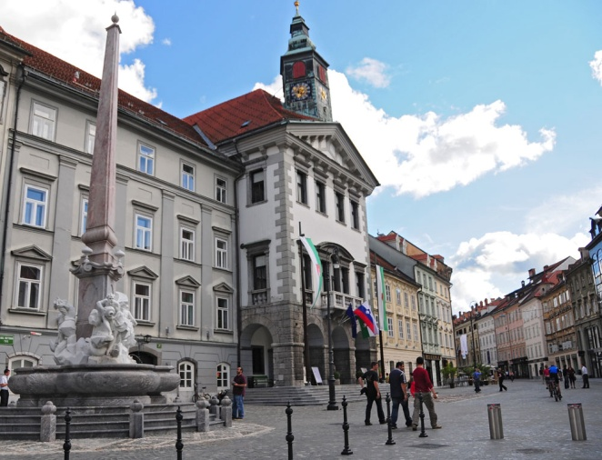
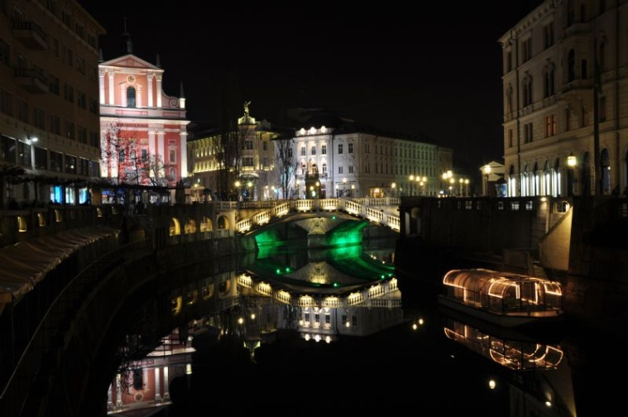
CITY CENTER:
The center is very close to the school
PrešerEn square and statue of the famous poet
the famous triple bridge
The river Ljubljanica
Town hall
RobBA fountain
Park tivoli is near

