Slide 1
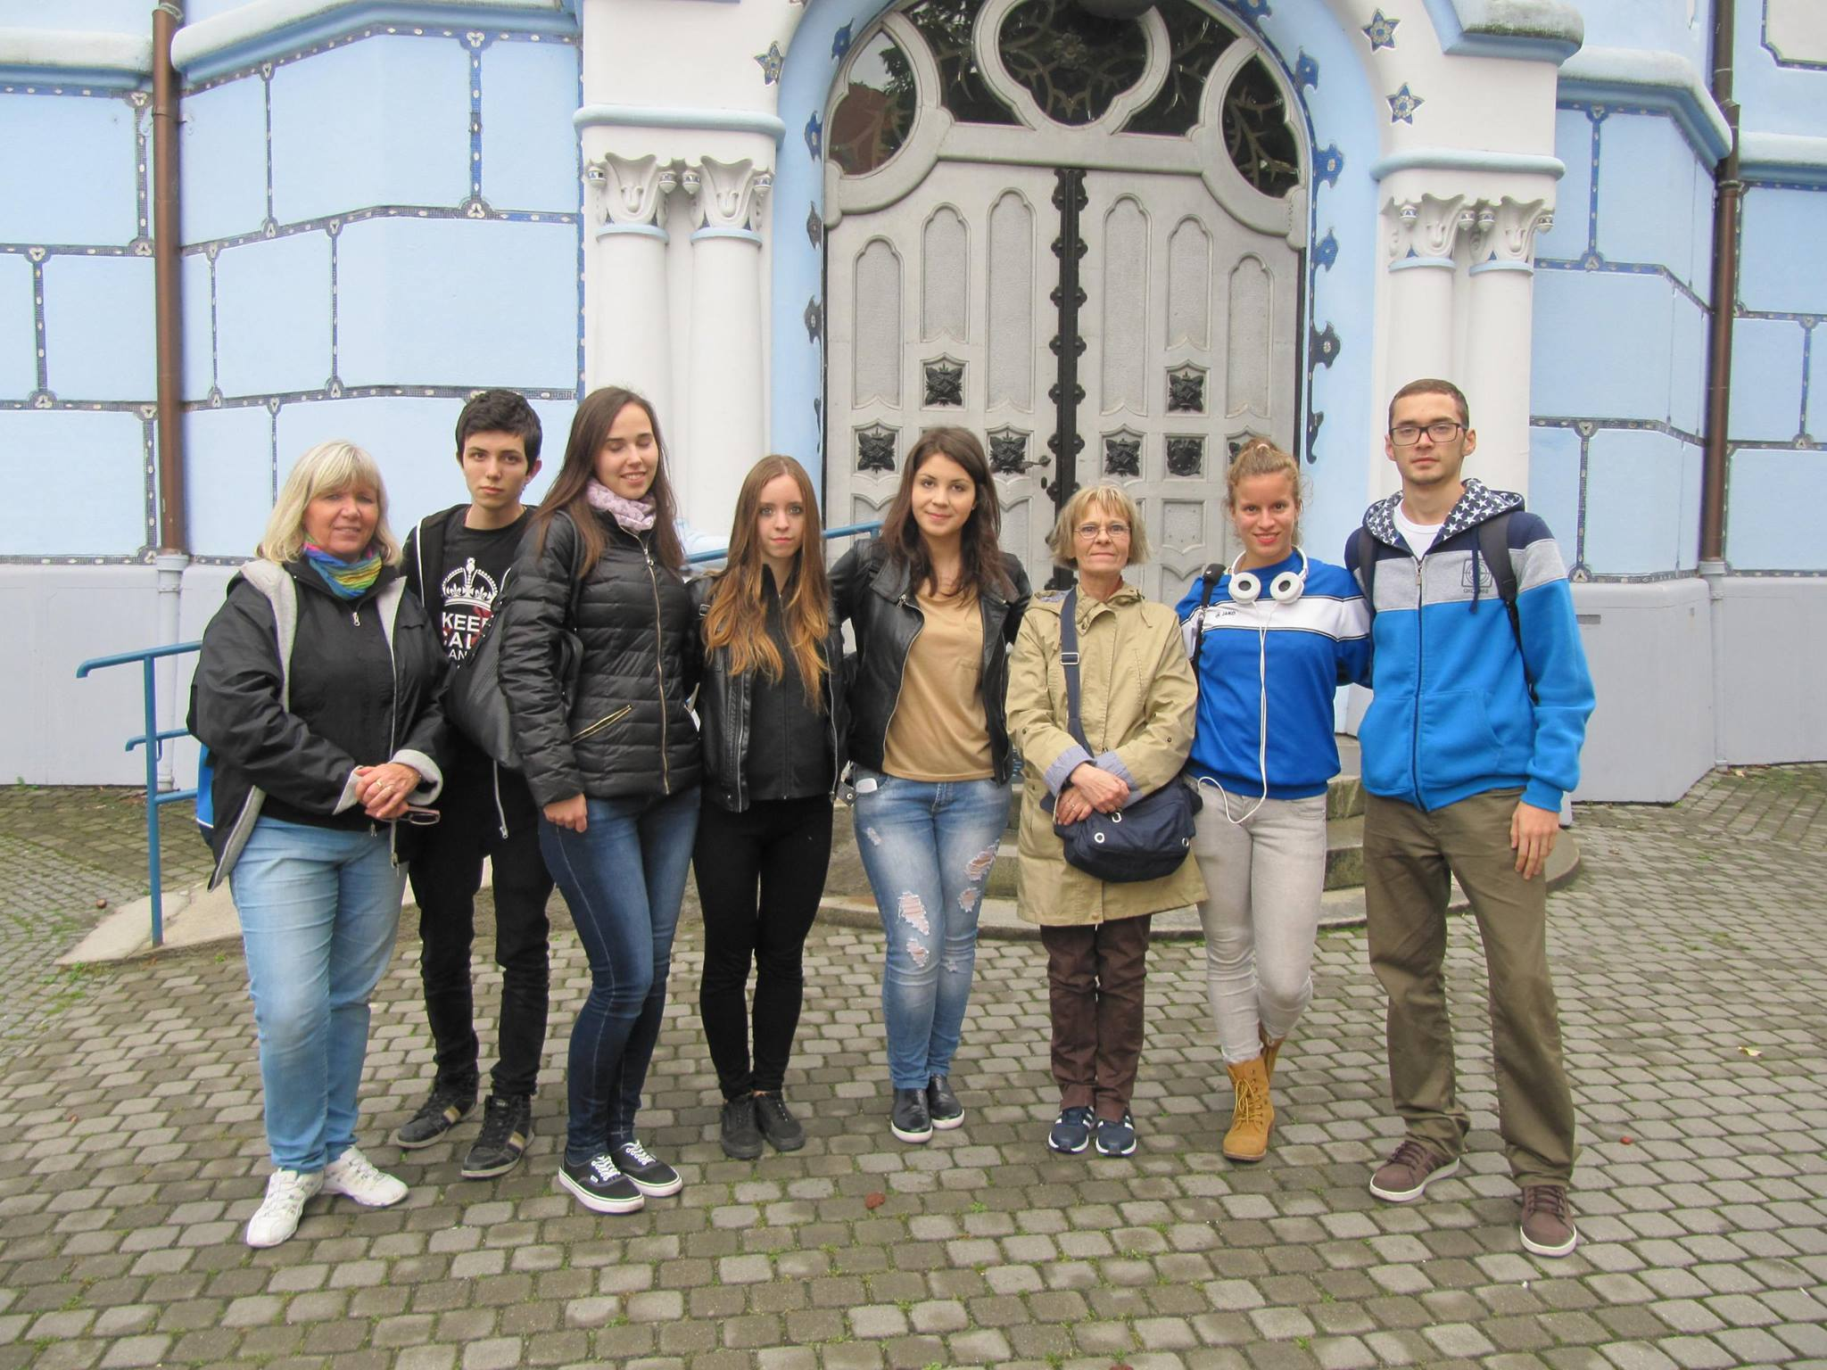
About the Fair in PÁrkány
Made by: the Hungarian team

Slide 2
Accessory shop:
They came from Budapest
The prices are between 0,80€ and 3€
Other Accessory shop:
They came from Hatvan
The prices are between 3€ and 7€
The Hungarian price is between
300 and 1300 Forints

Slide 3
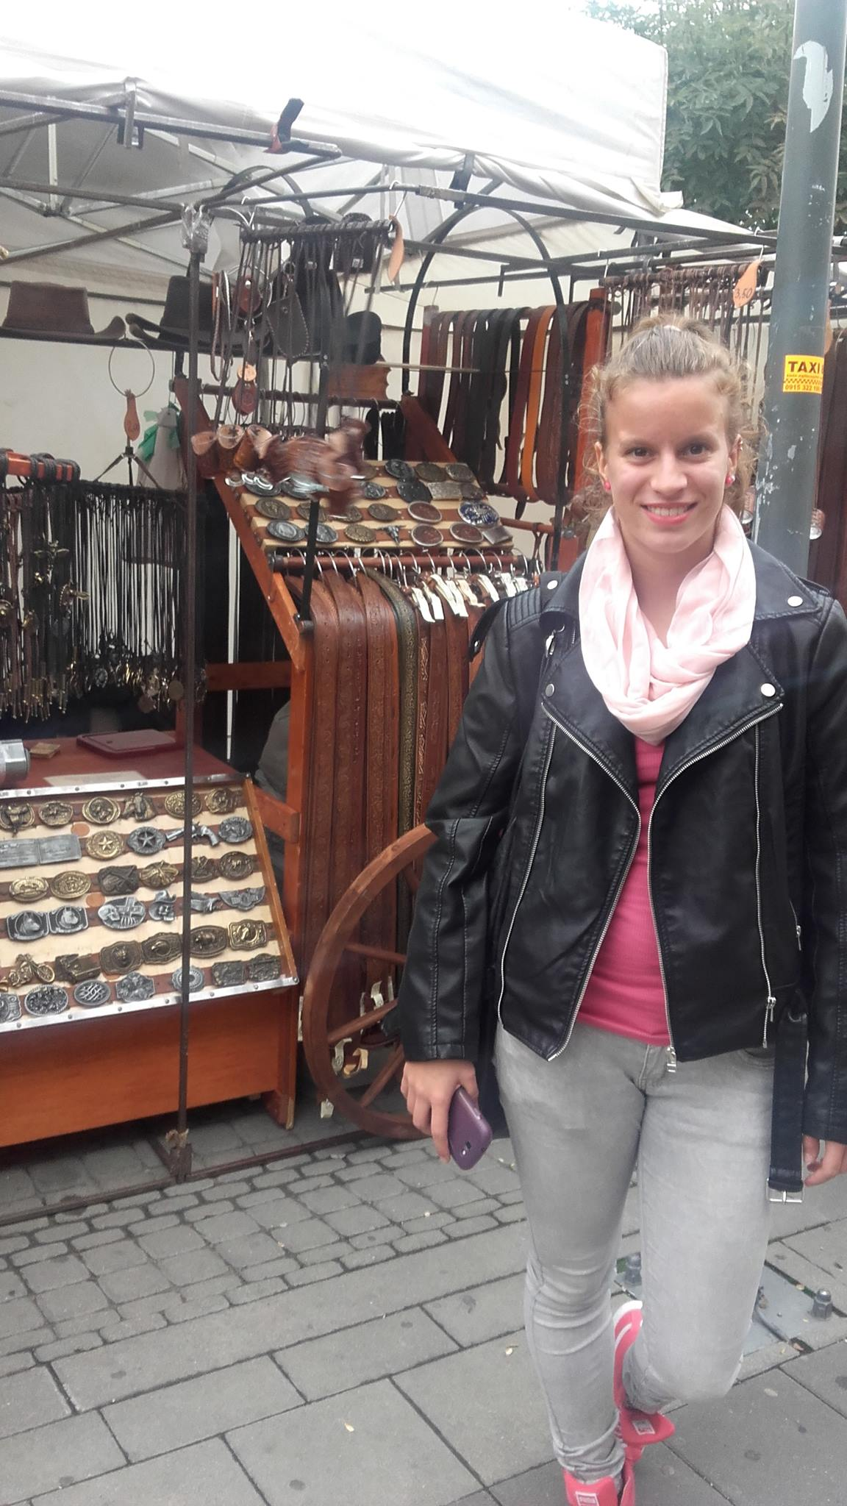
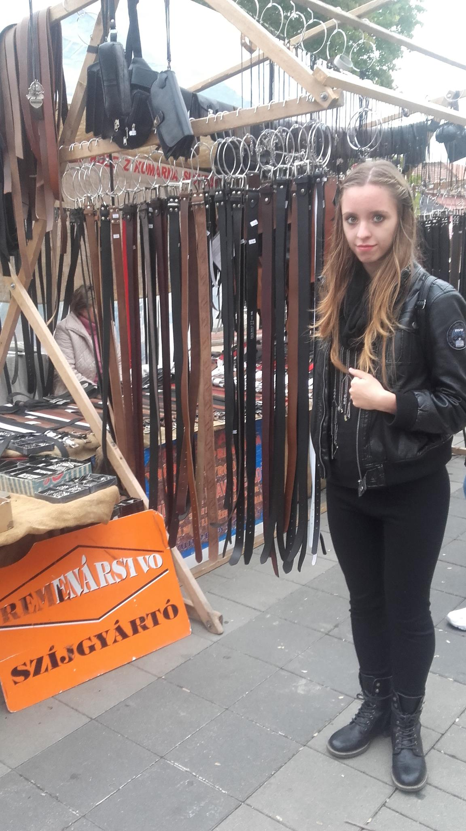
Leather vendors:
They came from Kassa
The prices are between 24 and 35€
Hand-made
Leather vendors:
They came from Komárom
The prices are between 1 and 10€
Hand-made
The Hungarian price is between
6000 and 15000 Forint

Slide 4
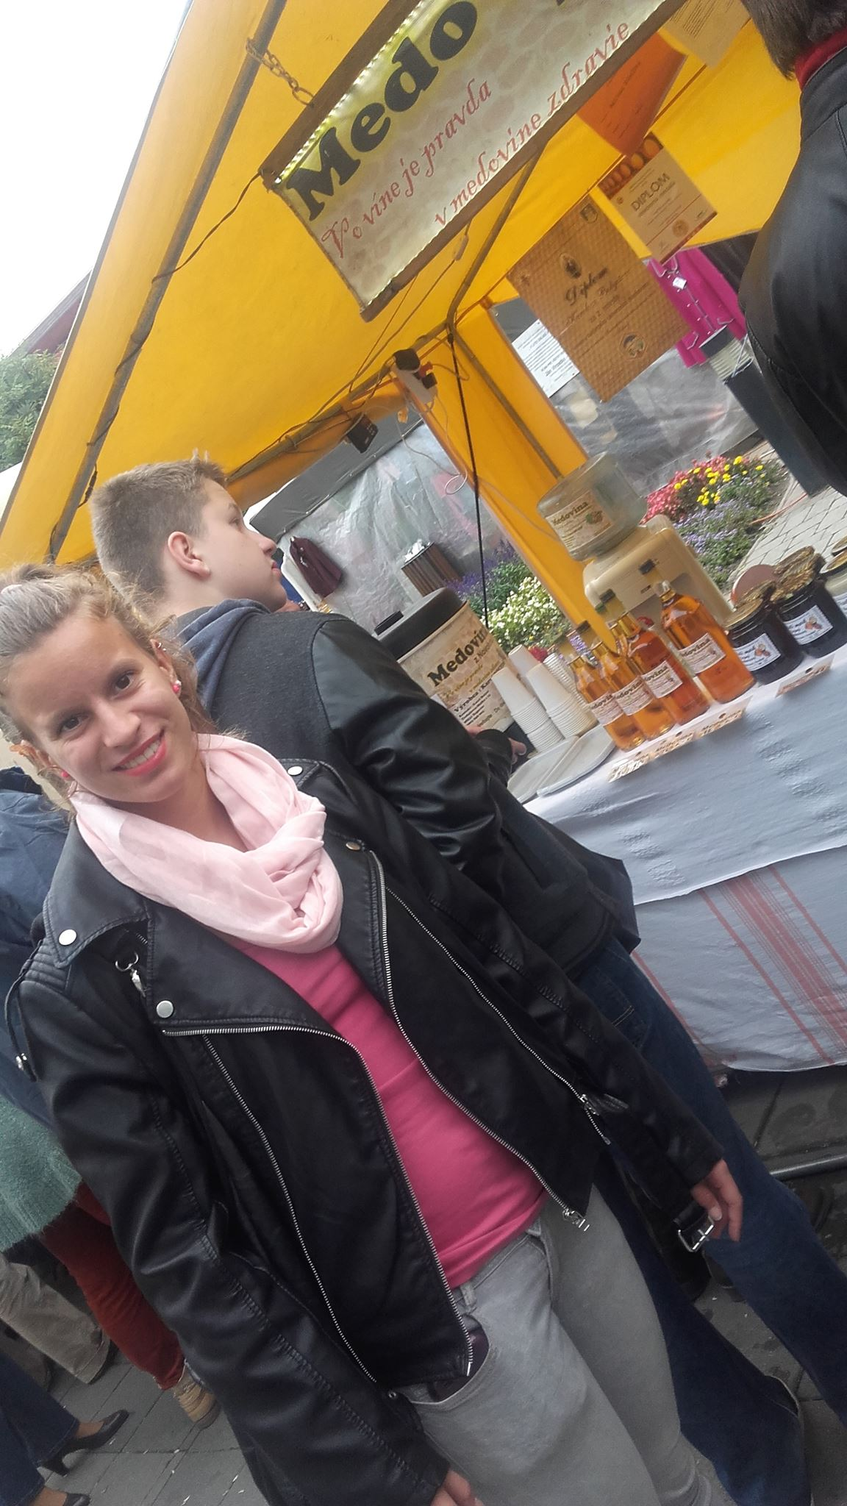
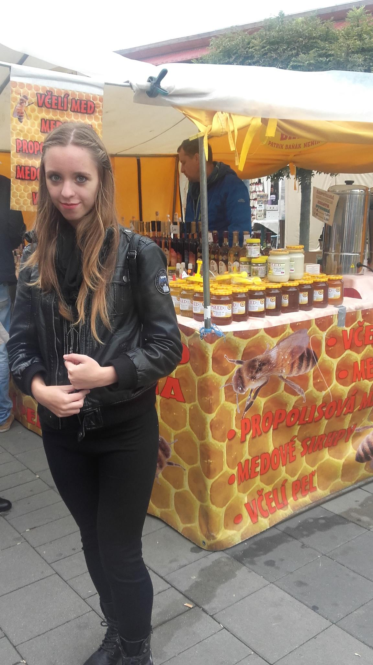
Honey vendors:
They came from Losonc
They prices are between 7 and 8€
Honey Vendors:
They came from Slovakia
Thier prices are between 6 and 9€
The Hungarian price is between
1500 and 2500 Forints

Slide 5
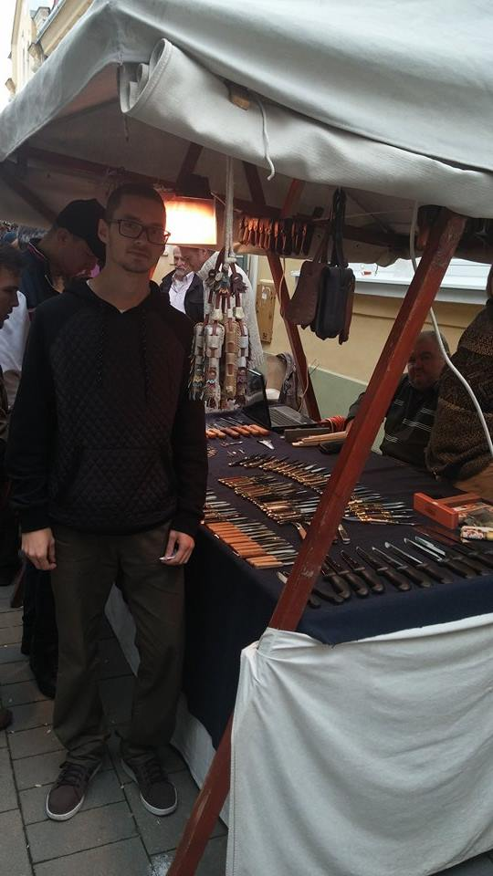
Knife vendors/makers:
They came from Sárosbogárd
The prices are between 6 and 60€
Knife vendors:
They came from Budapest
Their prices are between 5 and 45€
The Hungarian price is between
2000 and 25000 Forints

Slide 6
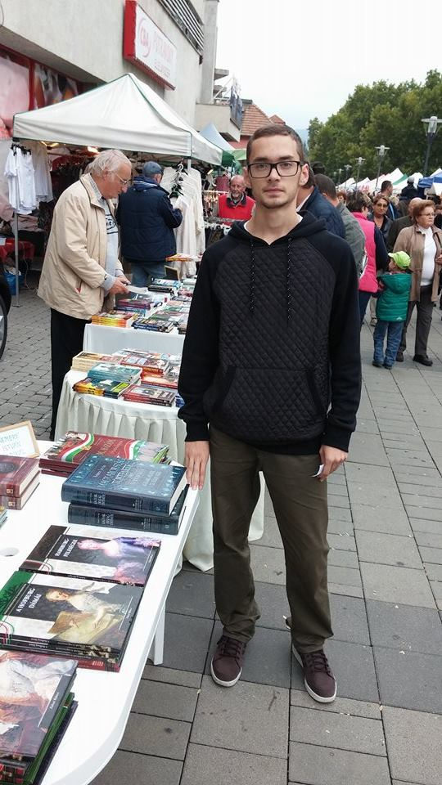
Booksellers:
They came from Gödöllő/Budapest
Their prices are between 2 and 15€
Booksellers:
They came from Esztergom
Prices are between 1 and 10€
The Hungarian price is between 500 and 7000 Forints

Slide 7
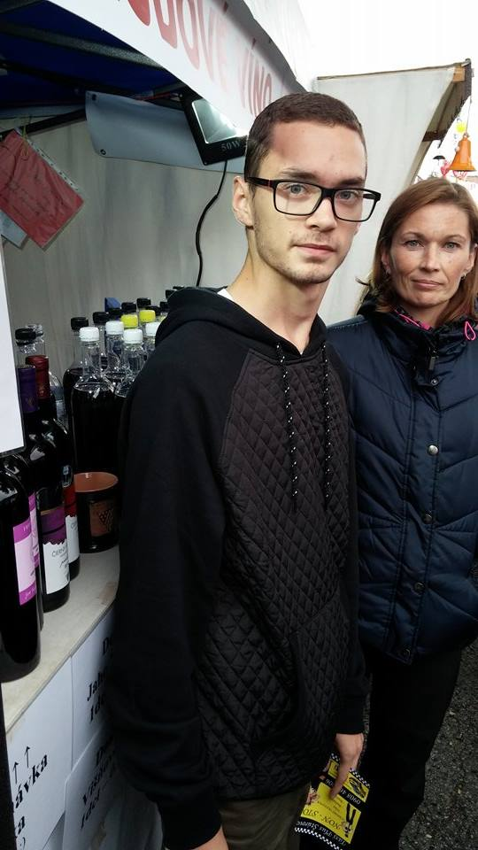
Wine merchants:
She came from Slovakia
The prices are between 0,6 and 5,50€
Wine merchants:
They came from Komárom
Their prices are between 1 and 6€
The Hungarian price is between 300 and 3000 Forints

Slide 8
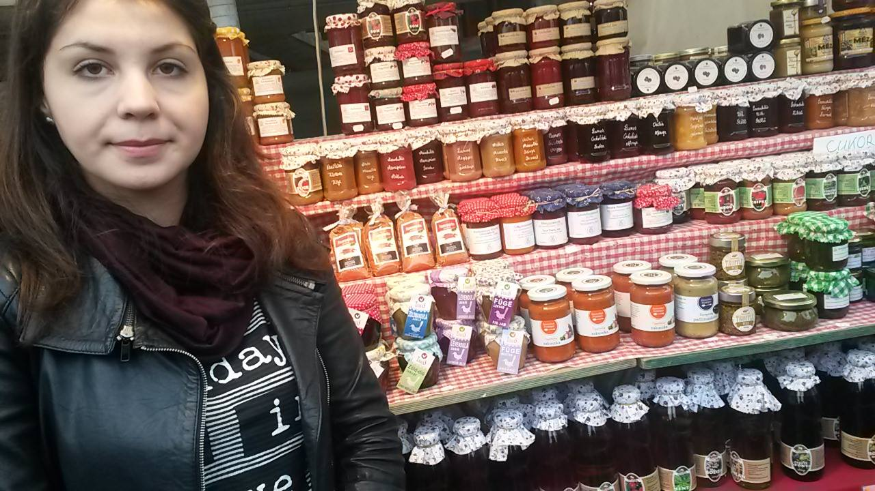
Jam vendors:
They came from Hungary
The prices are between 1 and 4€
Jam vendors:
They came from Tatabánya
The prices are between 0,50 and 4,50€
The Hungarian price is between
250 and 1500 Forints

Slide 9
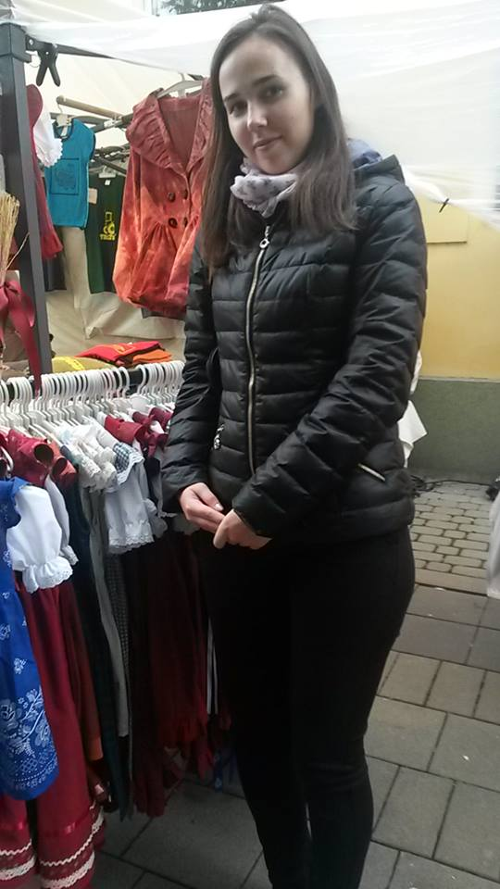
Clothing vendors:
They came from Esztergom
Their prices are between 5 and 35€
Clothing vendors:
They came from Párkány
Their prices are between 4 and 60€
The Hungarian price is between 2000 and 15000 Forints

Slide 10
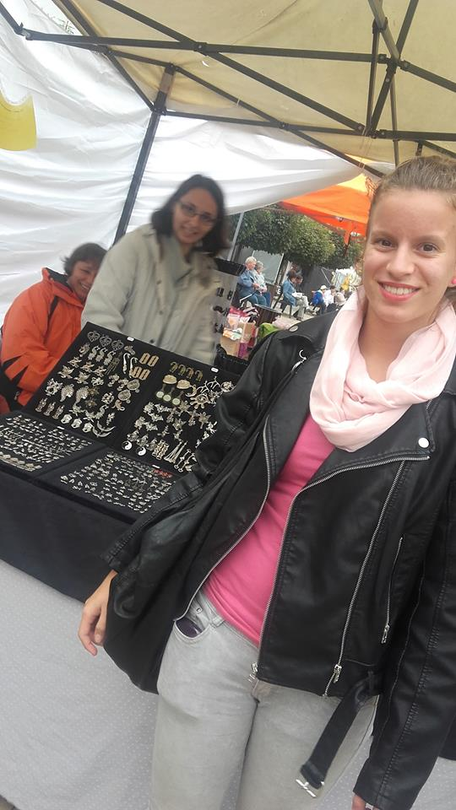
Three typical products in the region
Accessories:
There were many different accessories, some of them were made out of silver and gold
Most of them were very shiny and colourful

Slide 11
2. Honey
There were a lot of different types of honey
Most of them were home-made

Slide 12
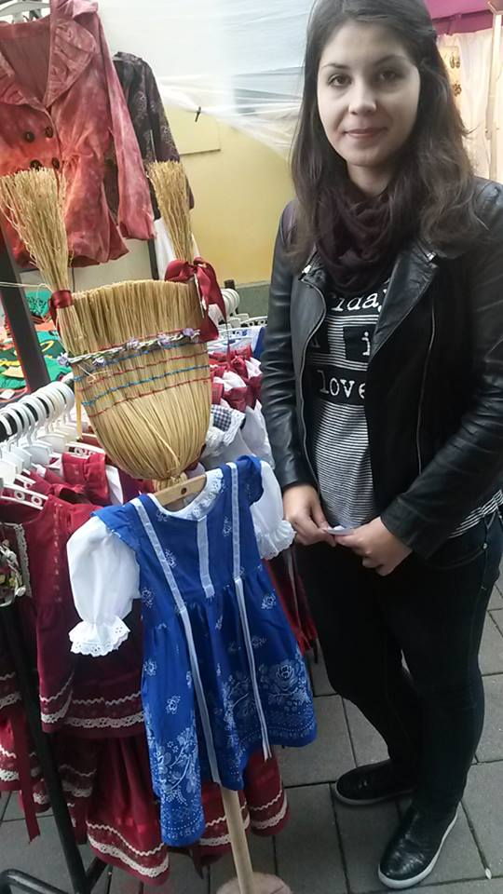
3. Clothing
Most of the clothing were traditional and for kids
There were a lot of different scarfs, the girls liked them very much

Slide 13
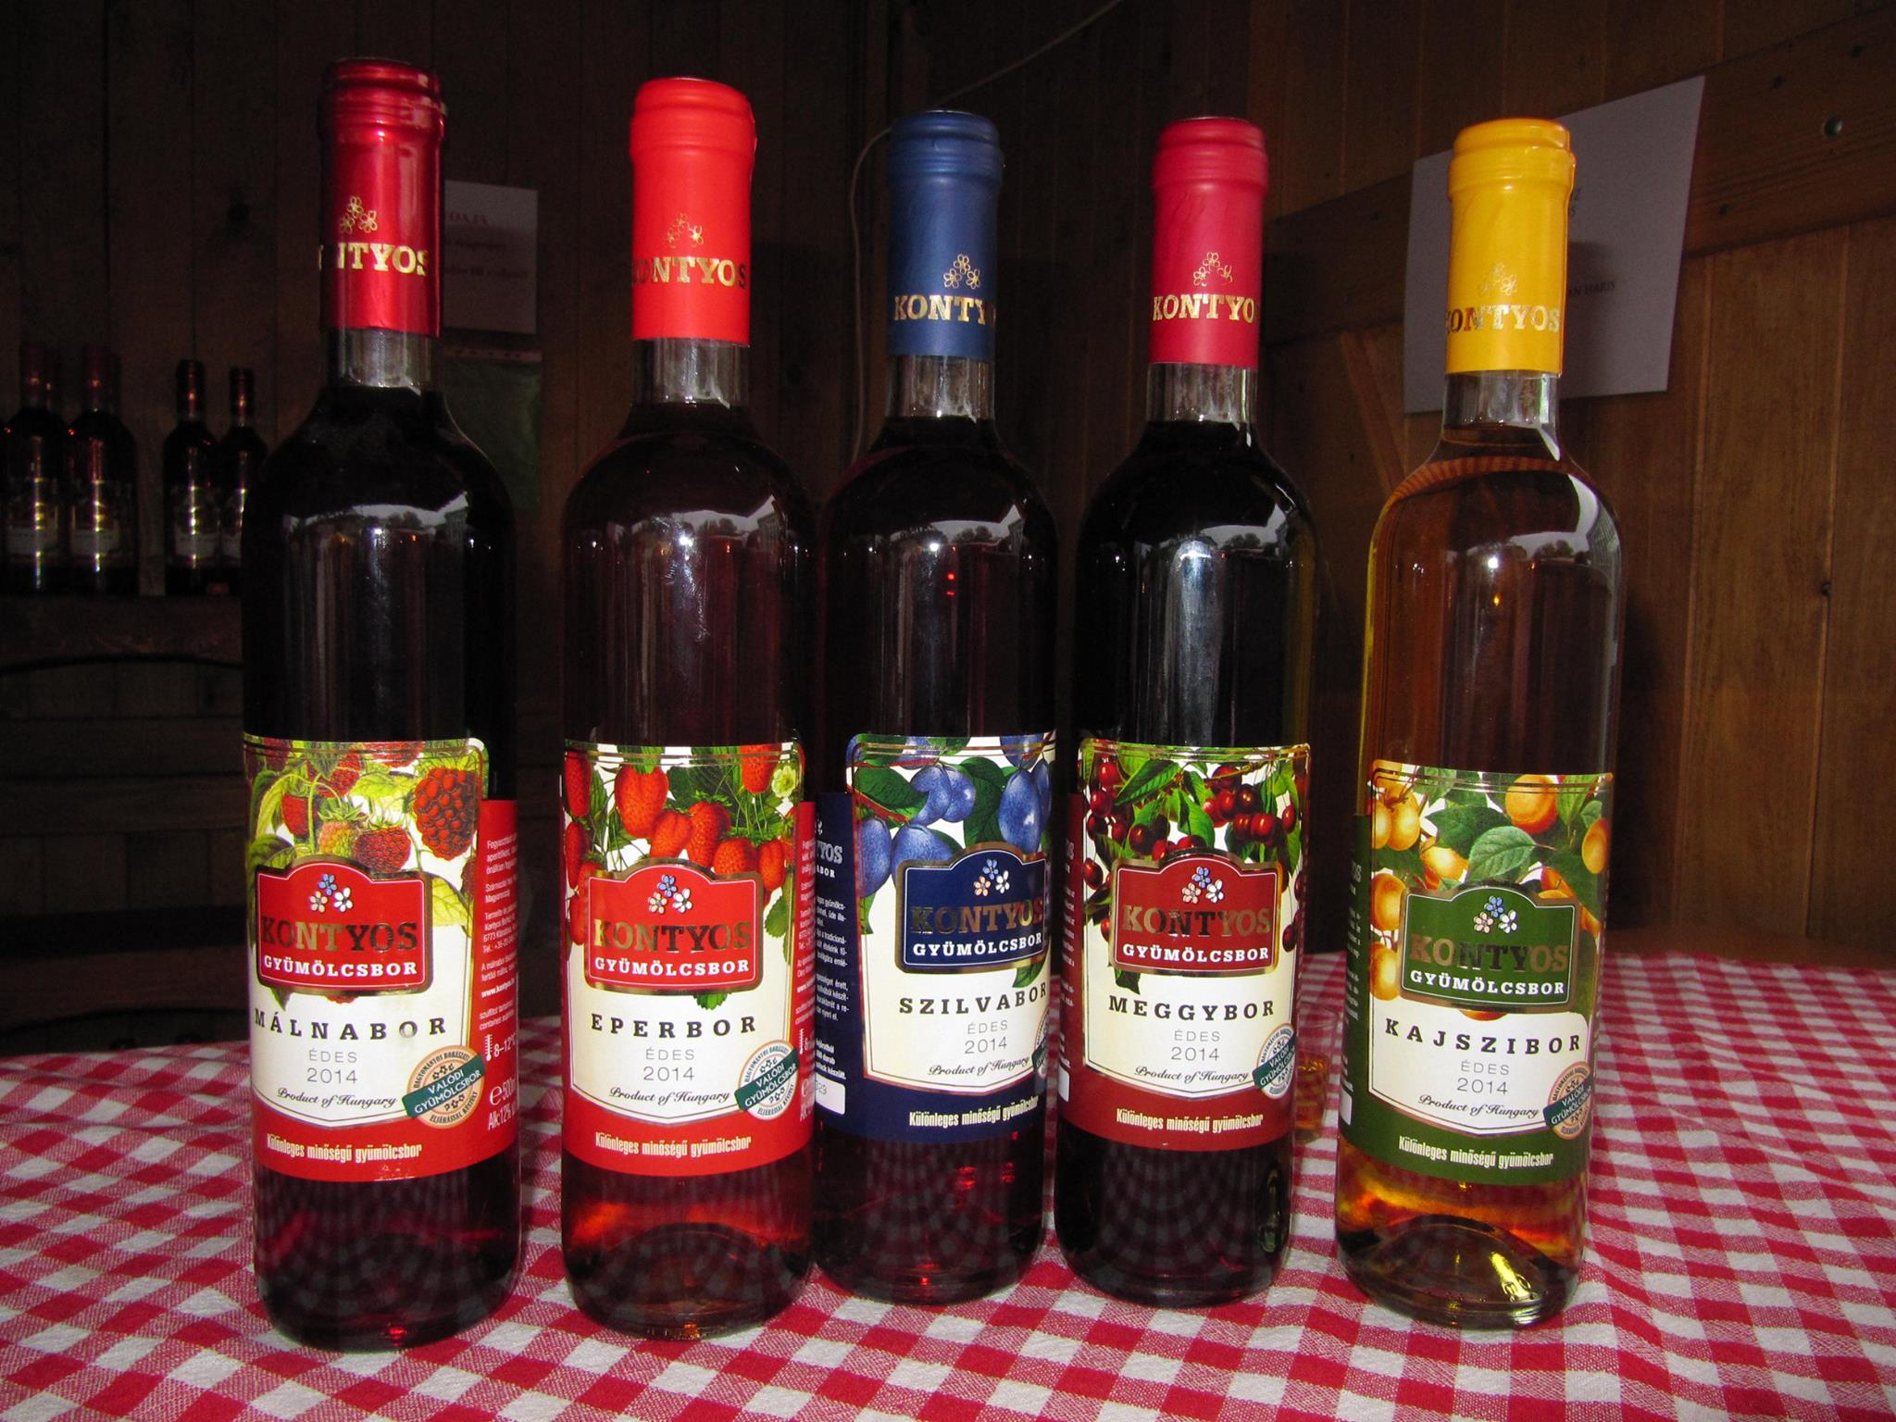
Region products
There weren’t any products from our region, but there were some Hungarian products like wine and books by Hungarian writers.

Slide 14
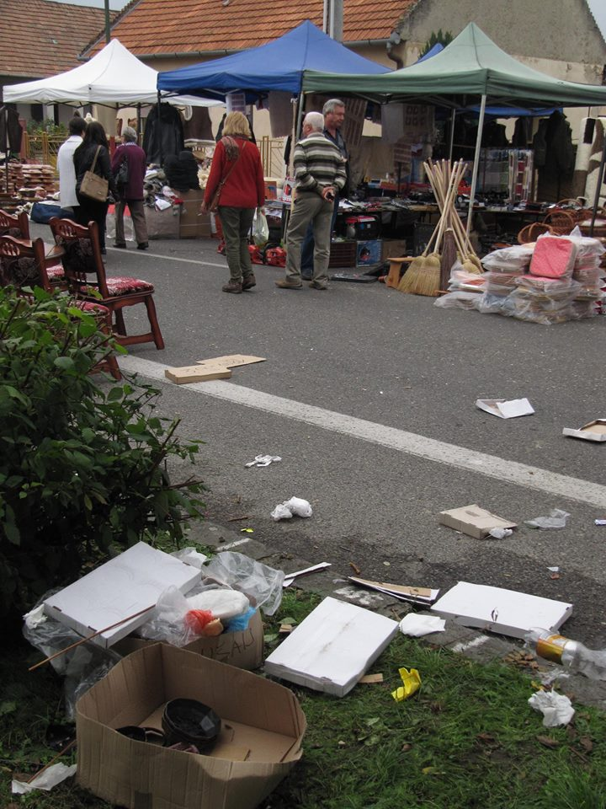
disadvantages of the fair
A fair has some disadvantages as well. It is visited by a lot of people, some of them do not pay attention to where they throw their litter. Not only the visitors but some of the sellers leave their unneccesary things behind after the end of the fair without caring about them. That’s why you can see a lot of rubbish in the streets, most oof it is packaging (paper, cardboard and plastic).

