Slide 1
Tábor

Slide 2
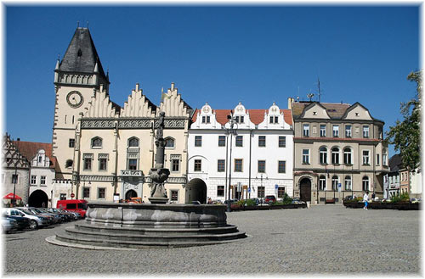
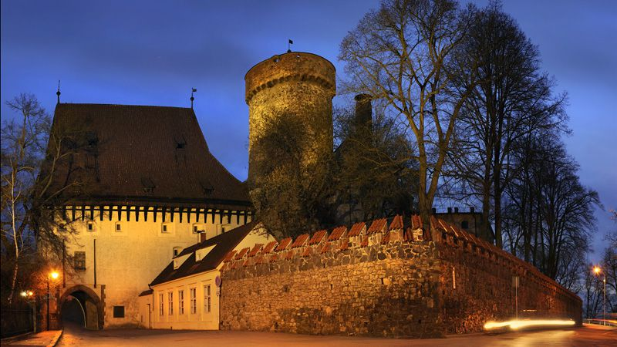
Tourists highlights
Tourists ride to our town especially over monument for example Žižkovo square, pond Jordán and castle Kotnov

Slide 3
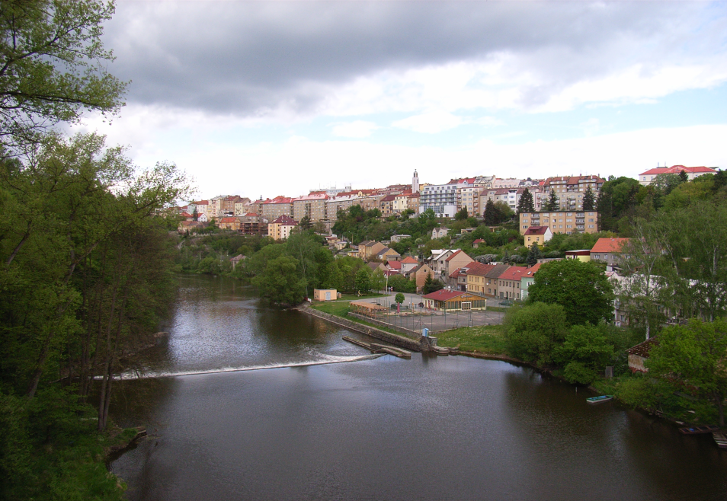
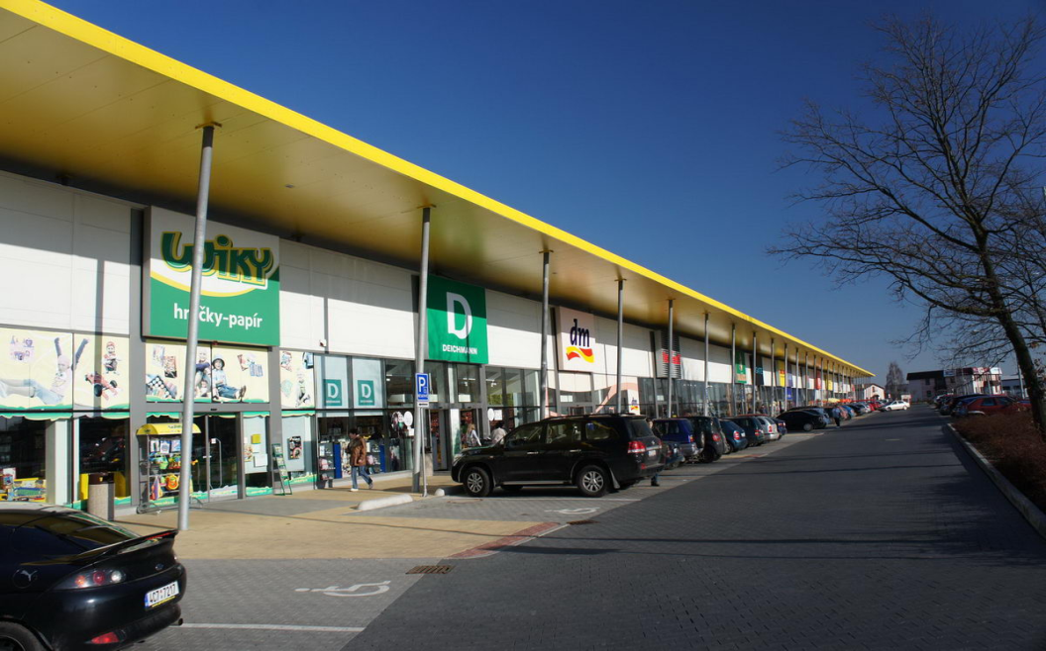
Tourists higlights
Who likes nature, can visit area Tabor or river Luznice
Who likes shopping, can visit shopping centre Dvorak or Stopshop

Slide 4
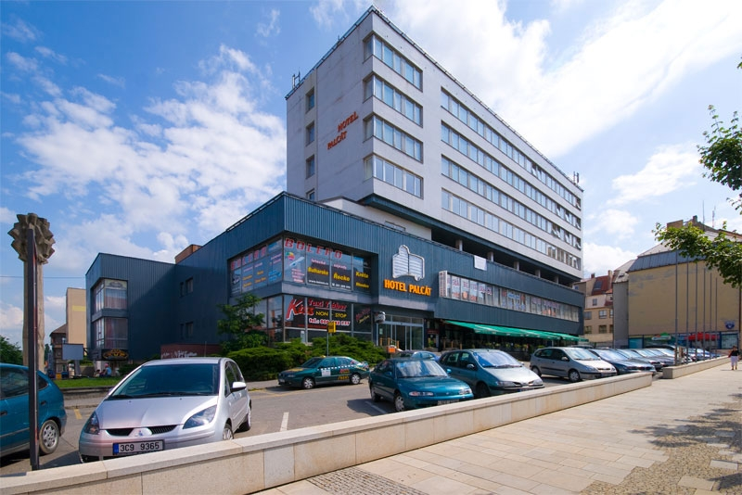
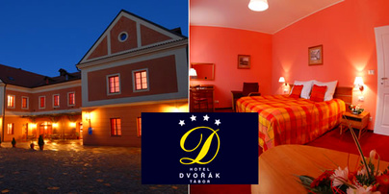
Availability of accommodation
In Tabor are not so many hotels
The largest hotels are for example hotel Dvorak or hotel Palcat with club and Chinese restaurant

Slide 5
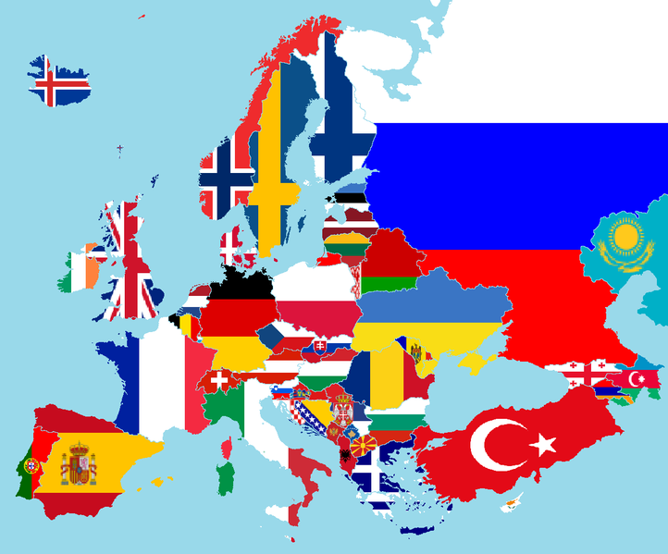
About tourists
Tourists come to Czech republic from Poland, Slovakia, Austria, Germany, China, Turkey, Arabia and Japan…

Slide 6
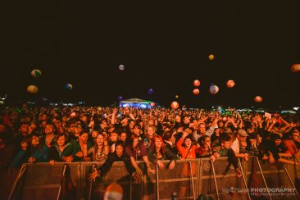
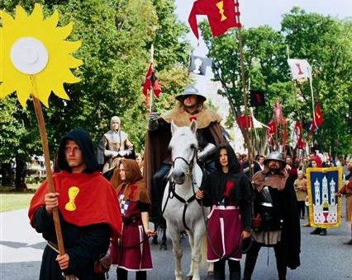
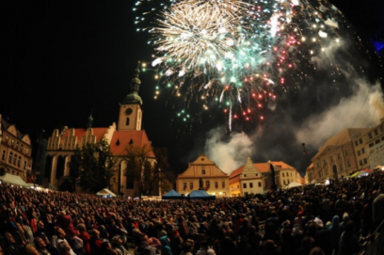
Measures to promote the region
Our special measures are :
Championship of cyclocross
Summer music festival Migty Sounds
Tabor‘s meeting
Evening run
Athletics cup

Slide 7
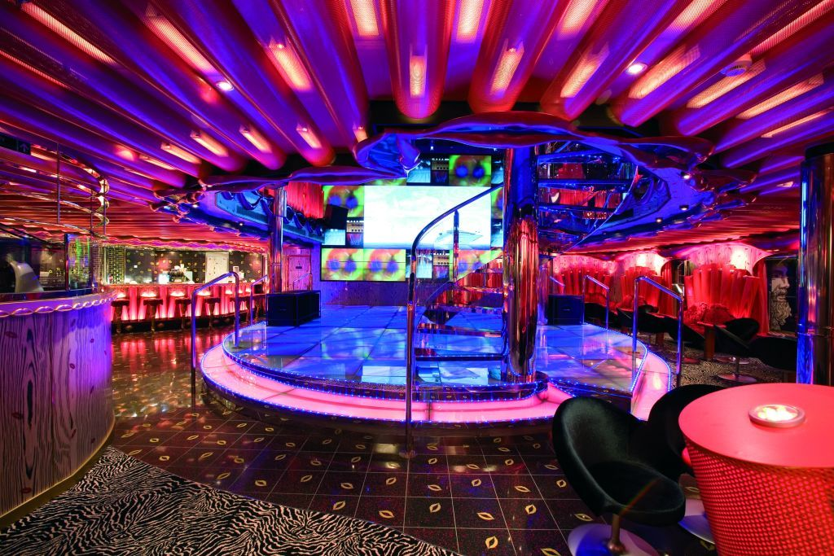
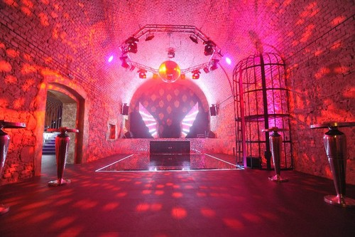
Facilities for young people
In Tabor we have got some dance clubs for example Milenium, NYX, Kotnov or Apollo

Slide 8
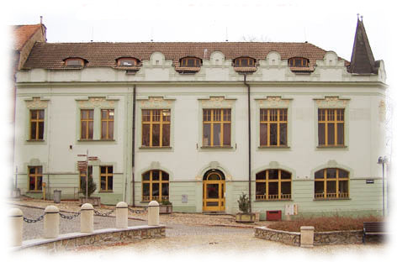
Facilities for young people
We have house for children and young people, where we can learn for some musical instruments, some languages or some sports

Slide 9
Thank you for your attention!

