Slide 1
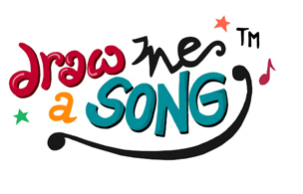
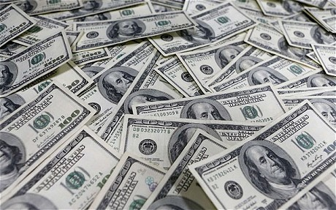
Let’s draw a song!
Put pictures on each slide to go with the lines
while listening to the song.
If I had a million dollars

Slide 2
1. If I had a 1,000,000 dollars
(If I had a 1,000,000 dollars)
I'd buy you a house
(I would buy you a house)

Slide 3
2. If I had a 1,000,000 dollars
(If I had a 1,000,000 dollars)
I'd buy you furniture for your house
(maybe a nice chesterfield or an ottoman)

Slide 4
3. If I had a 1,000,000 dollars
(If I had a 1,000,000 dollars)
I'd but you a K-car
(a nice reliant automobile)
If I had a 1,000,000 dollars,
I'd buy you love!

Slide 5
4. If I had a 1,000,000 dollars
I'd build a treefort in our yard
If I had a 1,000,000 dollars
You could help, it wouldn't be that hard.

Slide 6
5. If I had a 1,000,000 dollars
Maybe we could put a refrigerator in there
Wouldn't that be fabulous!
If I had a 1,000,000 dollars
(If I had a 1,000,000 dollars)
I'd buy you a fur coat
(but not a real fur coat that's cruel)

Slide 7
6. If I had a 1,000,000 dollars
(If I had a 1,000,000 dollars)
I'd buy you an exotic pet
(like a llama or an emu)

Slide 8
7. If I had a 1,000,000 dollars
(If I had a 1,000,000 dollars)
I'd but you John Merick's remains
(All them crazy elephant bones)
If I had a 1,000,000 dollars
I'd buy your love!

Slide 9
8. If I had a 1,000,000 dollars
We wouldn't have to walk to the store
If I had a 1,000,000 dollars
We'd take a limousine cause it costs more.
If I had a 1,000,000 dollars
we wouldn’t have to eat Kraft dinner

Slide 10
9. If I had a 1,000,000 dollars
(If I had a 1,000,000 dollars)
I'd buy you a green dress
( but not a real green dress that's cruel)
If I had a 1,000,000 dollars
(If I had a 1,000,000 dollars)
I'd but you some art
(A Picasso or a Garfunkel)

Slide 11
10. If I had a 1,000,000 dollars
(If I had a 1,000,000 dollars)
I'd buy you a monkey
(haven't you always wanted a monkey?)
If I had a 1,000,000 dollars
If I had a 1,000,000 dollars
If I had a 1,000,000 dollars
If I had a 1,000,000 dollars
I'd be RICH!

Slide 12
Now watch the video in Youtube. Yours is funnier, isn’t it? :)

