Slide 1
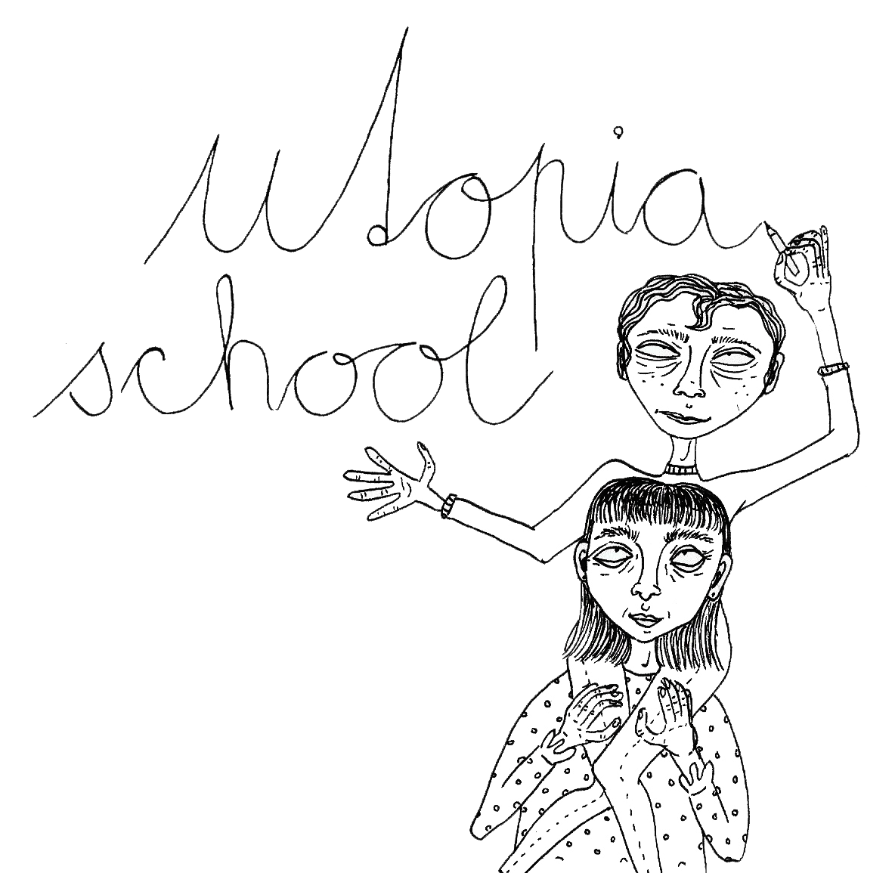
Ama Péčová

Slide 2
SCHOOL ADMINISTRATION
TEACHERS
polite
fair
always nice
patient
educated
helpful
smart
funny
accurate
tolerant
caring
open-minded
engaged
friendly

Slide 3
Our students are curious, polite, eager to learn, confident, hard-working and creative. They can vote on class rules which gives them a sense of ownership over their daily lives, not just passive acceptance of the rules.
Parents support both teachers and students, they are interested, but not too involved in school affairs either.

Slide 4
The school building is bright with plenty of windows and plants. Resting places are provided as well as free wi-fi. The building is spacious yet not too big, in the corridors gentle calming music is broadcast from an extensive web of speakers. There is a school canteen with tasty food and sparkling water for free. There is a library and newest technology at your disposal.
All classrooms are large and painted in bright colours. There are not more than 15 students in a class so that the teacher can attend to everyone's enquiries.

Slide 5
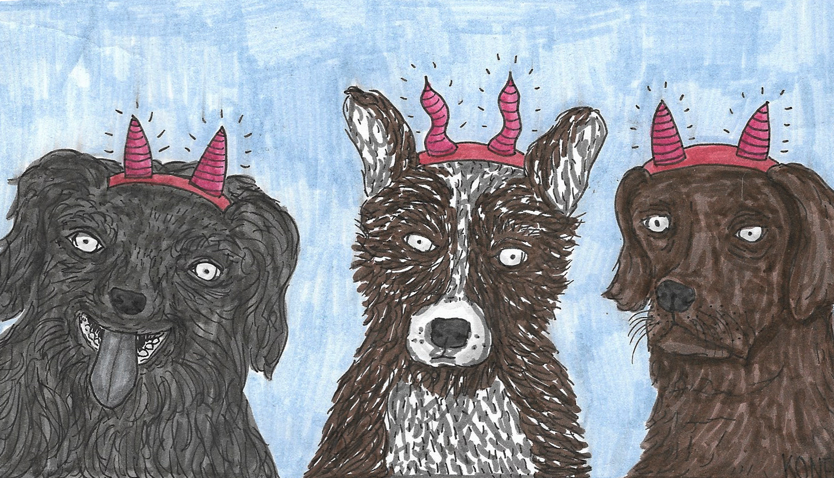
There is a very popular garden where you find chairs and tables, flowers and trees, a swing, a swimming pool and last but not least puppies to hug when you feel down.

Slide 6
There are 4 or 5 lessons a day and the school day never starts before 9 AM. There is a great choice of after lesson activities which are open for everyone but never obligatory. The most popular include painting, acting, music corner, sport and games and cinema club.
There are exams but no marks at all. There are not any homework assignments and no uniforms.

Slide 7
THANK
YOU

