Slide 1
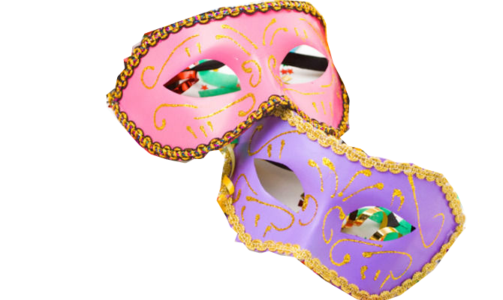
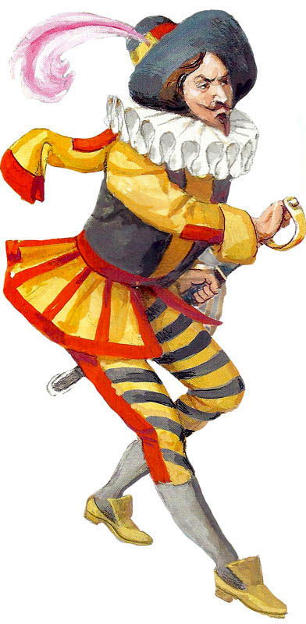
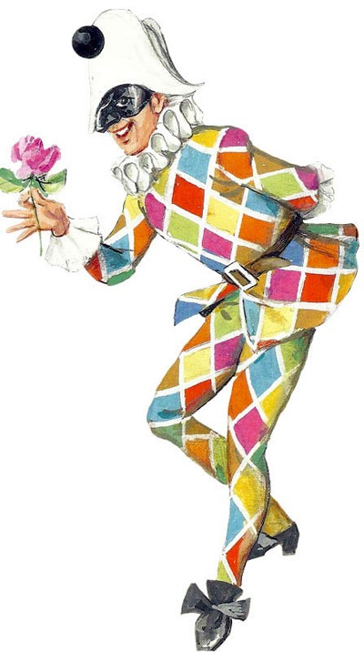
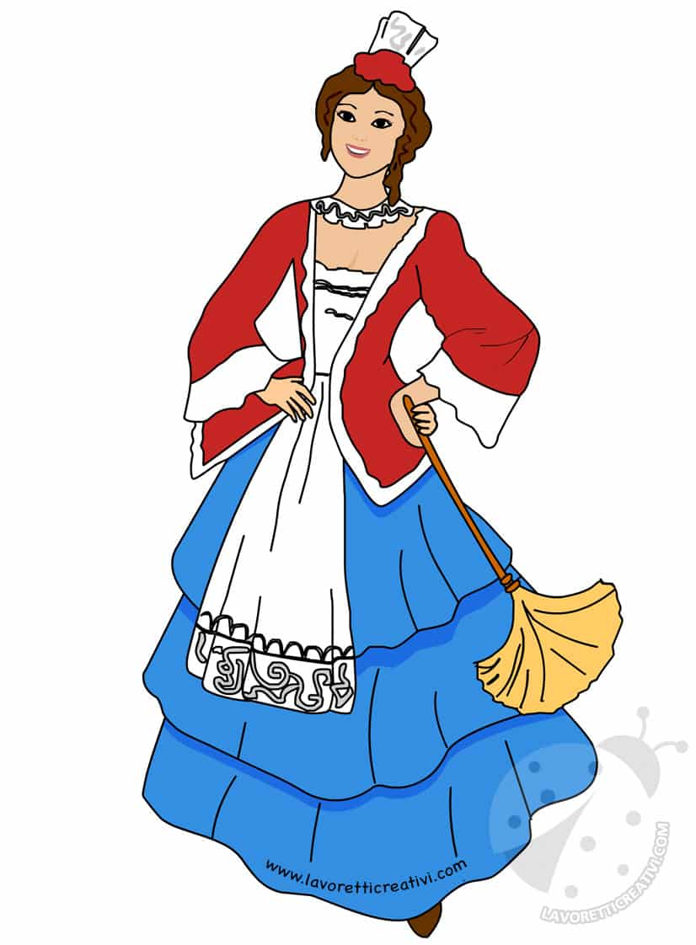
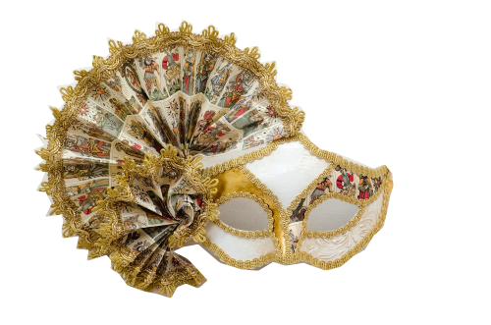
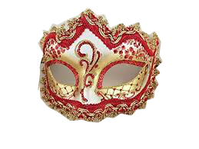
Maschere Italiane Italian Masks

Slide 2
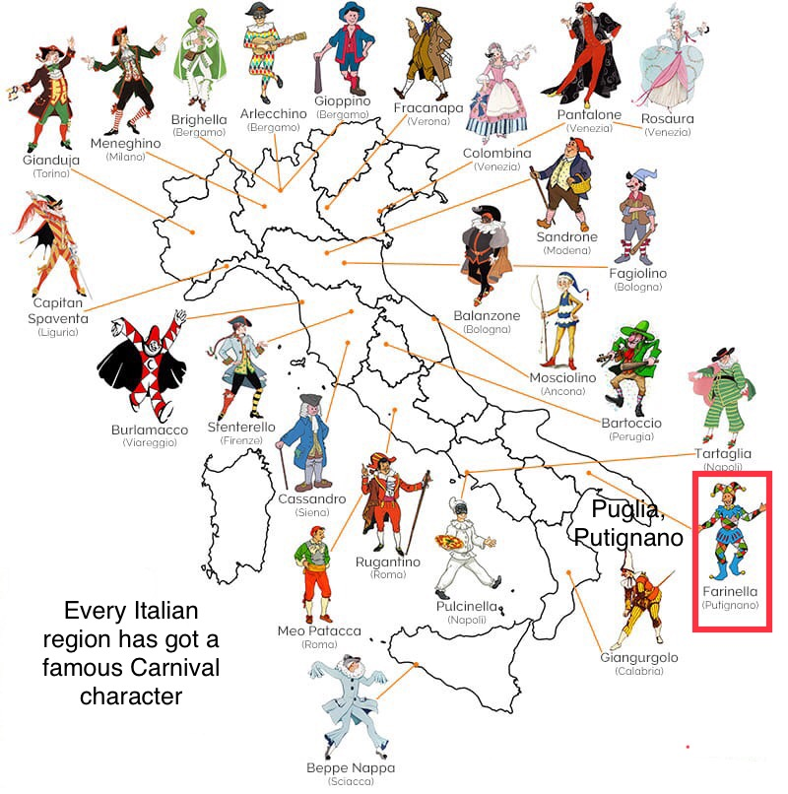

Slide 3
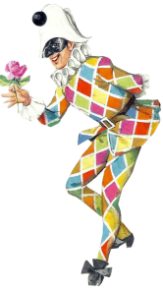
Arlecchino
Arlecchino, in English Harlequin, is the most famous and popular Carnival mask.
He was born in a poor neighborhood in Bergamo, in Lombardy in 16th century. He is a Zanni, a silly servant for noble families.
He is very lively and funny, at the beginning he was very silly, but then he became very clever and he loves making jokes to other people. He has a lot of imagination and fantasy!
Harlequin is characterized by his checked clothes. The legend about his costume tells that one day his teacher told the class that they had to wear a Carnival costume for the Carnival party at school but Harlequin's mum was poor and she couldn't buy a costume for his son and so his friends decided to give his mum some pieces of their costumes and the mum sew a coloured costume for Harlequin who was very happy!
Harlequin is always hungry and he often looks for food around the village. He carries a stick to use when he fights with other people after his jokes.

Slide 4
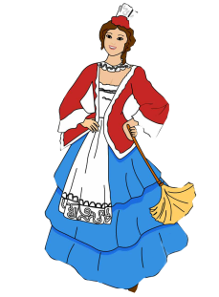
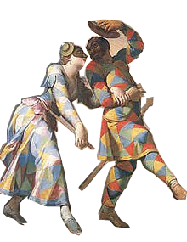
Colombina
Colombina has Venetian origins, she is a typical mask of Venetian carnival; she was born in 16thcentury. She is clever, pretty and lively. Colombina usually wears a white skirt, a pink top and a white apron. She is a servant, her mistress is Rosaura; Colombina always helps her in her relationships. Colombina is very mischievous, fascinating and wooed but she is faithful to her boyfriend Arlecchino; she often plays his girlfriend or wife and she often takes the name of Arlecchina and wears his typical costume.
Colombina is courted by Pantalone, Rosaura’s dad. She has other names: Diamantina, Marinetta, Franceschetta, Violetta, Corallina or Bettina.

Slide 5
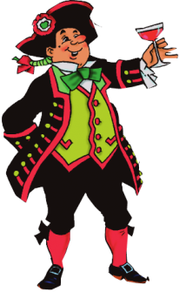
Gianduja
Gianduja is a popular mask of Turin. He was born at the end of the 17th century from the fantasy of two puppeteers.
His name derives from the name Gioann da Doja, or Giovanni del boccale ( John with the mug).
He is the mask of Piedmont and in the period of Carnival he is accompanied by other masks of other cities like Balanzone from Bologna, Pantalone from Venice and Pulcinella from Naples.

Slide 6
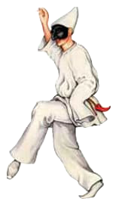
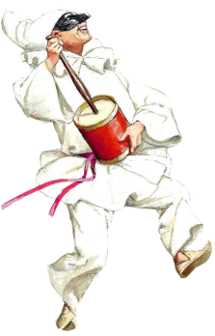
Pulcinella
Pulcinella was born in Naples, in the South of Italy, during the second half of the XVI century. It was invented by the actor Silvio Fiorillo, for the Commedia dell’ Arte. This mask, however, recalls some characters of Latin fables. The name Pulcinella may be associated to ‘pulcinello’, a little chick, which seems to prove the Roman origin of Pulcinella Pulcinella wears a large white shirt and white trousers, a black belt on his waist, black shoes, a white hood and a black mask covering his face. He has a curved nose and some wrinkles on his forehead that give him a funny expression. Pulcinella is a lazy and sneaky servant, who walks in an awkward way, gesticulates excessively and tends to show his happiness by dancing, hopping and shouting. He likes living life day by day, exploiting every situation, often pretending to be poor, or rich or a thief, depending on what his aims are. He friendly, funny, talkative, melancholic and very unreliable.

Slide 7
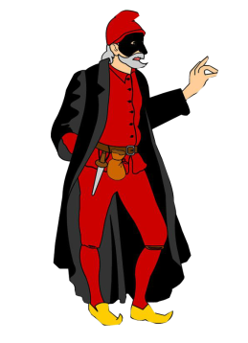
Pantalone
Pantalone is an important character of commedia dell'arte (an early form of theatre that was born in Italy and became popular from the 16th to the 18th century). This mask was born in Venice in the middle of the 16th century and it represents the typical old, lustful merchant of the time.
Pantolone wears a red suit and a Greek-style hat, a pair of breeches with stockings and a black jacket. The costume often includes also a coin purse.
He wears a mask with a long and hooked nose and big eyebrows; he has a moustache, and a long and pointy beard.
People say that our term “Pantalone”, which means “trousers”, derives from this character. Pantalone also means “money” because of his greed.

Slide 8
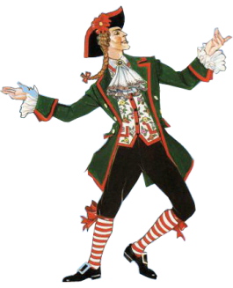
Meneghino
Meneghino is a fictional character from Teatro Milanese and later became the mask of Commedia dell'arte. Its name means ‘ citizien of Milan’ and he is one of the most famous symbols of the city .
Meneghino wears a dark green jacket with red hemming and buttons; a red-bordered waistcoat with flowers, dark short breeches, red striped stockings and black shoes with buckles
He doesn't wear a mask. It has a dark black tail and a black felt three-pointed hat, edged in red .

Slide 9
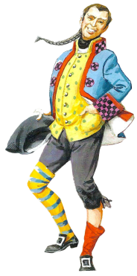
Stenterello
Stenterello is a typical Tuscan mask that was probably invented at the end of the1700s by the actor Luigi del Buono.
The mask is short, thin, without teeth and with a long nose. He is very nice, scary, cunning, talkative and messy.
Stenterello always wears a sock of one color and the other of another, the blue jacket with red and black checkered lapels, short and tight knee-length trousers, a dotted waistcoat, a wig with a pigtail and a boat-shaped cap.
This mask, like all the Tuscans, is very generous and entertains people without using bad words or double meanings.

Slide 10
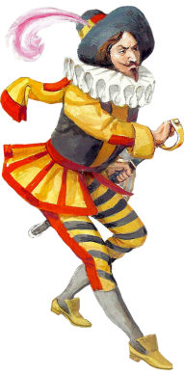
Capitan Spaventa
Captain Spaventa of Vall'Inferna is a Ligurian mask of the Art commedy created by the actor Francesco Andreini (1548-1624).
He rappresents the braggart and blowhard soldier.
He tells about incredible stories .
A faithful partner of Captain Spaventa is a very big sword that he uses rarely: he prefers to fight with his tongue.

Slide 11
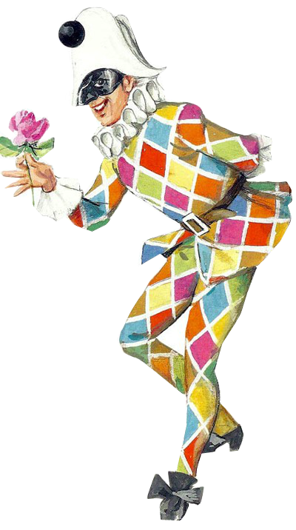

Slide 12
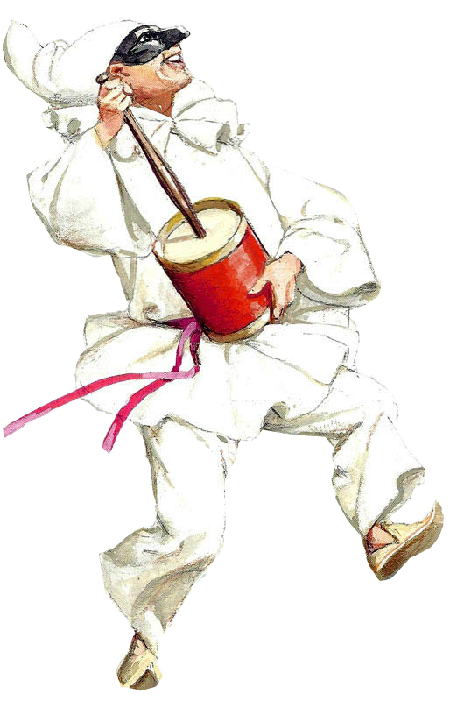

Slide 13
