Slide 1
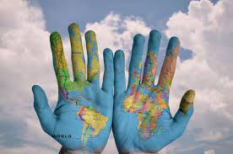
CHANGE THE WORLD IS IN OUR HANDS

