Slide 1
Media Literacy
alphabet for the 21st century
Ana Dokler, editor in chief of website medijskapismenost.hr

Slide 2
Media Literacy
given that the media is embedded in all aspects of human life today, it is considered one of the key skills in the 21st century
it needs to be developed in children from the moment they start using the media
the subject of lifelong learning, as the media is constantly evolving

Slide 3
Definition of Media Literacy
the ability to understand,
analyze,
evaluate
and create media messages in a wide variety of forms
Aufderheide, A Report of the National Leadership Conference on Media, 1992.

Slide 4
all the technical, cognitive, social, civic and creative capacities that enable citizens to access and interact with the media
all these capacities enable citizens to participate in economic, social and cultural aspects of society, but also to actively participate in democratic processes
includes all types of media (television, radio, print, digital information networks, social media platforms, etc.) and all types of channels

Slide 5
Stakeholder cooperation
“Media education will be most effective when parents, teachers, media personnel and decision-makers all acknowledge they have a role to play in developing greater critical awareness among listeners, viewers and readers. The greater integration of educational and communications systems would undoubtedly be an
important step towards more effective education.”
UNESCO, Grunwald Declaration on Media Education, 1982.

Slide 8
Media Literacy in Croatia
one of the few EU countries that does not have a national media literacy policy
education system: Media culture within the Croatian language so far; in the new curriculum - subject area Culture and media in Croatian language, cross-curricular topic Use of ICT, etc. + extracurricular activities
civil society organizations (DKMK, GONG, CSI, HFS ...) - media literacy projects, workshops, educations, clubs...
AEM and UNICEF

Slide 9
Agency for Electronic Media and UNICEF partnership
research on children's media habits in 2014 and 2016; and on media literacy in Croatia in 2018 and 2019
“Let's Choose What We Watch” campaign, 2015
Recommendations for the Protection of Children and the Safe Use of Electronic Media, 2016
portal medijskapismenost.hr, 2016
Media Literacy Days, 2018 and 2019
+ AEM: Co-financing media literacy projects (from 2015); participation in the EU Kids Online project

Slide 11
The goals of portal medijskapismenost.hr
to empower parents and teachers in teaching children and young people how to critically consume media content, or how to analyze, evaluate and critically reflect on media messages
encourage conversations about the media and the safe use of technology

Slide 12
Content of portal
examples of good practice from Croatian schools, kindergartens and NGOs
research findings on the impact of media on children and young people
recommendations for parents
teaching and other materials suitable for teaching children about various aspects of media literacy

Slide 14
Media Literacy Days
organizers: Agency for Electronic Media and UNICEF Office for Croatia, in cooperation with numerous partners and under the auspices of by the Ministry of Culture and the Ministry of Science and Education
objective: enable learning on media literacy to as many children and adults as possible in Croatia
a platform for various activities and events aimed at promoting media literacy, organized by various stakeholders
support for educators and teachers by developing educational materials for media education
1st time in April 2018, 2nd time in April 2019

Slide 16
Worskops and lectures

Slide 17
“Children meet the media”

Slide 18
Publications

Slide 19
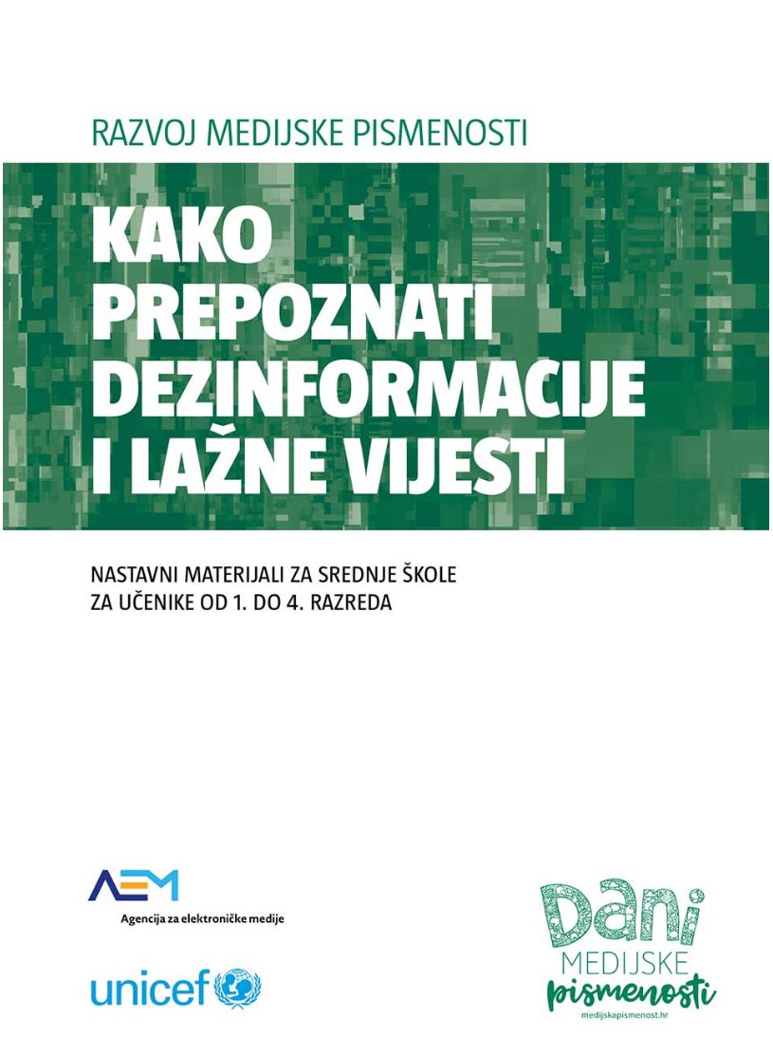
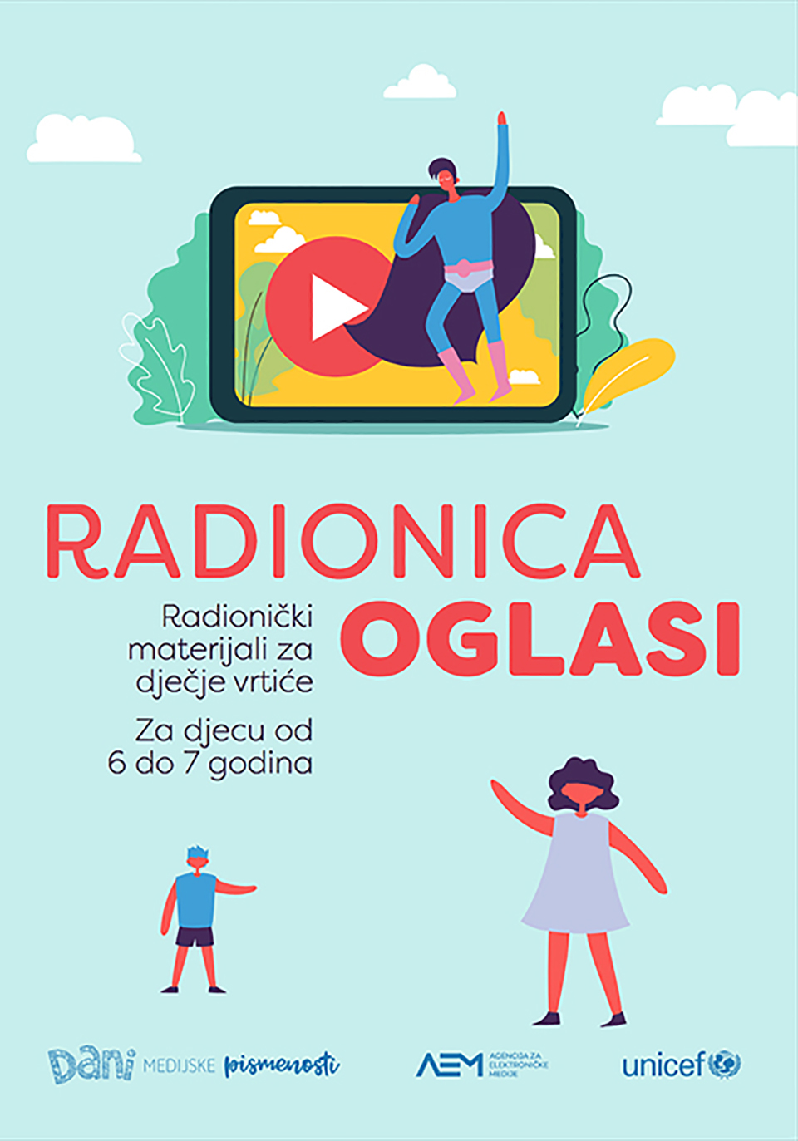
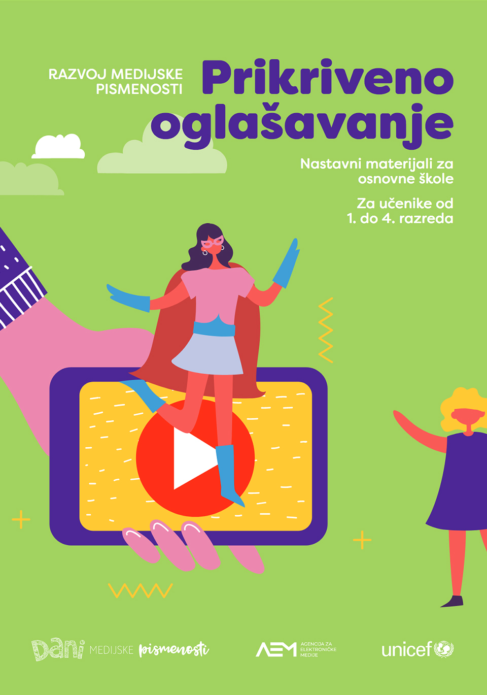
Educational materials

Slide 20
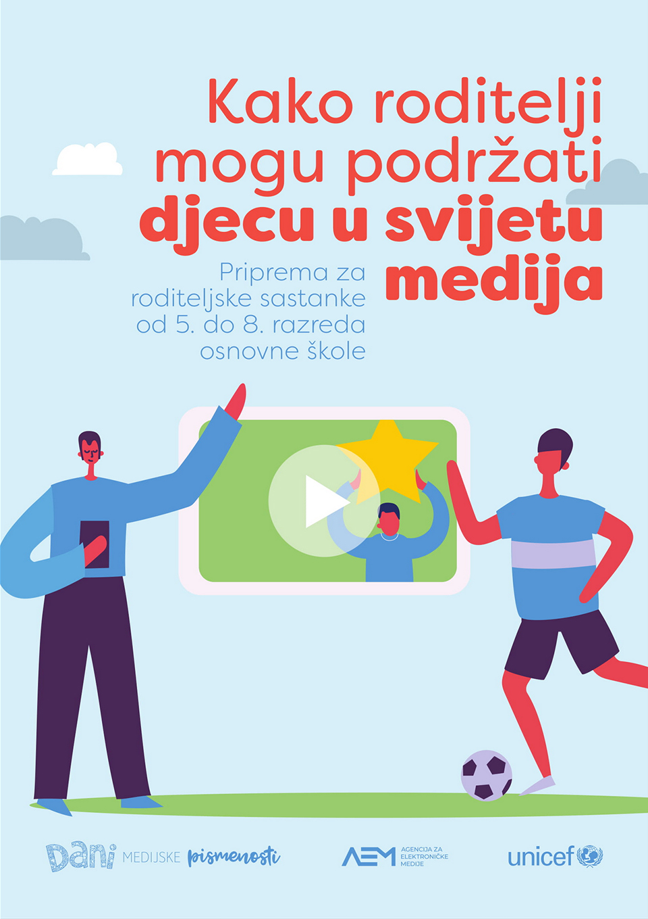
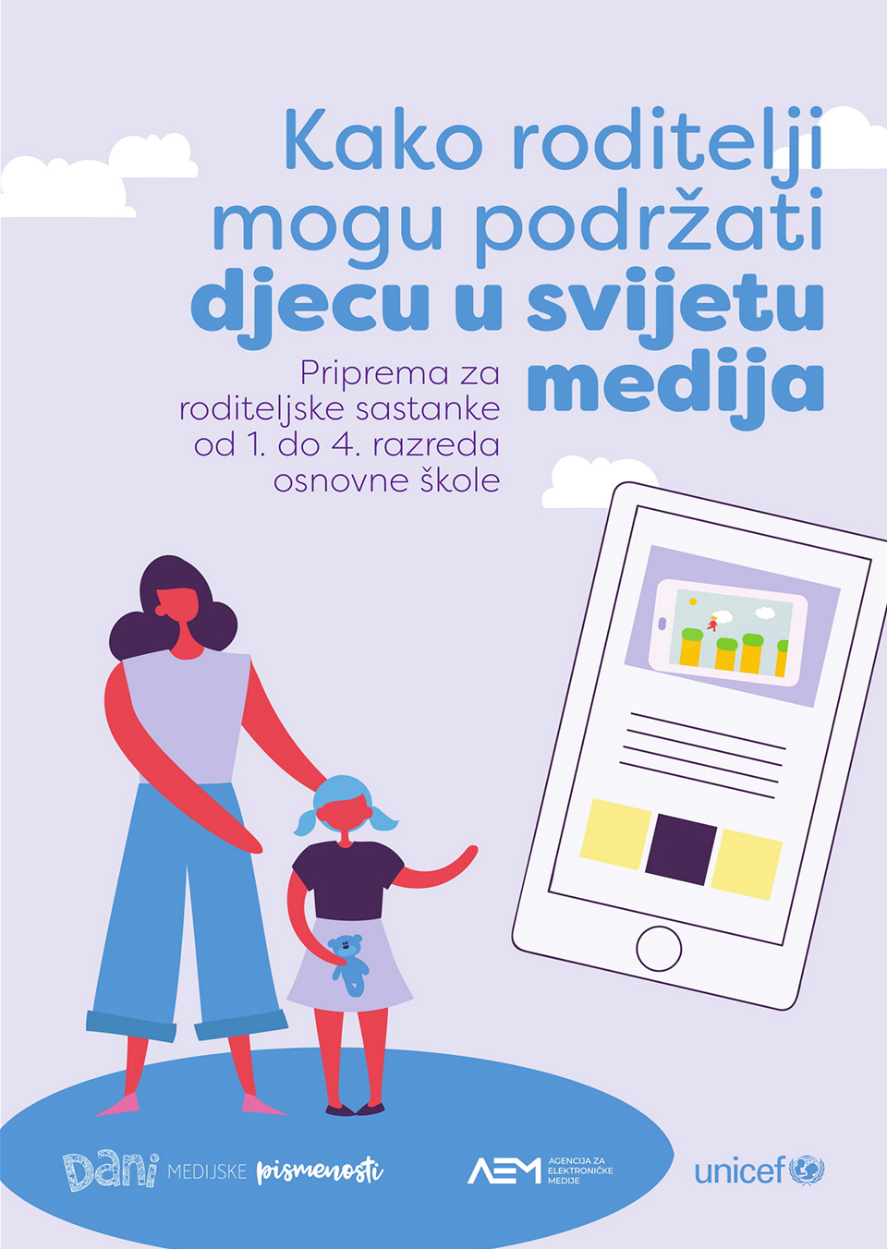
Materials for parents meetings

Slide 21
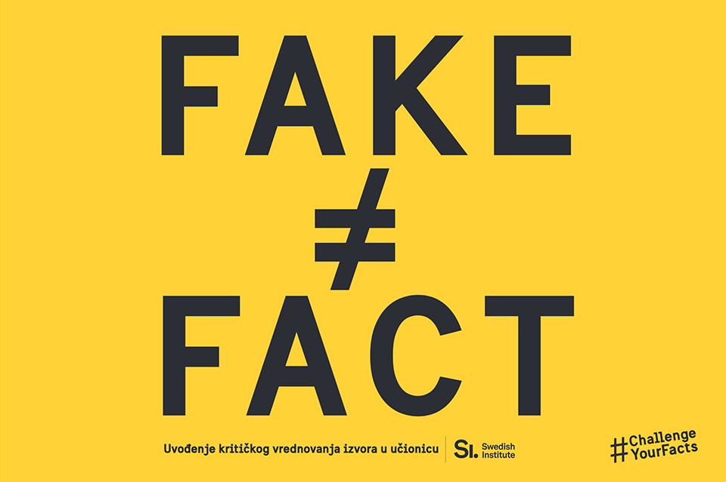
Translated materials

Slide 22
Critical Media Literacy
critical thinking is one of the key skills in Media Literacy - analysis and evaluation skills necessary for interpreting and understanding media content
necessary for informed decision making and active citizenship
it’s not the same as criticizing, it’s about asking the right questions

Slide 23
Questions for analysis
Media Education Lab

Slide 24
Fake or Fact: Uvođenje kritičkog vrednovanja izvora u učionice

Slide 25
Creating media content
“Media literate persons should be able to use the media creatively to express and communicate ideas, information and opinions”- The European Charter for Media Literacy
“Learning how to create content helps a person analyze the content created by others.” - Sonia Livigstone
important for active citizenship, participation in society
classroom assignments, projects, homework: short film, photography, advertisement, poster, leaflet, film criticis…
extracurricular activities: media, photography, film, radio, journalism groups…

Slide 26
Inspiration: BBC Young Reporters
competition for young people from 11 to 18 years
opportunity to tell their story via TV, radio, internet and social media with the help of BBC journalists and producers
topics: "My Life" and "Our World”
the best stories are published on BBC channels
resources (videos) for learning about media literacy, information verification and media creation: https://www.bbc.co.uk/academy/en/collections/youngreporter
lesson on writing news: https://www.youtube.com/watch?v=ypZG5NrhArQ

