Slide 1
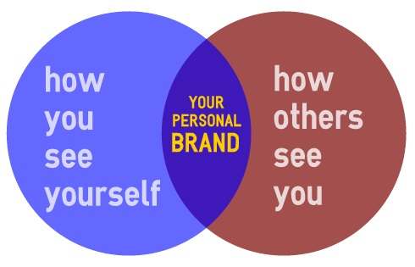
Personal Branding
Marketing yourself

Slide 2
personal branding
Your personal brand is how you appear to the world
A strong brand is preferable to one that is unintresting or unpolished

Slide 3
personal branding
Once people know who you are and begin to identify you with a specific area of understanding or expertise, you'll be well on your way to becoming the go-to person in your niche or industry.

Slide 4
personal branding
The question is, how do you become more recognized?
How do you build your authority and your following?
5 steps to build your brand

Slide 5
1. Understand and be your authentic self
Your brand should be a reflection of who you are.
Do you know what you believe?
What you stand for?
What your strengths and weaknesses are?

Slide 6
1. Understand and be your authentic self
developing an understanding of your true self
sharing that with the world.

Slide 7
2. Speaking engagements
Speak from a place of knowledge and power.
Show that you are confident.
Thank others for sharing their views, and if the points they raised were legitimate, determine how you can improve and do better next time.

Slide 8
3. Write thought leadership articles and participate in interviews
As with speaking engagements, landing the best opportunities takes time and effort, but if you remain open to what comes your way, pretty soon you'll be showing up everywhere.

Slide 9
Build your online presence
Do you have social media profiles?
If so, are they fully fleshed out with all of your information?
Do they present you in the best light possible, and make you look professional?

Slide 10
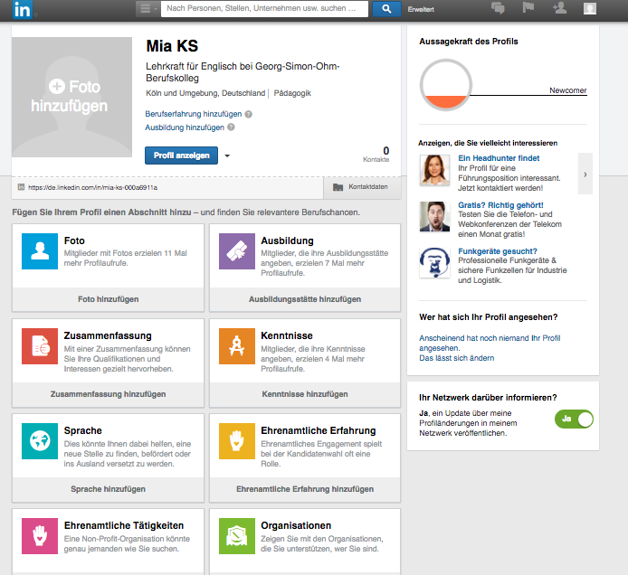
Build your online presence

Slide 11
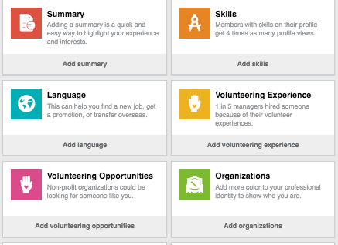

Slide 12
5. Remain a student of your industry
things are changing at a faster rate than ever before, and you have to stay up-to-date with the latest changes and trends
It also pays to learn new things, develop new skills, and to expand your knowledge

Slide 13
Things to keep in mind
Be proud of things you have accomplished.
Be open about your shortcomings and weaknesses.
Be authentic.
Look forwards.

Slide 14
Questions?

