Slide 1
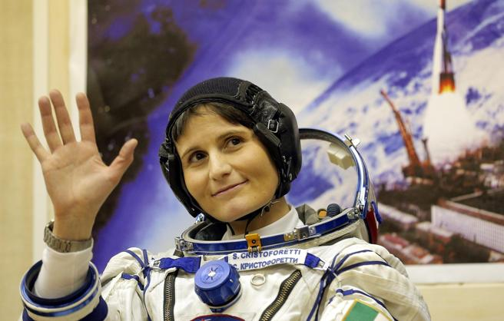
Samantha Cristoforetti
«Many times an obstacle is only a message that life gives you. You have to find another way, but it doesn't mean you can't get to your destination.»

Slide 2
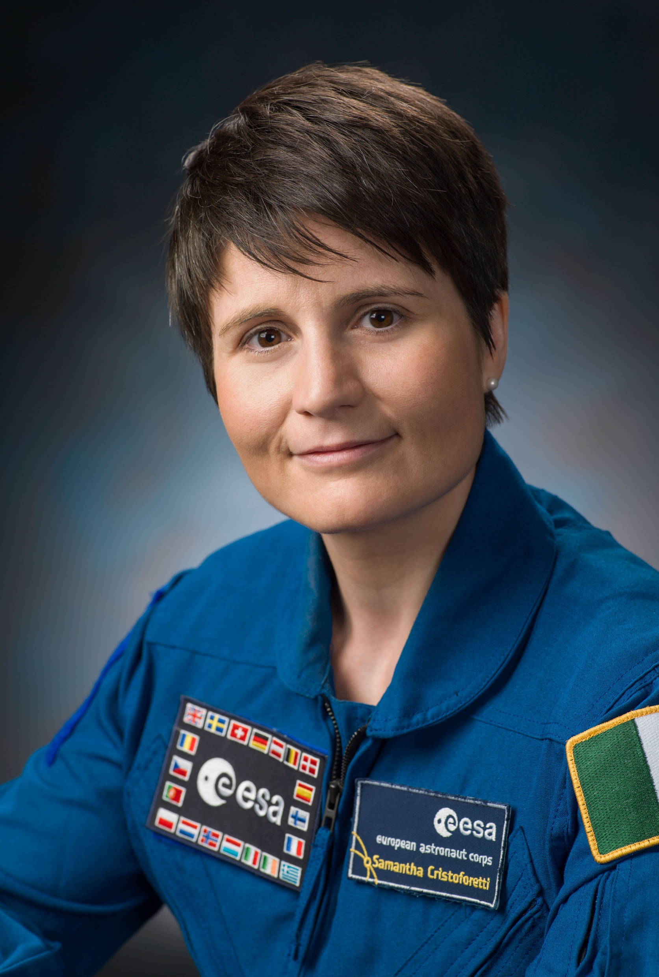
Biography
Samantha Cristoforetti is an Italian European Space Agency astronaut, Italian Air Force pilot and engineer, fluent in Italian, English, German, French and Russian. She is the first Italian woman in space and, with her199 days and 16hours and 42 minutes, she holds the European and female record of permanence in space in a single flight. That’s why her nickname is ASTROSAMANTHA. Cristoforetti was born in Milan in 1977. She spent her childhood in Malè, in Val di Sole, Trentino, Italy. When she was 18, she took a US foreign exchange program and attended Space Camp. She studied in Bolzano and Trento and graduated from the Technical University of Munich with a degree in Mechanical Engineering, with specialisations in aerospace propulsion and lightweight . She studied at the École nationale supérieure de l'aéronautique et de l'espace in Toulouse, France, working on an experimental project in aerodynamics. She wrote her master’s thesis in solid rocket propellants during a 10-month research stay at the Mendeleev University of Chemical Technologies in Moscow, Russia. She also graduated in Aeronautics Sciences at the Italian Accademia Aeronautica in Pozzuoli, in 2005, becoming one of the first women to be a lieutenant and fighter pilot in the Italian Air Force. Following her graduation in 2005, she attended the Euro-NATO Joint Jet Pilot Training program at Sheppard Air Force Base in the United States, where she earned her fighter pilot wings in 2006. Upon her return to Italy she was assigned to fly the AM-X ground attack fighter at the 51st Bomber Wing in Istrana.

Slide 3
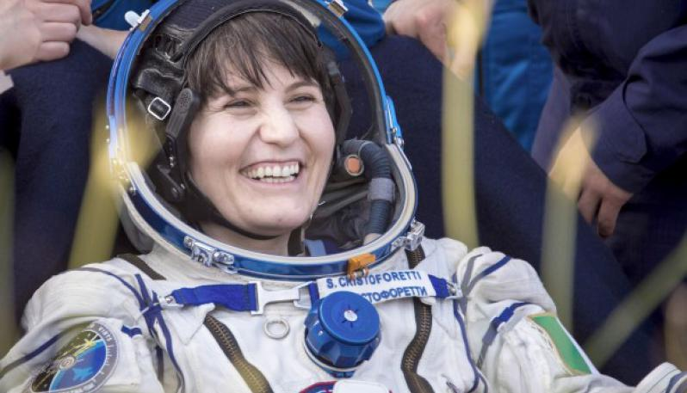
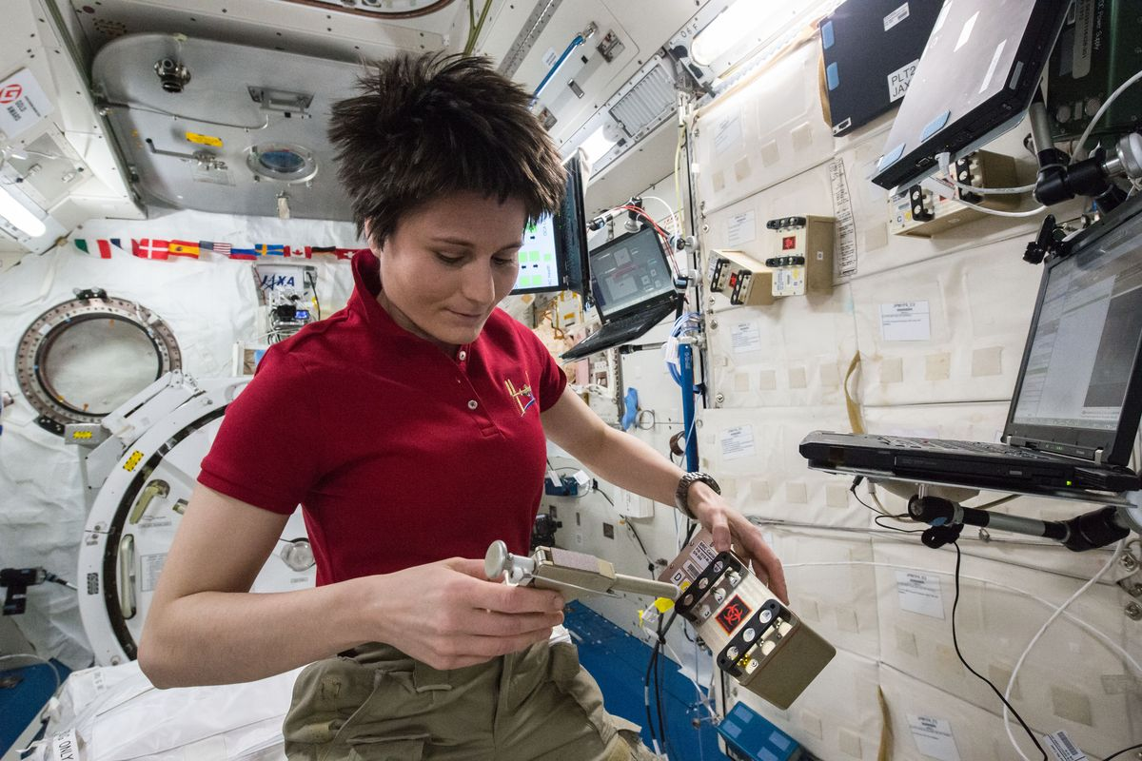
Samantha was selected as an ESA astronaut in May 2009, resulting among the best six candidates, in a selection in which about 8500 people participate. She joined ESA in September 2009 and completed her basic astronaut training in November 2010. She was then assigned to the role of ESA reserve astronaut, which allowed her to earn her initial qualifications in EVA and robotics, as well as the certification as flight engineer of the Russian spacecraft Soyuz. On July 3, 2012, the European Space Agency announced that Cristoforetti was set for a long-duration mission to the ISS in 2014. The training was followed very much online thanks to a daily diary starting from 500 days before departure, which was initially set in December 2014, held by the astronaut herself in English and translated almost instantly into Italian, French and Spanish. Samantha promised:”I will take virtually anyone who wants to take part in this journey into space."

Slide 4
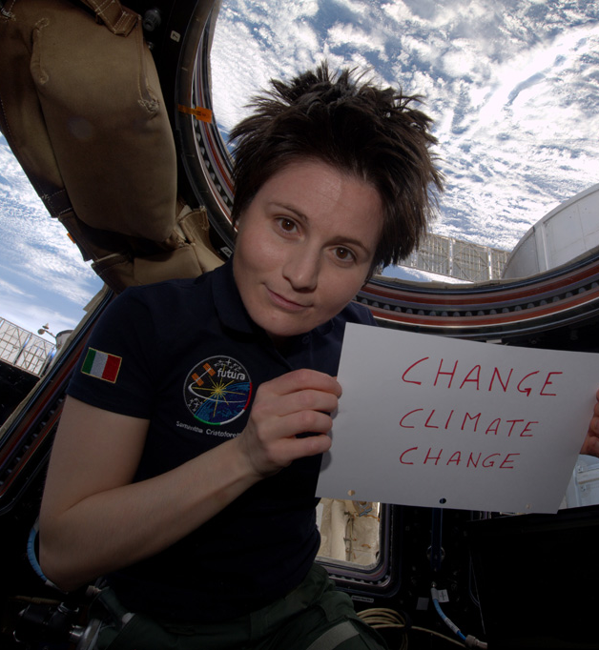
On November 23, 2014, Soyuz TMA-15M carrying Cristoforetti and two other astronauts launched from the Baikonur Cosmodrome, Kazakhstan. It successfully docked at the International Space Station roughly six She returned to Earth on 11 June, 2015 after spending 200 days in space, currently the longest spaceflight of a European. The mission, which was given the name Futura, was the second long-duration flight opportunity for the Italian Space Agency, the eighth for an ESA astronaut.

Slide 5
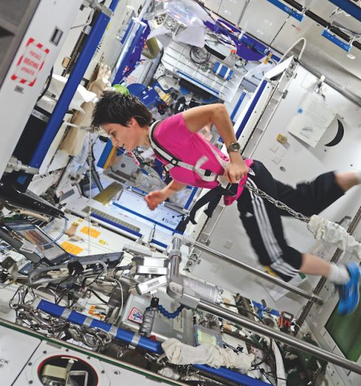
The Italian astronaut has set a record of consecutive stay in space for a woman thanks to the Futura mission, designed and organized by the Italian Space Agency (ASI) in collaboration with the European Space Agency (ESA). During the mission (which assumes the international name of "ISS 42/43") important experiments were carried out concerning nanotechnology, as well as the possibility of making prints with 3-dimensional (3D) technology, indispensable for the continuation of exploration space. Another important experiment saw the monitoring of diseases such as osteoporosis or the natural dysfunction of the sleep / wake cycle, all pathologies that in case of frequent stays in the absence of gravity could alter the psycho-physical perception of astronauts. The "Futura" mission, due to its particular shape and the experiments that have been carried out, has certainly placed itself at the forefront of long-term missions

Slide 6
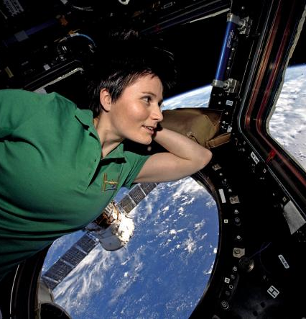
After completing her post-flight tasks, while waiting for assignment to a second spaceflight, Samantha has been given technical and management duties at the European Astronaut Centre. For several years she led the Spaceship EAC initiative, a student-centred team working on the technological challenges of future missions to the Moon. She is now crew representative for ESA in the Lunar Orbital Platform – Gateway project. Samantha is also part of a working group tasked with working with Chinese counterparts to define and implement cooperation in the field of astronaut operations. In July 2015 Samantha was awarded the Knight Grand Cross of the Order of Merit of the Italian Republic by the Italian President

Slide 7
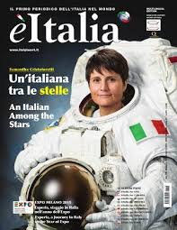
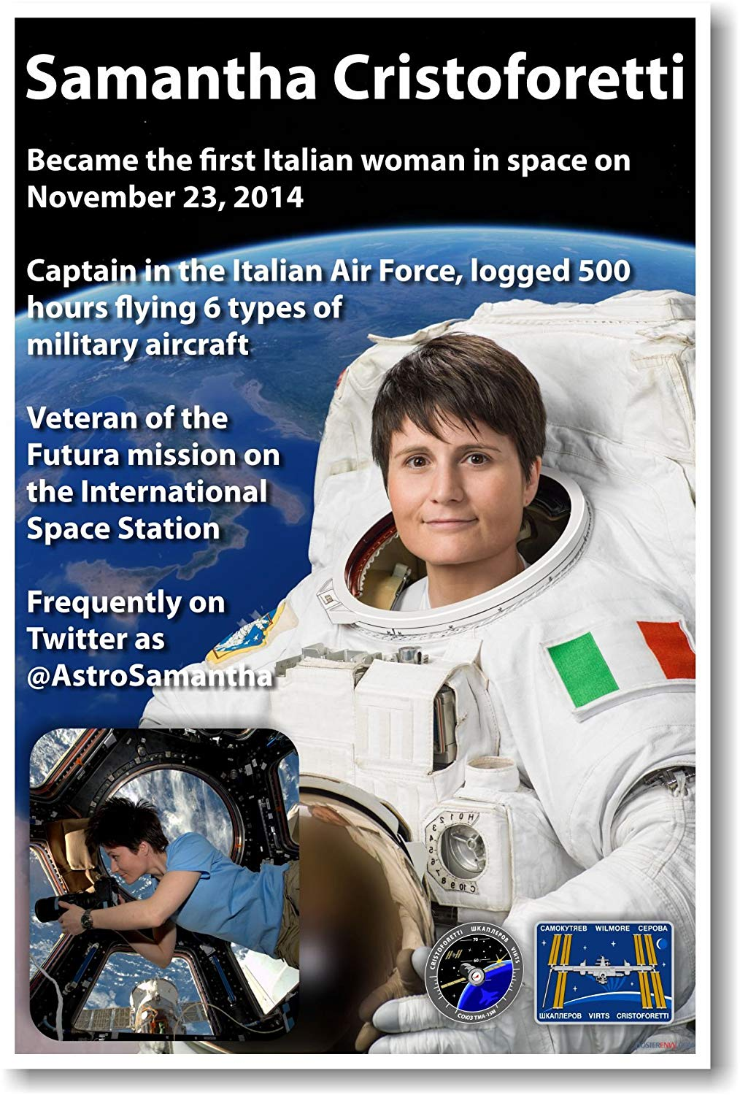
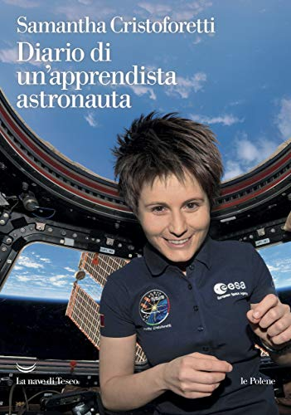
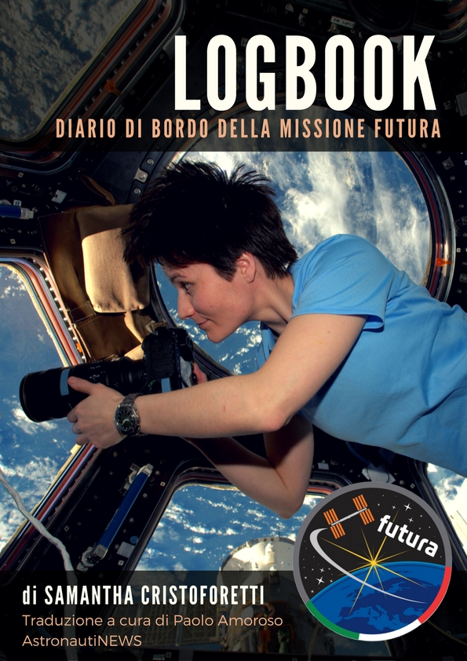
Newspapers and books
Notes:
Argomenti da prendere in considerazione:
Premessa
Gli uomini e le donne delle missioni spaziali

