Slide 1
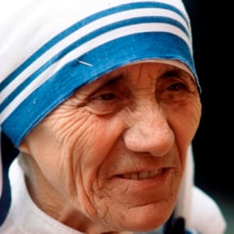
Mother Teresa was the founder of the Order of the Missionaries of Charity, a Roman Catholic congregation of women dedicated to helping the poor. Considered one of the 20th Century's greatest humanitarians, she was canonized as Saint Teresa of Calcutta in 2016.

Slide 2
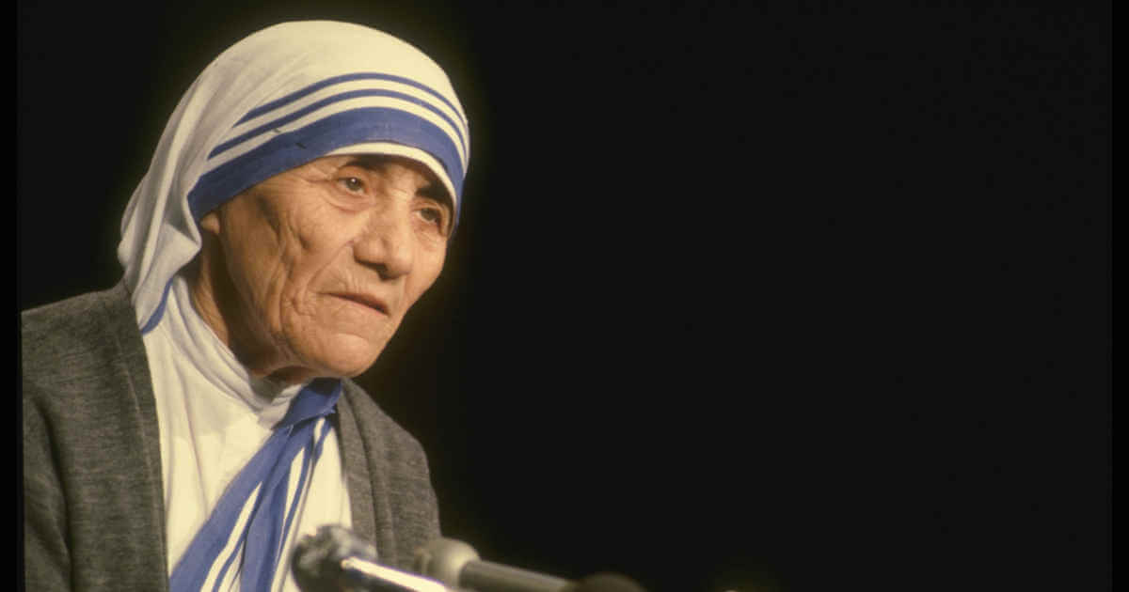
Question: When and where was Mother Teresa born?
Answer: Mother Teresa was born on 26 August 1910 as Agnes Gonxha Bojaxhiu in Skopje in Macedonia, Ottoman Empire. She was baptised on 27 August.

Slide 3
Question: What were the names of Mother Teresa’s family members?
Answer: Mother Teresa was the third child of Albanian grocer Nikola Bojaxhiu and his wife Drane. She had an older sister, Aga, and an older brother, Lazar. Her father died when she was about eight years old

Slide 4
Question: Why did Mother Teresa go to India?
Answer: In 1928, when Mother Teresa was 18 years old, she went to Ireland to join the Sisters of Loreto at the Institute of the Blessed Virgin Mary, a community of nuns with missions in India. Six weeks later she travelled to India to work as a teacher in the order’s school in Calcutta.

Slide 5
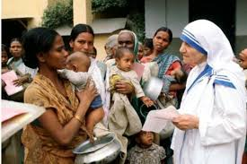
Question: What order did Mother Teresa start?
Answer: In 1946 Mother Teresa experienced what she described as a “call within a call”, or inspiration, to leave the Loreto convent and devote herself to caring for the sick and poor. She then moved into the slums. In 1950, she received permission from the Vatican to found the Missionaries of
Charity, a Roman Catholic religious
order of women, dedicated to serving
“the poorest of the poor”.

Slide 6
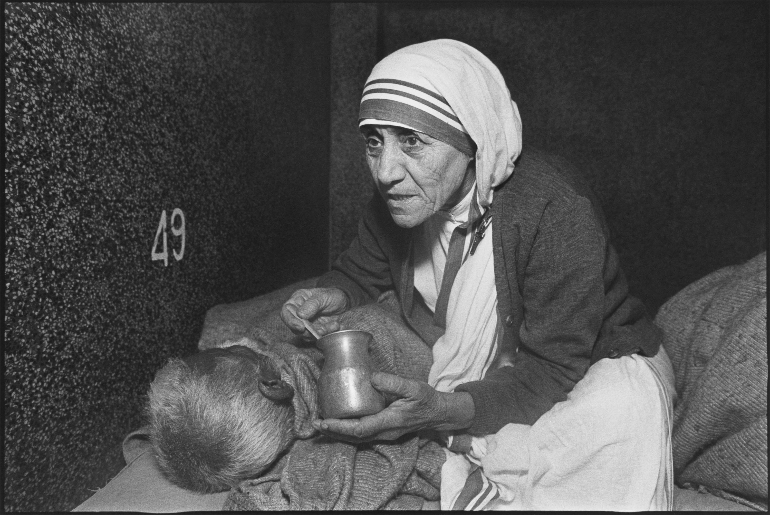
Question: Why was she called Mother Teresa?
Answer: When she joined the Irish
order Sisters of Loreto, she was
given the name Sister Teresa after
Saint Thérèse de Lisieux. She
became Mother Teresa after
making her final vows.

Slide 7
Question: Why did Mother Teresa start her own hospice?
Answer: Mother Teresa’s “call” was caring for the sick and poor. In 1952, she established a hospice where the terminally ill could die with dignity.
At the time of her death, Mother Teresa’s Missionaries of Charity had over 4,000 sisters and hundreds of thousand of volunteers working in hundreds of centres around the world. These included homes for orphaned children, homes for people with HIV/AIDS, leper colonies, and hospices for the terminally ill.

Slide 8
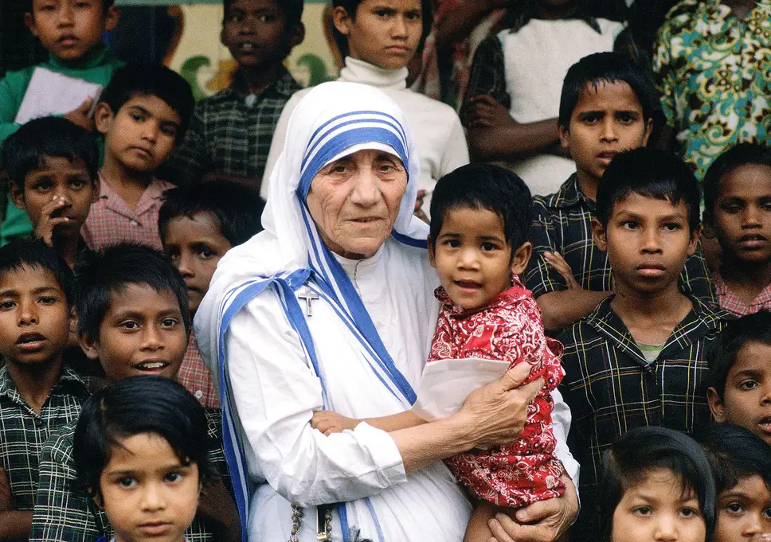

Slide 9
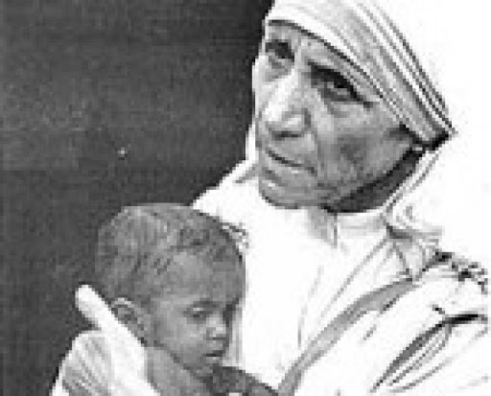
Question: What influenced Mother Teresa?
Answer: In her Nobel Lecture, Mother Teresa said: “I think that we in our family don’t need bombs and guns, to destroy to bring peace – just get together, love one another, bring that peace, that joy, that strength of presence of each other in the home. And we will be able to overcome all the evil that is in the world.”

Slide 10
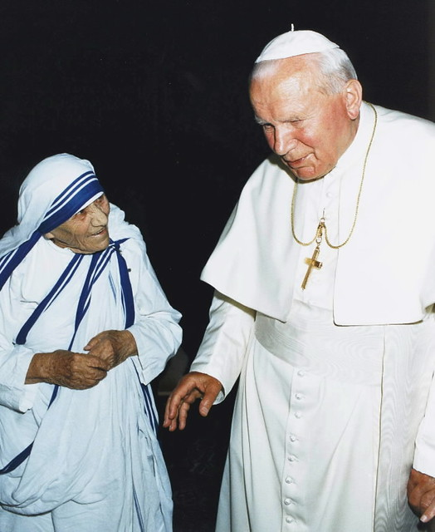
Question: Was Mother Teresa ever named a saint and is it documented?
Answer: In 1999, only two years after her death, the process to declare her a saint began; a process that
normally takes about five years. On 10
October 2003 she was beatified by
Pope John Paul II, the third of the four
steps in the canonization process to declare
a deceased person to be a saint.
On 4 September 2016 Mother Teresa was
canonized, declared a saint, by Pope Francis.

Slide 11
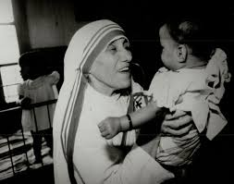
Question: Why did Mother Teresa get the 1979 Nobel Peace Prize?
Answer: The Norwegian Nobel Committee writes in their motivation: “In making the award the Norwegian Nobel Committee has expressed its recognition of Mother Teresa’s work in bringing help to suffering humanity. This year the world has turned its attention to the plight of children and refugees, and these are precisely the categories for whom Mother Teresa has for many years worked so selflessly.”

Slide 12
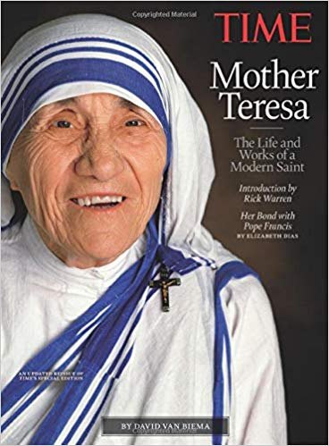
Question: When did Mother Teresa die?
Answer: Mother Teresa died of heart failure at the age of 87 on 5 September 1997 in Calcutta, India.

Slide 13
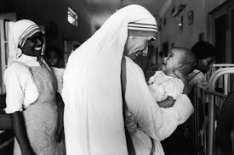
Mother Teresa’s work has been recognized and acclaimed throughout the world and she has received a number of awards and distinctions, including the Pope John XXIII Peace Prize (1971) and the Nehru Prize for her promotion of international peace and understanding (1972). She also received the Balzan Prize (1979) and the Templeton and Magsaysay awards.

Slide 14
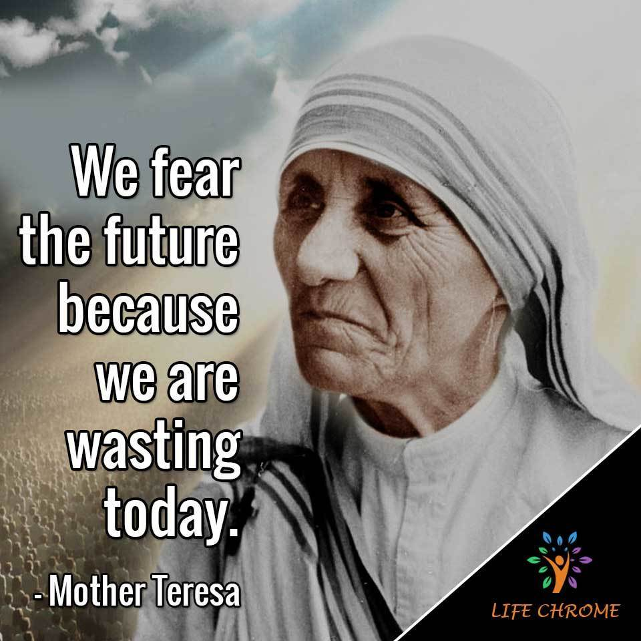

Slide 16
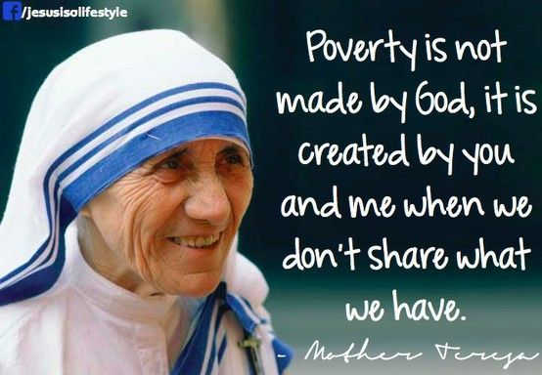

Slide 17
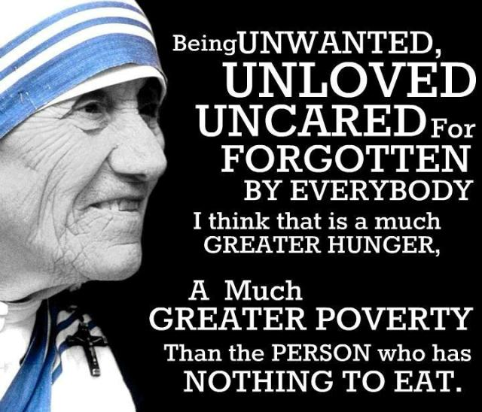

Slide 18
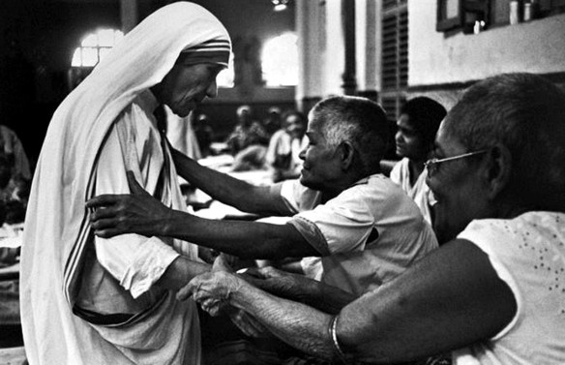

Slide 19
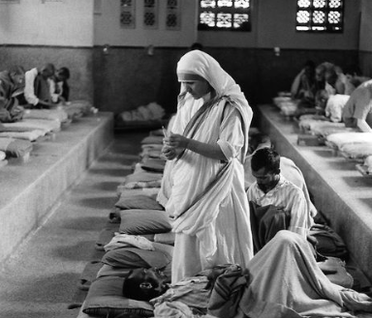

Slide 20
