Slide 1
Analysing compost
SLOVENIA

Slide 2
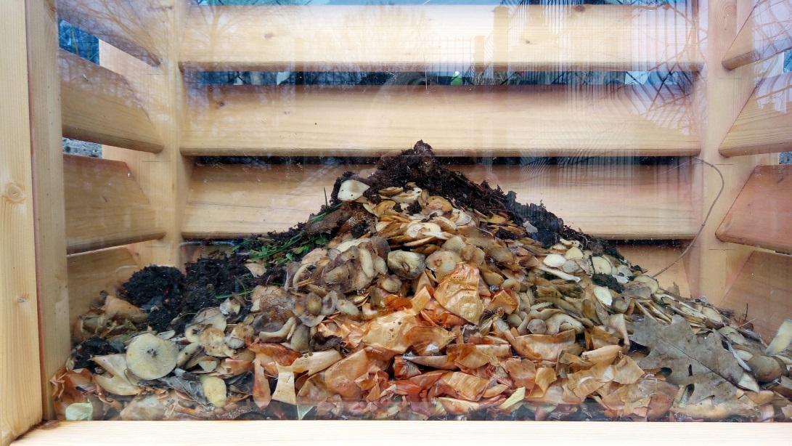
One year ago we put a composter in front of our school. It was made of wooden tiles and placed into the shadow. We placed plant litter from our school kitchen and mowed grass. We took care that the composter was suitably wet and aired.

Slide 3
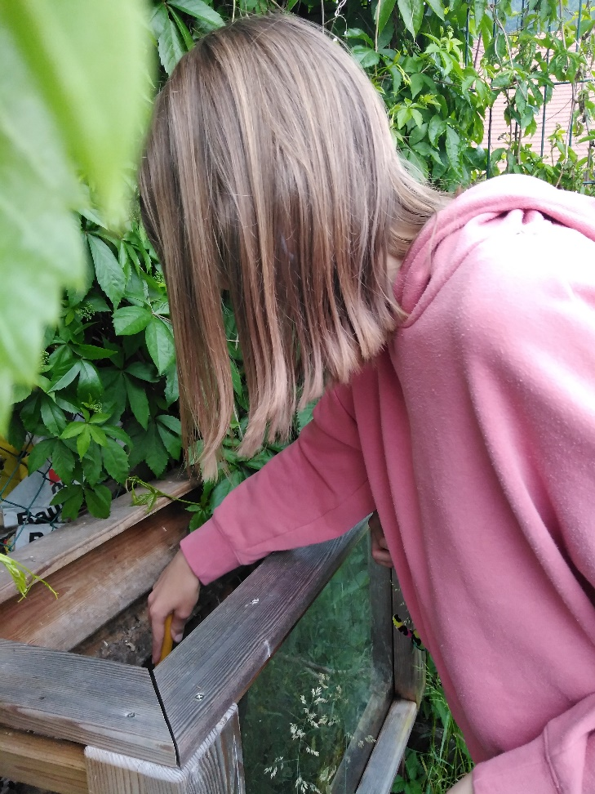
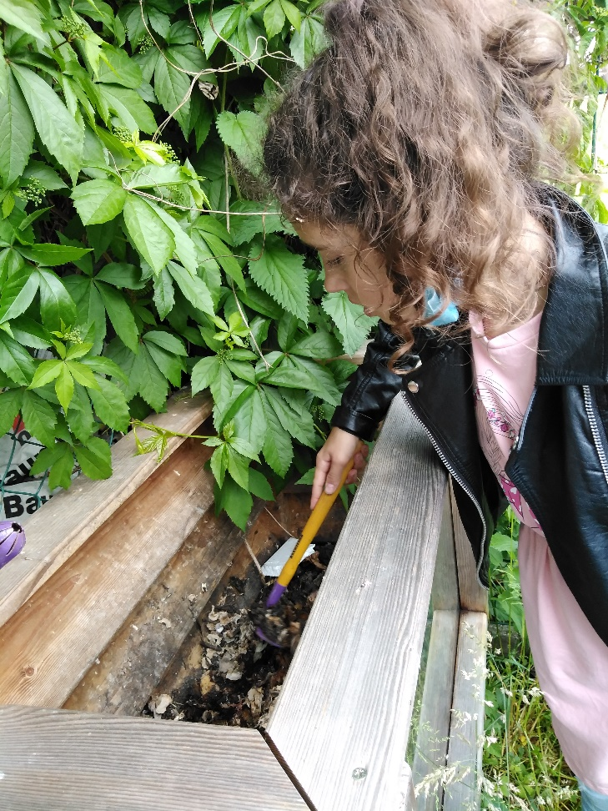
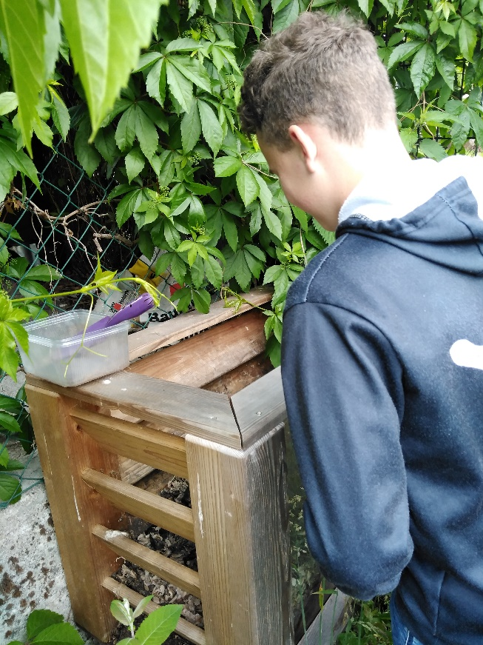
After of composting we analised the compost. We put some compost in the pots and took them to the classroom. We were divided into 5 groups. The teacher gave us the instructions to work.

Slide 4
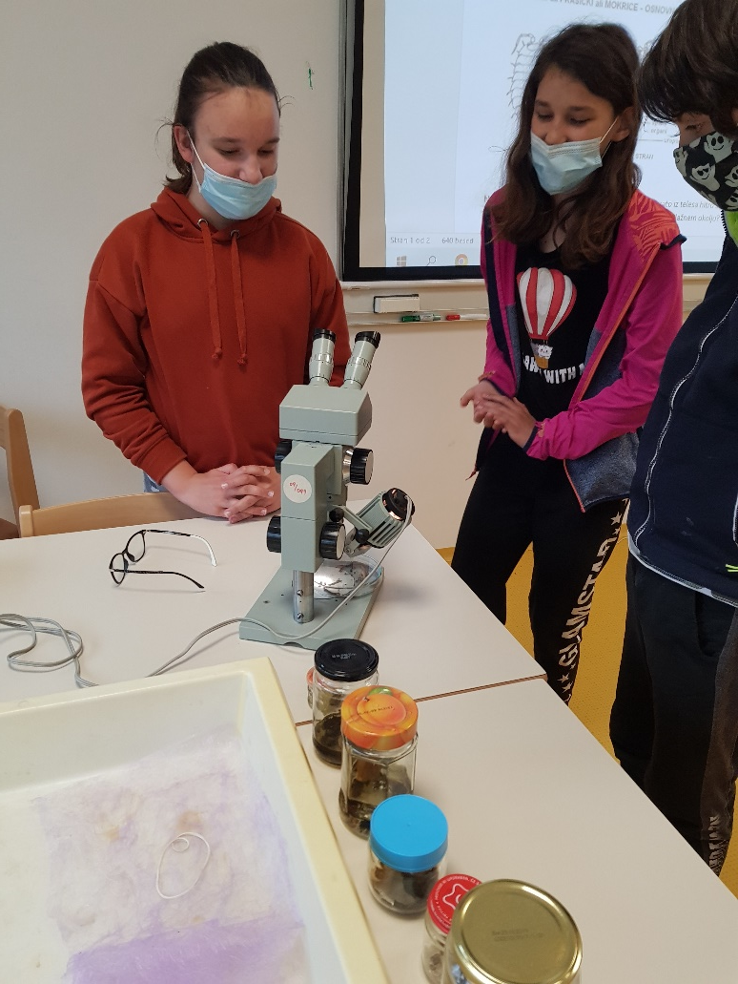
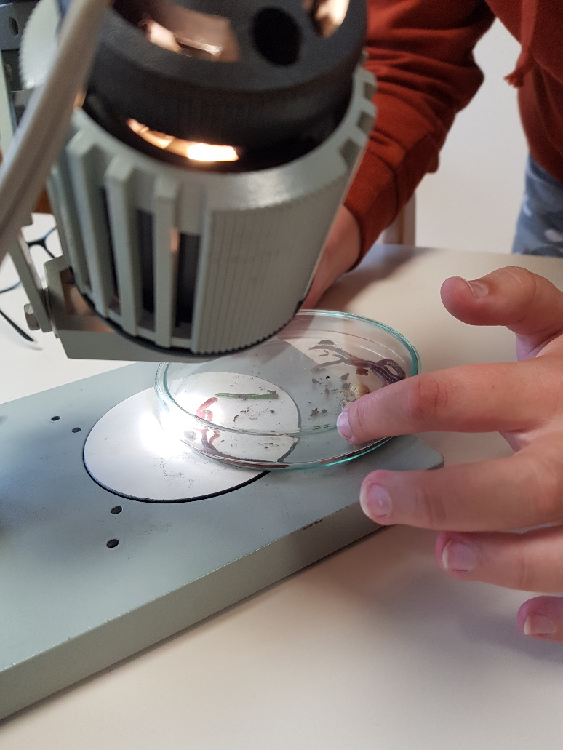
Each group thoroughly studied the animals which we could notice with our eyes. Later we studied all the animals with the magnyfing glass and with the microscope. We determined the species of the animals.

Slide 5
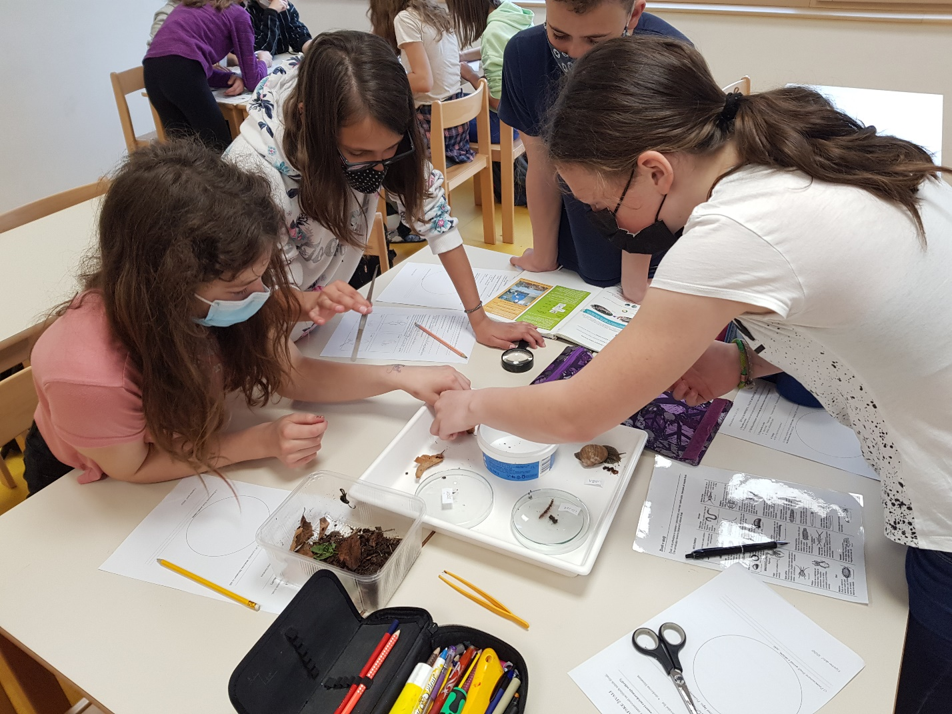
In the composter we found earthworms, snails, wet worms, little iron snakes and some other worms. We were surprised by the number of the animals found.

Slide 6
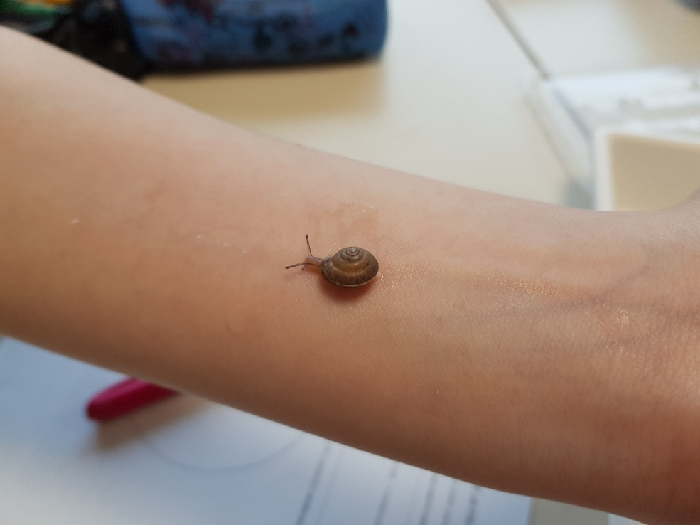
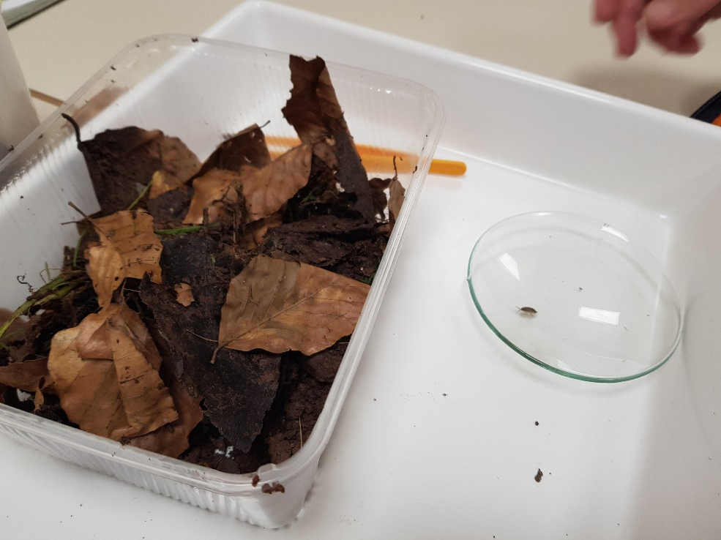
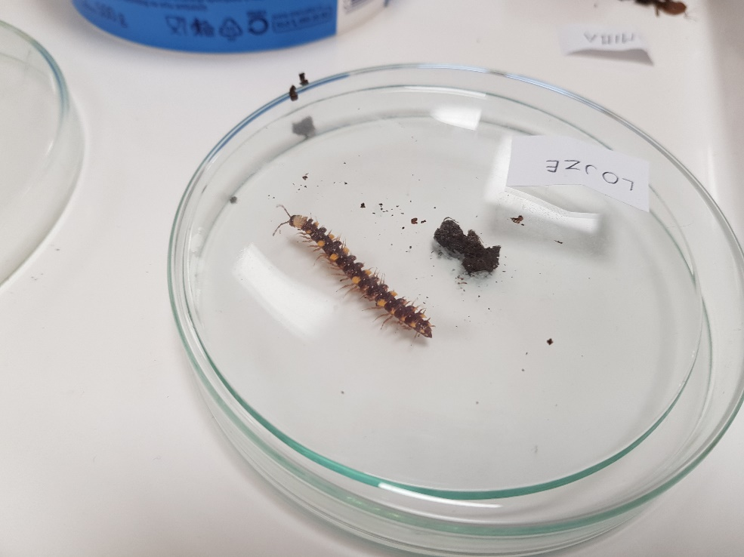

Slide 7
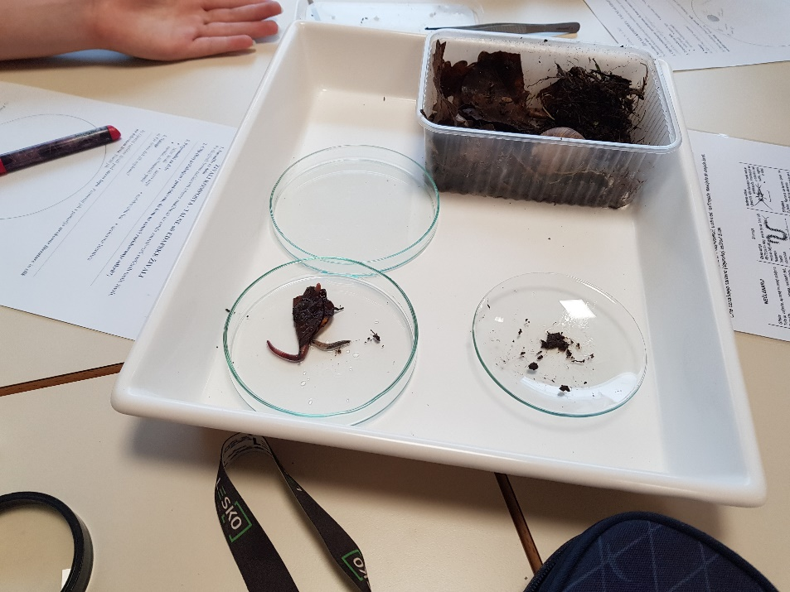
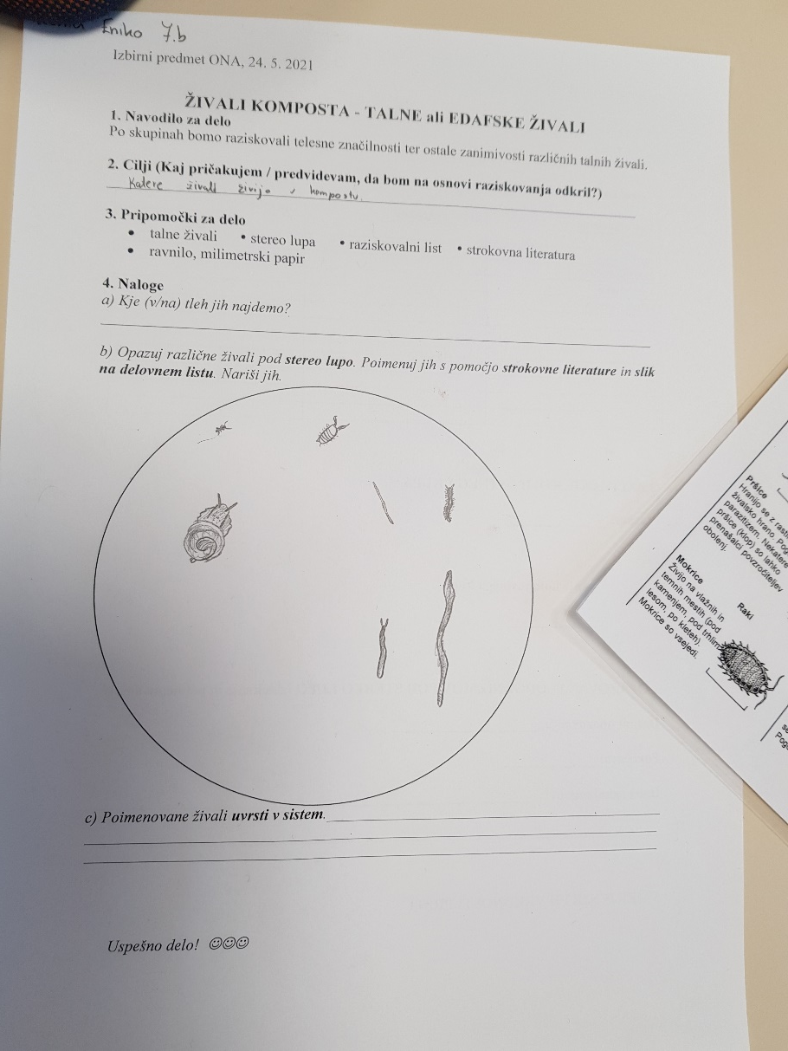
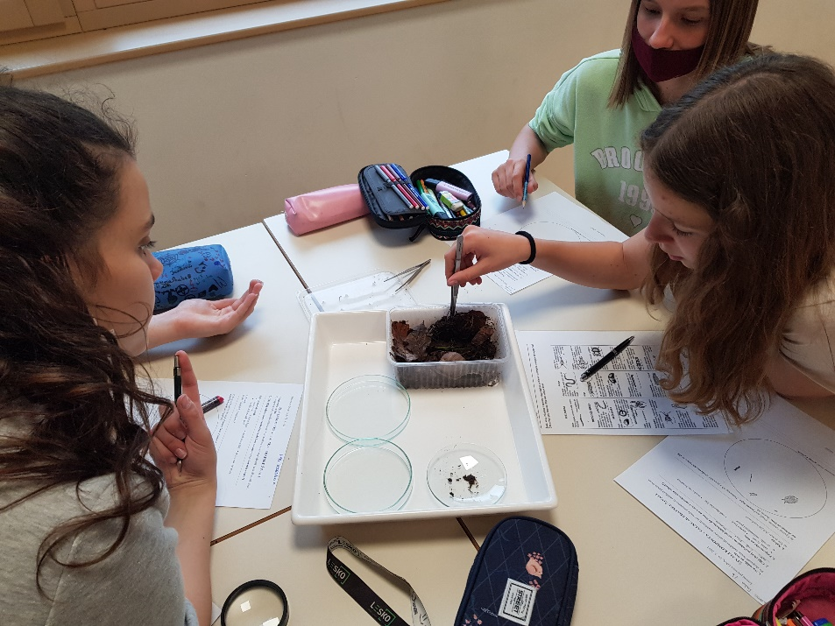

Slide 8
