Slide 1
Recycled food from leftovers
Notes:
NOTE: To replace a picture, just select and delete it. Then use the Insert Picture icon to replace it with one of your own!

Slide 2
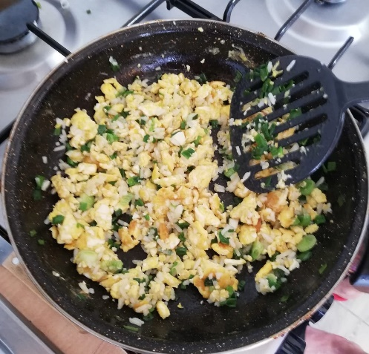
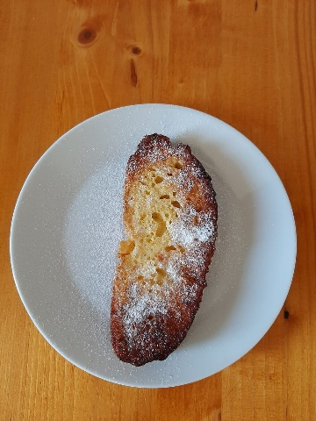
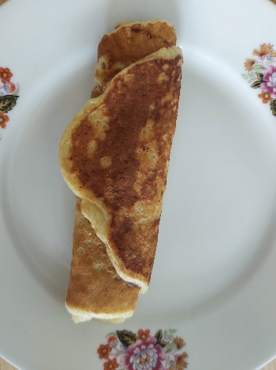
#LeftoversChallenge
How can we reuse food creatively, how can we avoid throwing away food after we are tired of a dish?
We invited teachers and students involved in the project to post pictures and recipes of what they cooked using the forgotten ingredients in the fridge or pantry.
We will share some of them with you.

Slide 3
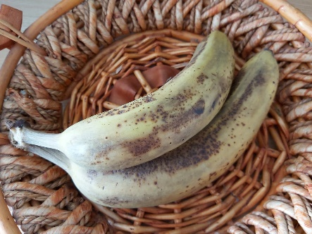
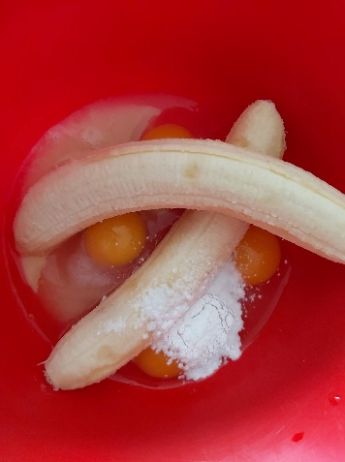
Banana pancakes
Ingredients
2 ripe bananas, sliced thinly
½ tsp of baking powder
2 eggs
Instructions
In a mixing bowl, combine the bananas, eggs, and baking powder. Mash with a fork or potato masher until smooth.
Heat a pan over low heat and spray some cooking spray in or add some butter to the pan.
Ladle in 2 or 3 tbsp of the mixture and cook for a couple of minutes on each side until the pancake is golden brown. Repeat this for all of the batter.
Pour some syrup over the top, or add jam and roll them. Serve, and enjoy your banana pancakes.

Slide 4
Picture with Caption Layout
Ingredients
6 spring onions
250 g precooked rice
Other vegetables you have in the fridge
2 large free-range eggs
150 g firm cheese
Method
Put a large non-stick frying pan on a medium-high heat.
Trim and finely slice the spring onions and fry with 1 tablespoon of olive oil for 1 minute.
Add the rice, a splash of water and a pinch of sea salt and black pepper, then toss for 2 minutes until everything is well coated.
Push the rice to the sides of the pan, making a big well in the middle. Crack the eggs into the well, then use a rubber spatula to start gently moving the eggs around to create big curds.
Break in the cheese, then fold the rice back through the egg until it’s all looking good. Taste and season to perfection.
Enjoy!

Slide 5
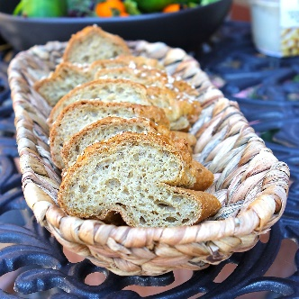
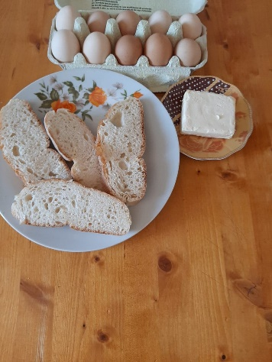
French toast
Ingredients
4 eggs
2/3 cup milk
2 teaspoons of cinnamon
8 thick slices of 2-day-old bread (better if slightly stale)
Butter (can sub vegetable oil)
Instructions
1 Make the egg mixture: In a medium bowl, whisk together the eggs, milk, and cinnamon. Stir in the orange zest and/or Triple Sec if using. Whisk the mixture until well blended and pour into a shallow bowl, wide enough to place a slice of the bread you will be using.
2 Soak bread slices in egg mixture: Place each slice of bread into the milk egg mixture, allowing the bread to soak in some of it.
3 Fry the french toast: Melt some butter in a large skillet over medium high heat. Shake off the excess egg mixture from the bread, and place the bread slices onto the hot skillet. Fry the French toast until browned on one side, then flip and brown the other side.
4 Serve hot with powder sugar.

Slide 6
Thank you!

