Slide 1
ENERGY IN THE HOUSEHOLD
Liceul Auto Traian Vuia

Slide 2
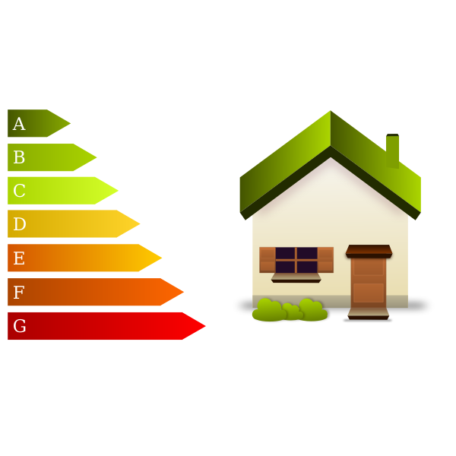
Components
Electricity consumption
Graphics of consumption
Comparing eletricity consumption
Conclusions

Slide 3
Distribution of energy consumption in the 4 seasons in our houses

Slide 4
CONCLUSIONS:
Long nights
Heating the house
Big electricity consumption

