Slide 1
Electricity consumption in a polish household
Polish Team
Hanna Mateusiak, Nikolaj Olsen, Weronika Siepsiak, Wiktoria Wołkowska, Nadia Zera & Hanna Żak
Primary School No. 2 in Olsztyn

Slide 2
A handful of facts:
an average Polish apartment is about 50 m²,
by the most Polish apartments are located in multi-family buildings,
85% of Polish apartments are insulated,
the average number of people in a household in Poland is almost 3.

Slide 3
Distribution of electricity consumption in Polish household (in kWh)
The data comes from the 2018 statistical yearbook

Slide 4
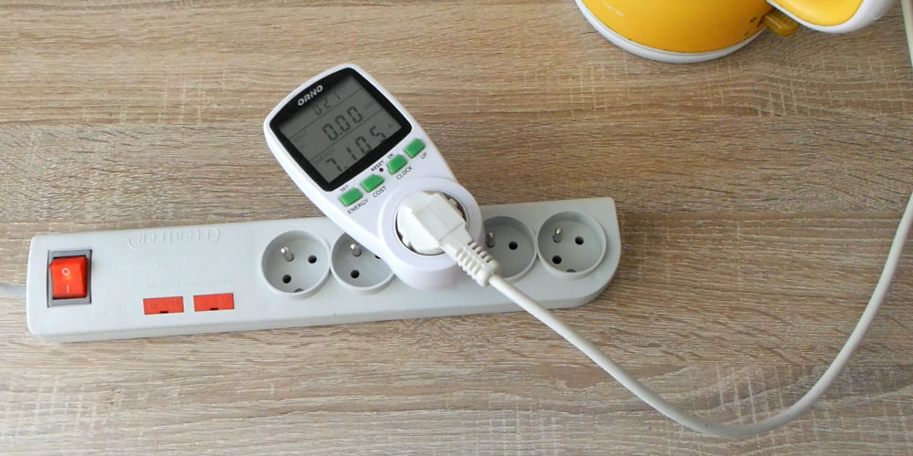
Most households were in the consumption range of 1501–2000 kWh. The smallest number of households was in the groups of the smallest and the largest consumption: less than 500 kWh, 5001–6000 kWh and over 6000 kWh.

Slide 5
We asked our school mates to complete at home a survey about the annual energy consumption of their households (based on their bills). We got 56 sheets back. The data shows the energy consumption.

Slide 6
Average electricity consumption in households of students
in our school

Slide 7
The lowest energy consumption occurs in the holiday months, which is caused by our holidays trips. The highest consumption is in the winter months, especially in December.
In winter months in our country temperature at night often drops below zero, so we turn on the heating. In addition, the sun sets then around 4:00 p.m. so we have to turn on the light earlier. In 2021, energy consumption during the school months was much higher than it is now. We spent this year on distance learning.

Slide 8
We were unable to collect detailed data on the energy consumption of our students' homes. However, researchers in Poland say that the most electricity is consumed by heating and cooking (24%), then lighting (20%) and finally household appliances and audio / video devices (15%).
household appliances and electronics – 15%
heating and cooking – 24%
lighting – 20%

Slide 9
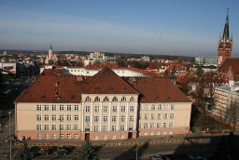
Thank you for your attention

