Slide 2
Warmia and Mazury voivodeship is located in the northeast in Poland.

Slide 3
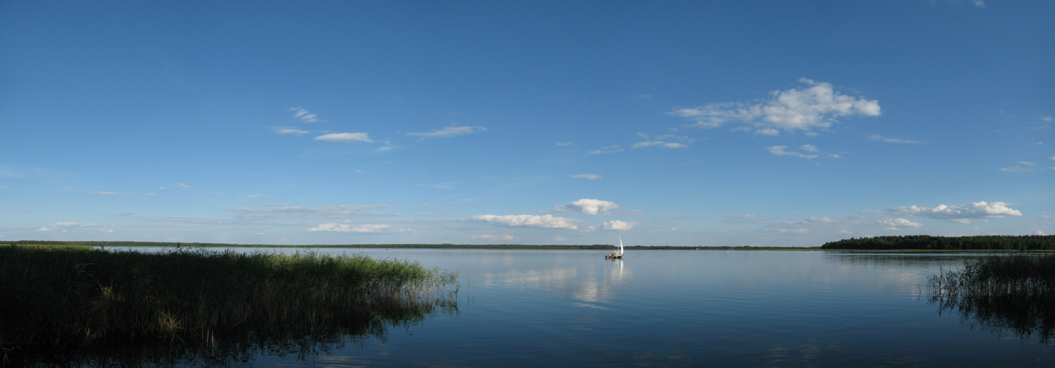
Warmia and Mazury is a region called ‘The land of a thousand lakes’ or ‘The Green Lungs of Poland’. It has a spectacular landscape with lots of hills, forests and lakes.

Slide 4
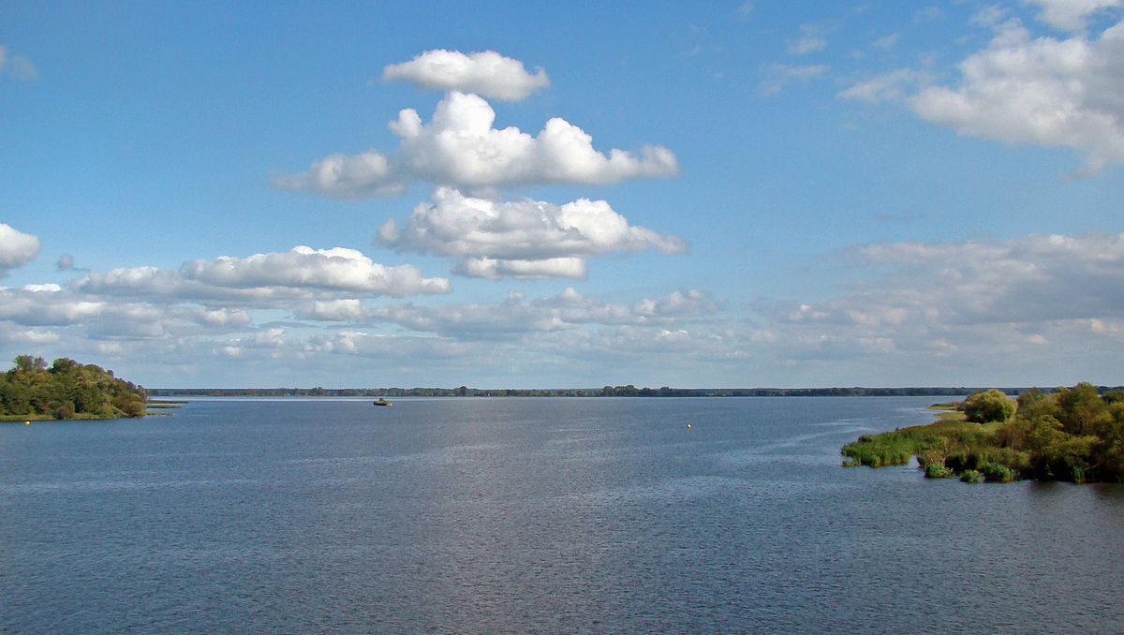
The most famous lakes in Warmia and Mazury
Mamry
One of the deepest lakes in Poland

Slide 5
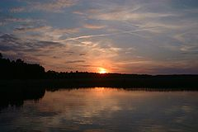
Śniardwy The biggest lake in Poland

Slide 6
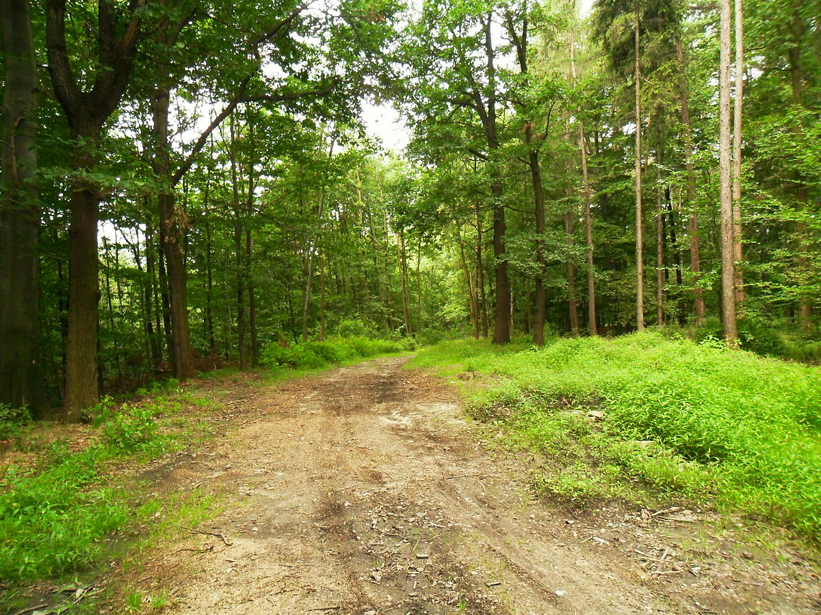
Forests constitute 29% of the entire voivodship’s area. There are a few national parks here and 230 nature reserves. This region is also rich in many birds and animals species. You can find lots of storks, swans, cormorants and blackcocks. In the forest you might find European bisons, moose and beavers.

Slide 7
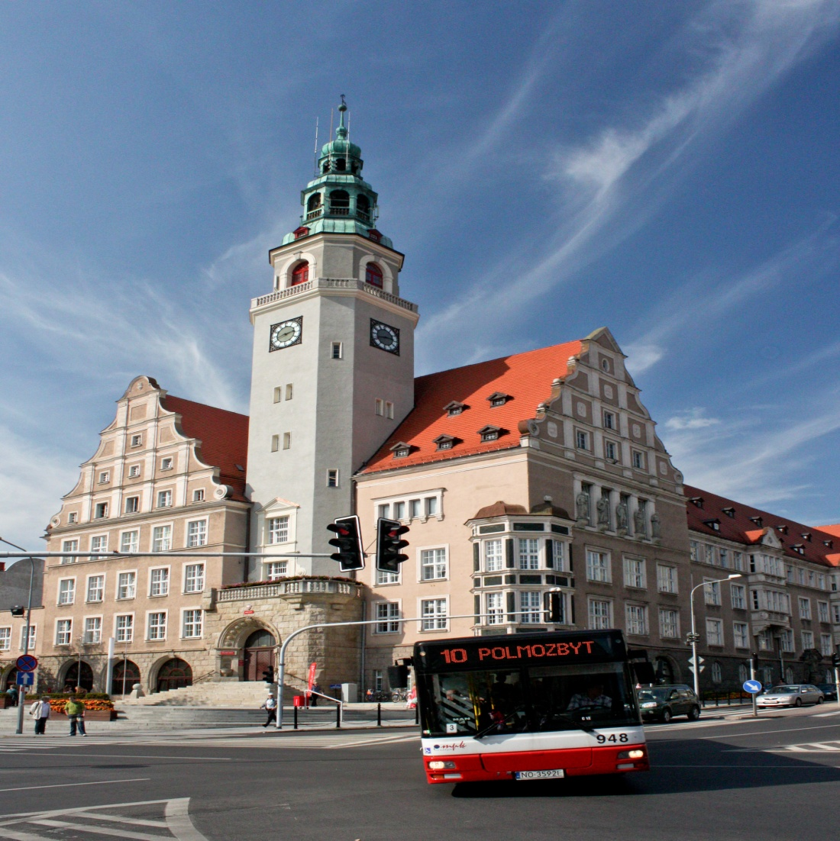
Olsztyn is the capital of the region

Slide 8
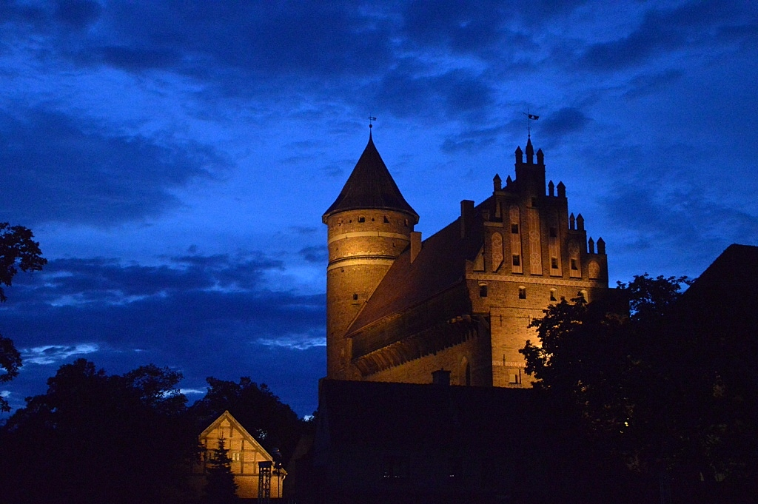
Things worth seeing in Olsztyn
The castle in Olsztyn was built by Teutonic Knights. Nicolaus Copernicus was the most famous inhabitant of the castle. Now it is the location of The Museum of Warmia and Mazury.

Slide 9
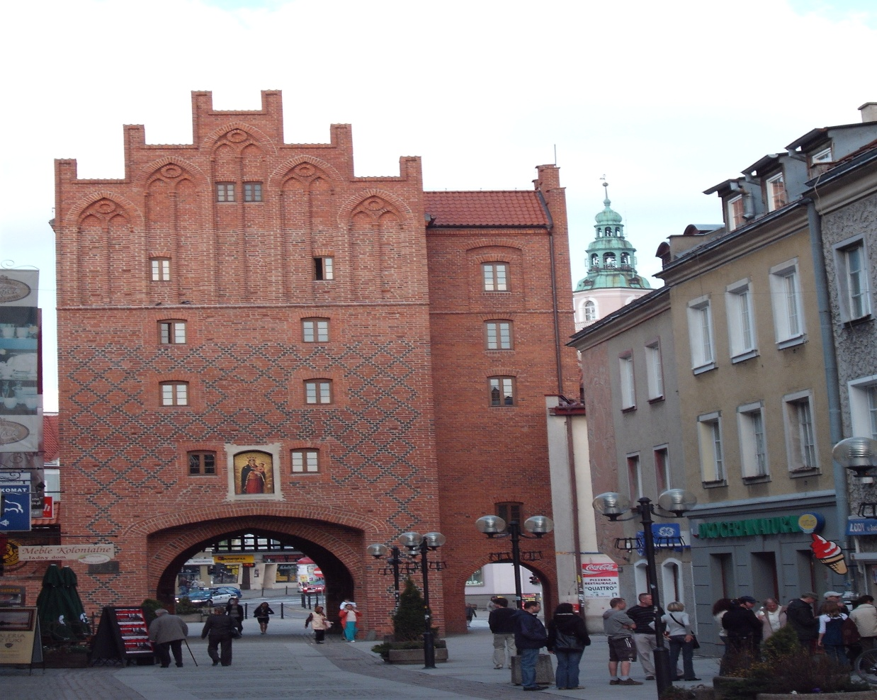
High Gate
The High Gate in Olsztyn was a part of city walls. It was built in 14th century.

Slide 10
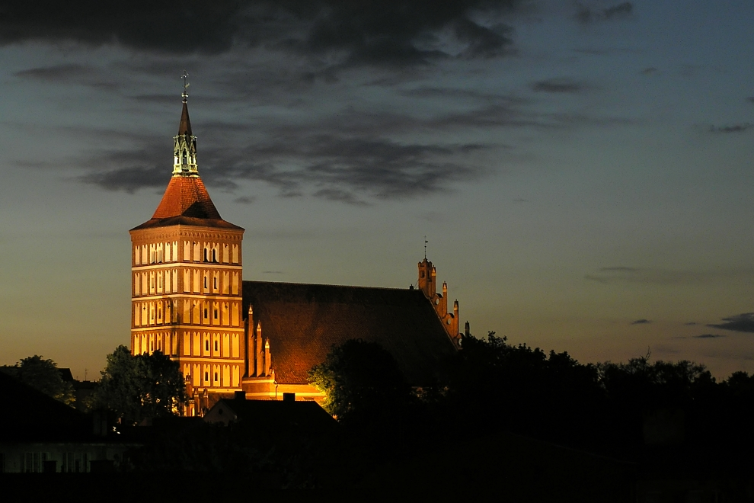
St. Jacob’s Cathedral was built in 14th century

Slide 11
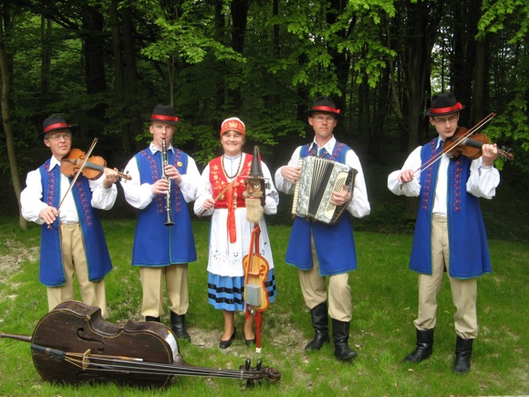
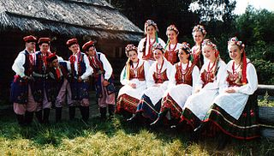
Folk costumes
Costume of Warmia inhabitants Costume of Mazury inhabitants

Slide 12
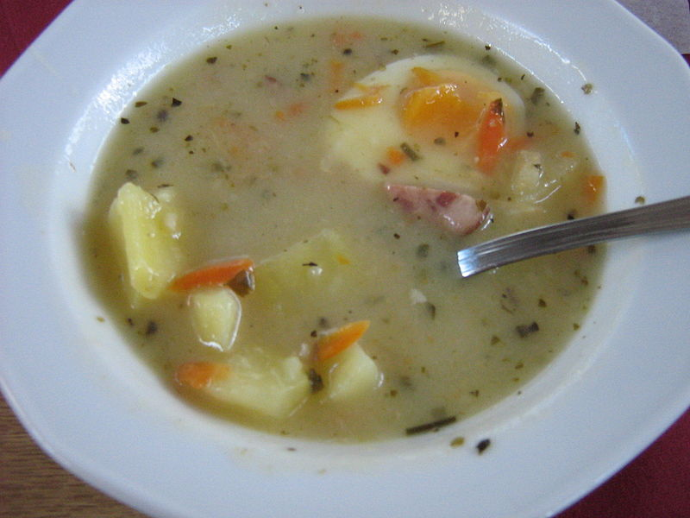
Warmia and Mazury cuisine

Slide 13
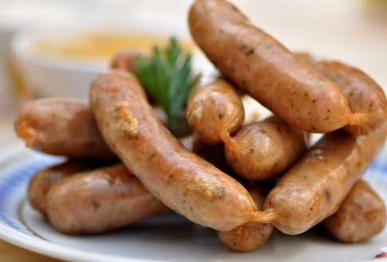
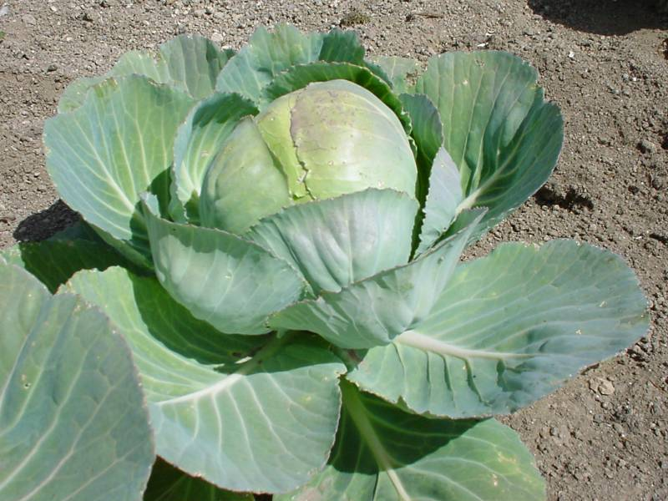
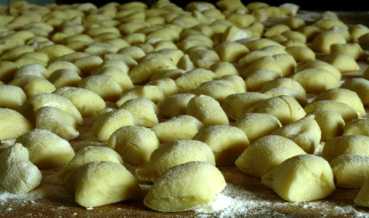
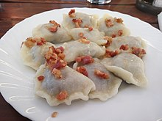
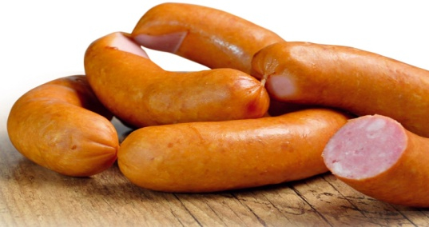
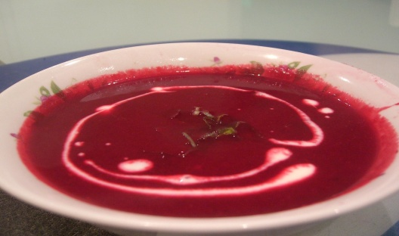
Culinary delicacies from this region are a mixture of influences of Polish and German
cuisine.
German cuisine influences can be found in the dishes with sausages, cabbage, meat and noodles.
Polish influences can be found in the dishes with sour cream, herbs, various sausages and traditional Polish soups such as ‘barszcz’.

Slide 14
Traditional dishes from Warmia and Mazury
Dzyndzałki ‘Black soup’
Dumplings from Warmia Duck soup with duck’s blood

Slide 15
Elbląg canal – sailing over the grass
Another must-see in Warmia and Mazury is Elbląg canal. The difference in water levels is about 100 m, and is overcome using locks and a remarkable system of inclined planes between lakes. It is considered one of the most significant monuments related to the history of technology and was named one of the Seven Wonders of Poland.

