Slide 1
Peter’s long walk
A boy-hero in the years of the German Occupation

Slide 3
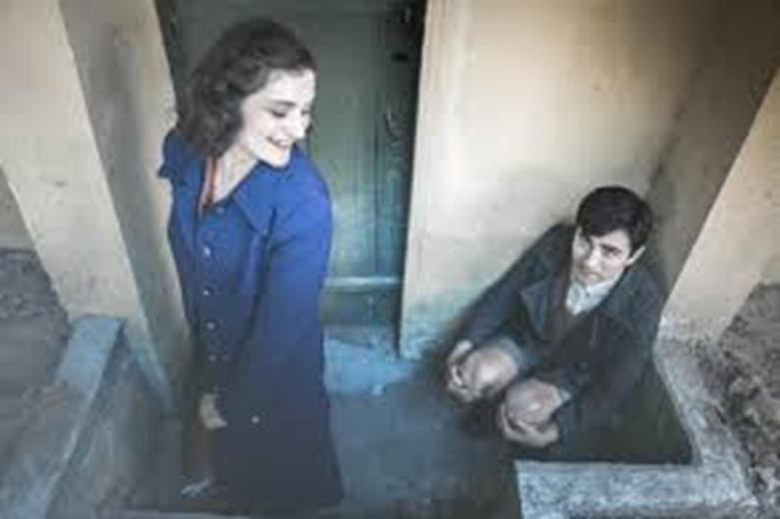
The story of the book begins on 27 October 1940, one day before the start of the 2nd World War. The main hero is the 9 year-old boy, Petros. He has a 14 year-old sister, called Antigoni.

Slide 4
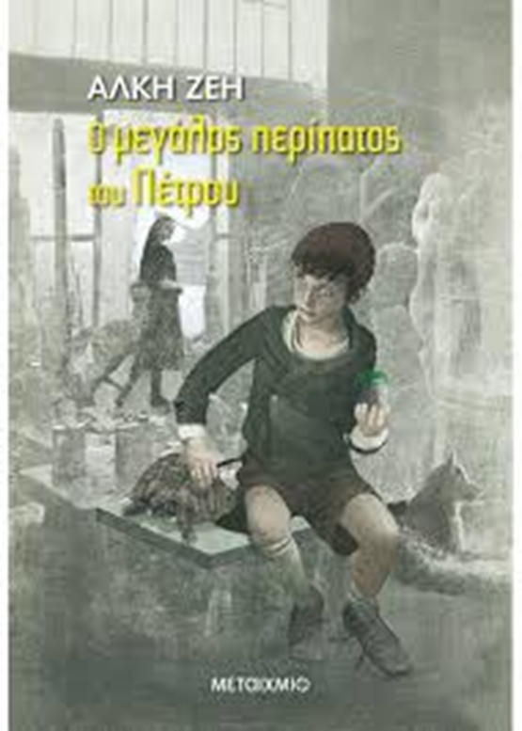
The next day Petros had a nightmare that the war had begun and woke up terrified. But it was not a lie. The sirens of the war had already begun to sound. It was October 28, 1940.

Slide 5
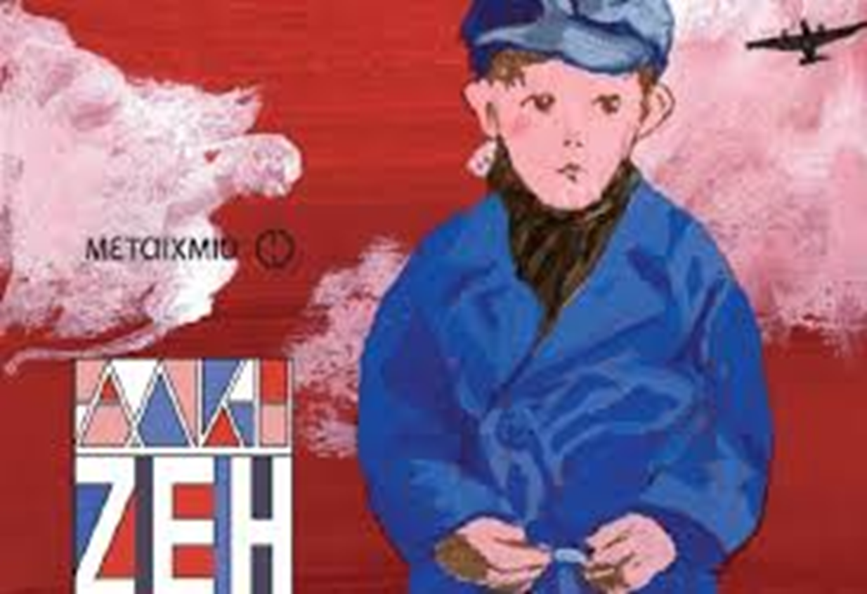
Peter saw everything changing around him. Within these new conditions, he will begin a long walk, full of adventures, feelings and experiences that will make him a little hero.

Slide 6
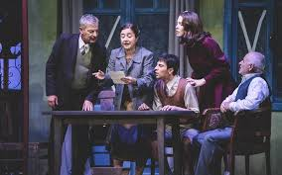
In the beginning everything looked like a celebration. Trucks full of soldiers, songs, flags. Peter’s uncle, was sent to war and
Petros imagined his uncle returning from war as a winner and a hero! Peter's mother though, soon started being sad. She was not happy with the great victories. She was very anxious about feeding her family.

Slide 7
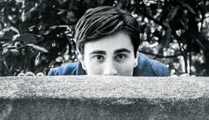
On April 6, 1941, the Germans declared war against the Greeks. On 27 April the Germans entered Athens. People were locked in the houses, while the German flag waved on the Acropolis.

Slide 8
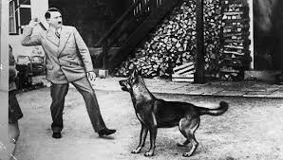
Petros’ neighbor Lela had a German friend who tortured a dog, by whipping him because the dog did not recognize him as a boss.
So Peter and his friends Sotiris and John decided to free the dog. Peter was very proud of this heroic act!

Slide 9
Peter met many friends who participated in the Resistance. With his friend Sotiris, Petros was writing on the walls the words “freedom", "hungry!“ and “Germans go home!”.

Slide 10
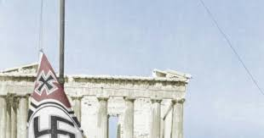
One day two Greek men from the Resistance took down the German flag from the Acropolis. Their act was heroic.

Slide 11
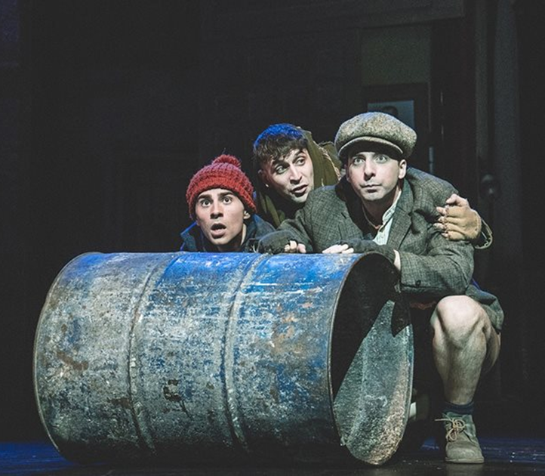
Next September the schools opened again.
This is where the children, Petros and his friends, begun to work for the Resistance. They sabotaged the conquerors with all means. They were throwing nails to flatten the tires of German lorries, they carried messages and flyers and newspapers.

Slide 12
Hunger began to reap. People died in the streets.
Only people working with the enemy had no hunger.

Slide 13
All the children (Petros, Antigoni, Giannis, Achilleas, Rita, Drosoula) participated in the first demonstration against the Germans.
One of his friends Drosoula,
got killed in a demonstration. Petros was shocked.

Slide 14
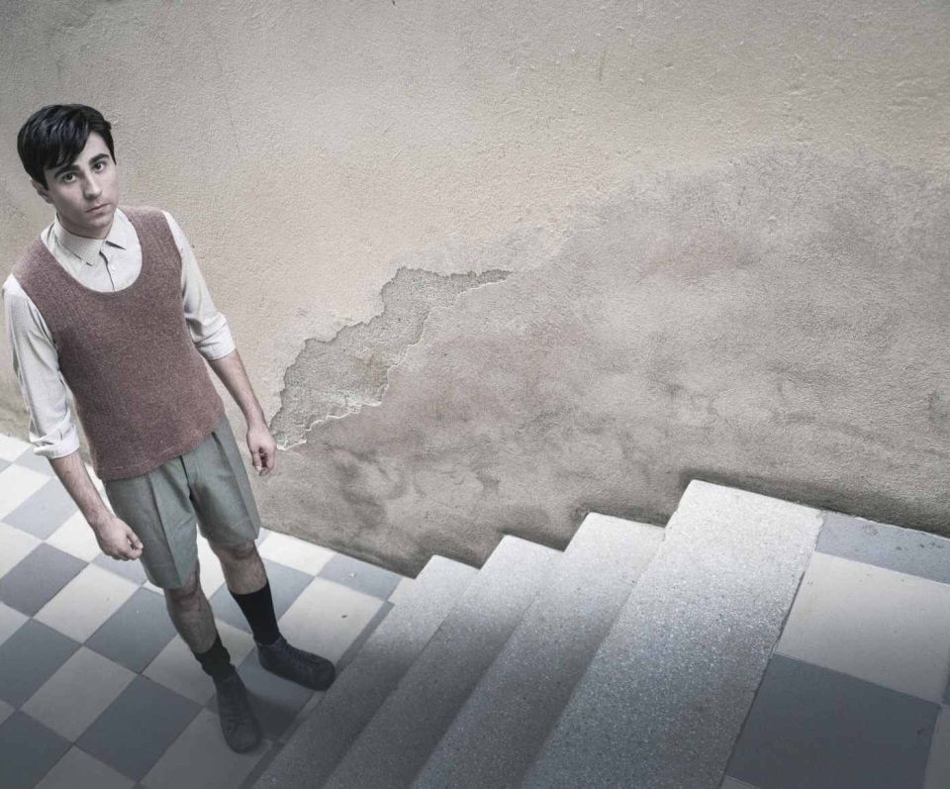
It ‘s the last days of the war. The Germans began to flee from Greece. On the last day, Petros lost his best friend Sotiris, who got killed and he was very very sad.

Slide 15
Petros is one of the lucky ones who will be able to walk in the streets of Athens free. On 12 October 1944 Greece is liberated. Peter remembers his beloved friends who do not enjoy the freedom of Greece. The end of the War finds him playing on the streets, as a little hero, thirteen years old !!

Slide 16
3rd Primary School of Serres

