Slide 1
Peter Diamandis
A hero of our days

Slide 2
A visioner
Peter Diamandis is a Greek American
engineer, physician, and entrepreneur

Slide 3
A leader
Diamandis is best known for being founder and chairman of the X Prize Foundation
XPRIZE is a nonprofit organization that designs and manages public competitions intended to encourage technological development that could benefit humanity

Slide 4
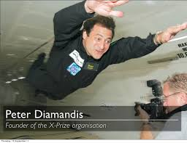
A pioneer
Diamandis is a cofounder and executive chairman of Singularity University

Slide 5
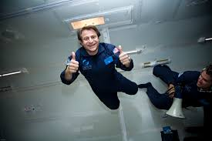
A creator
Peter Diamandis is cofounder or founder of many companies and organisations related all with space exploration:
Zero Gravity Corporation
Space Adventures
Rocket Racing League
International Space University
Planetary Resources
Celularity
Students for the Exploration and Development of Space
Human Longevity, Inc.

