Slide 1
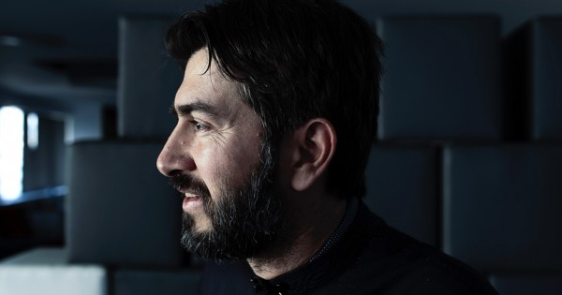
Father Antonios
A Today's Hero!
1st Kindergarten of N. Redestos

Slide 2
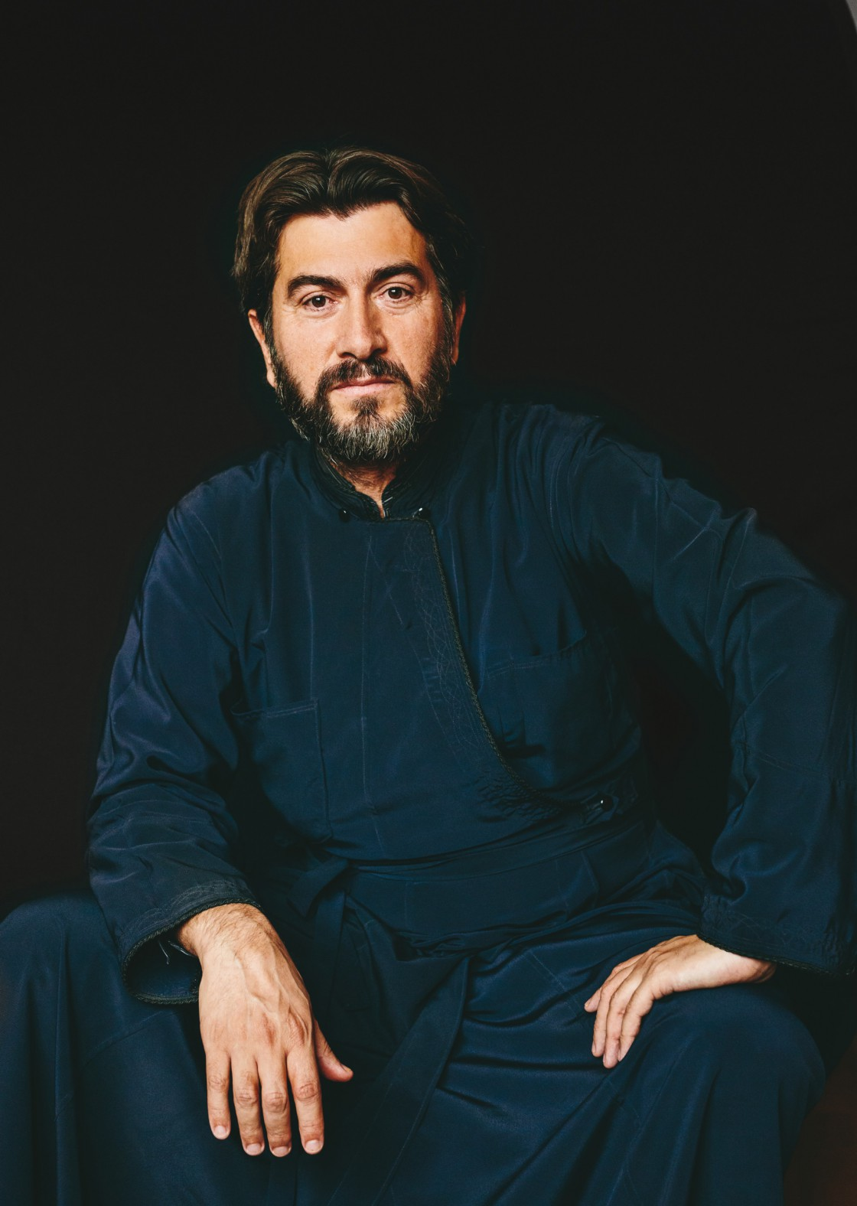
Father Antonios was born in 1971 and grew up in a poor neighborhood of Pireas. Αs he was part of a large family he learnt to share, so very soon he presented a will to help, and care about the others. He became a priest in a very degraded neighborhood.

Slide 3
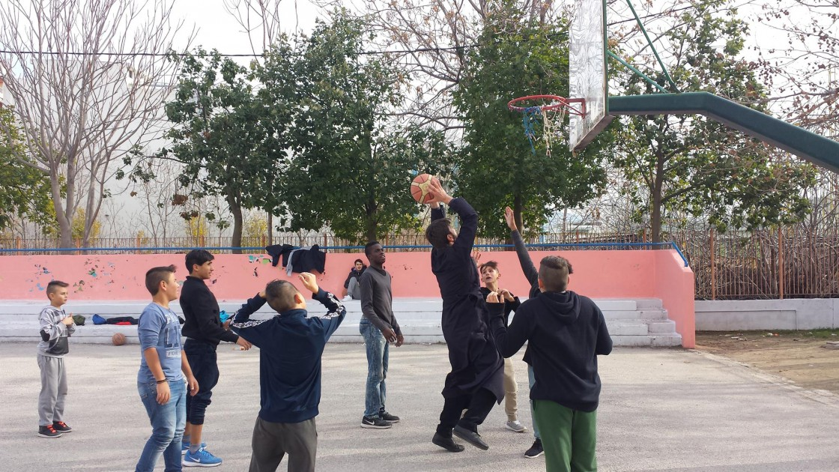
He tried to get close to the teenagers of this neighborhood, teenagers with drugs, delinquency and family problems. He gained their confidence and became the one that listened to their problems, show to them another way of living.

Slide 4
So, this is how the “World's Ark” established. In the beginning teenagers with Father Antonios used to gather in a place, like a cafe'. The name was chosen by the children because they felt like being in a safe place, a refuge. It was 1998.

Slide 5
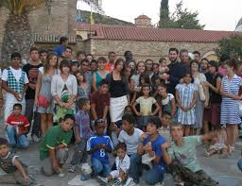
From 1998 till today, the “World's Ark” takes care of abandoned and unprotected children. It is a safe a warm home that provides food, clothes, education, medical care, love and a decent way of living. Children live there with their carers like a big family. Also in “World's Ark” can find help and support mothers with problems in order to be able to grow up and take care their children on their own. Women are supported not only by having a home but also by getting a job.

Slide 6
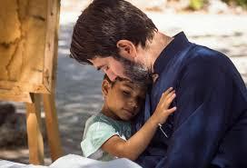
Father Antonios wants to make all the children of the Ark realize that all the bad things that happened to them were caused by others. Children must live the magical moments of their chilhood.
His biggest dream is “a home, a family for every child”

Slide 7
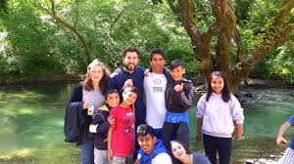
“World's Ark” is a big family, with children carers, volunteers. In Athens 400 children live there and 200 children live in several Arks around Greece. Children, either greek ones, either from other countries live in peace and find love and affection far away from hunger, war, racism and abandonment.

Slide 8
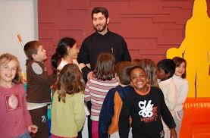
In World's Ark children learn “if you don't have what you love, love what you have”. Nobody must feel sorry for these children, but encourage them to create a better life for themselves.

Slide 9
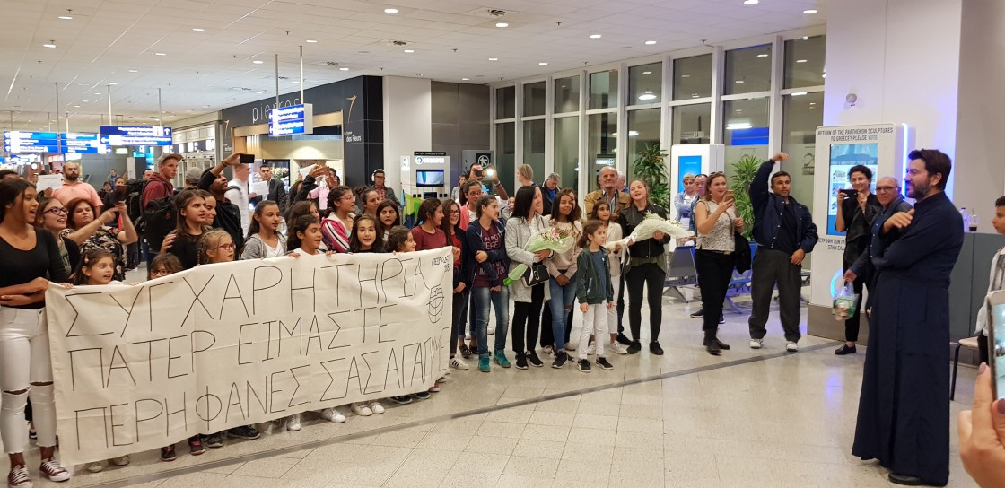
From 1998 till 2019 the World's Ark was never subcidized by the goverment. Volunteers are the only responsible for this great work.

Slide 10
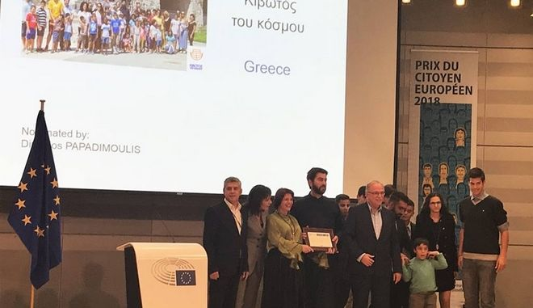
This year Father Antonios was chosen for the Award of The European Citizen.
We think that he deserves it!

