Slide 1
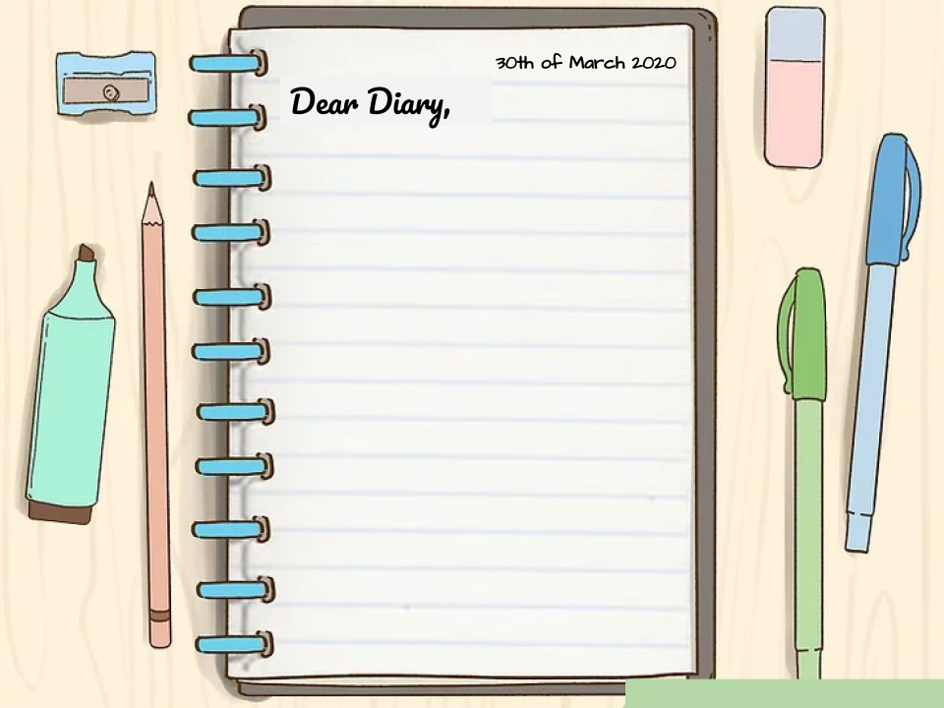
HI AITANA!
I WOULD LIKE TO TELL YOU THAT THREE MONTHS AGO A NEW PERIOD IN YOUR LIFE BEGINS. YOU WILL BE LOCKED UP AT HOME DUE TO A GLOBAL PANDEMIC SO I WOULD LIKE TO TELL YOU THAT YOU SHOULD ENJOY WITH YOUR FAMILY AND FRIENDS, THAT SOME HARD MONTHS OF PERSONAL CHANGE AWAIT YOU AND YOU WILL GET IT!
YOU HAVE A LOT TO LEARN FROM YOURSELF AND YOU ARE GOING TO MEET AN AITANA THAT YOU DIDN’T KNOW BEFORE, BUT OPEN YOUR MIND AND ENJOY. YOU WILL ALSO GIVE CLASSES ONLINE THAT WILL BE A MESS BUT DON’T WORRY!
AND TOMORROW WILL BE THE FIRST TIME YOU GO OUT AFTER 66 DAYS AT HOME AND THE FIRST THING YOU WILL DO IS MEET YOUR BEST FRIEND NATALIA.
GOOD LUCK!

