Slide 1
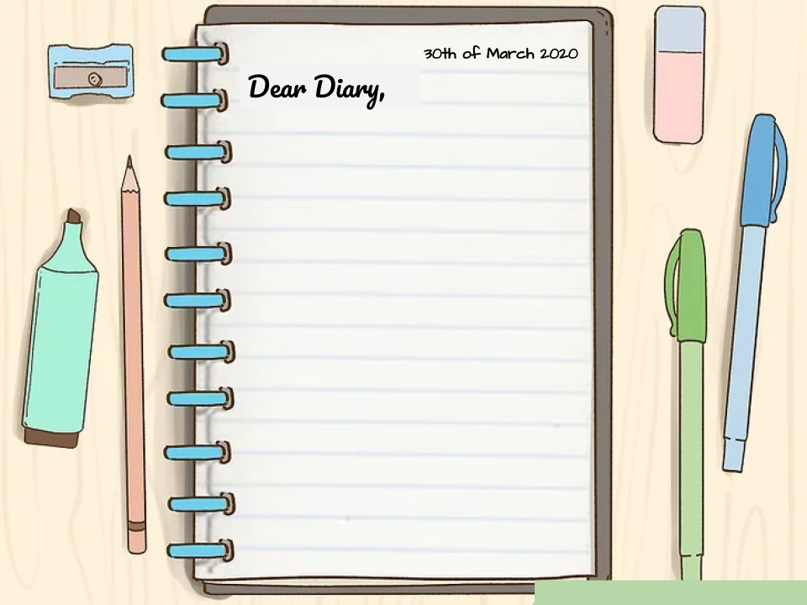
Hello dear diary, today is January 15 but I speak to you from March 30.
I want you to know that there are going to be difficult times and although today you see it as a joke, a pandemic is approaching. It is best not to leave the house because the virus is not very dangerous but it spreads very quickly.
It is also important not to buy everything in excess because then there will be people who will not be able to buy things as normal.

