Slide 1
Observation
Questioning the reality
Analysing the problem
Looking for a solution
Building a new knowledge as a starting point
APPROACHING PROBLEMS IN LEONARDO’S WAY

Slide 2
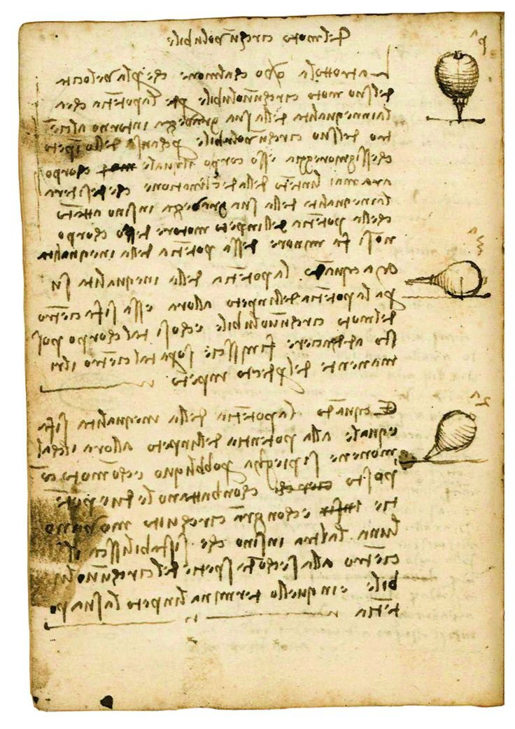
The Spinning top
OBSERVE AND DRAW
1-Choose an object and observe: The Spinning top
2-Ask yourself some questions:
2a) What is it?
2b) How does it work?
2c) What are its components?
2d) Can you break it down?
2e) In how many parts?
2f) How are the parts joined together?
2g) is it reproducible?
2h) how?
ANSWERS
2a) A spinning top
2b) The hand gives a rotary force that allows the object to turn on itself.
2c) Grip, central body, 4 moving limbs, rotating pin.
2d) Yes, it can be broken down
2e) It can be broken down into 6 parts.
2f) The parts join together.
2g) Yes.
2h) Reproducing and assembling the components.
2h) Reproducing and assembling the components.

Slide 3
Using the DOCUMENT CAMERA
Observing the toy as a whole
Breaking it down in its single components
Studying the different parts to comprehend their functions
let’s design the object to be drawn

Slide 4
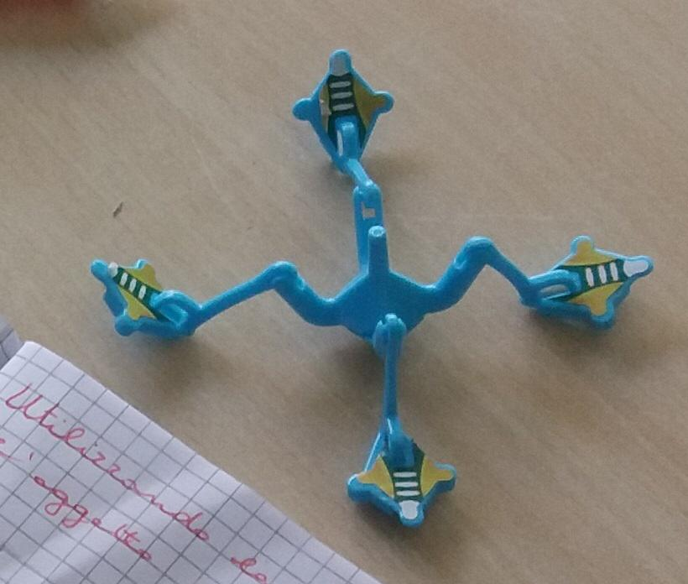
OBJECT: SPINNIG TOP
Drawing the toy
… as a whole….

Slide 5
… and in its single parts
handle
lower part
limbs

Slide 6
Understanding the assemblage of the toy and its movements
Two opposing forces are needed
to assemble
You have to fit the central body …
and hook the limbs to the central body

Slide 7
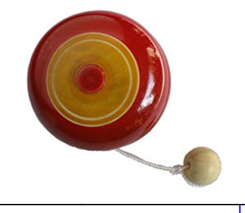
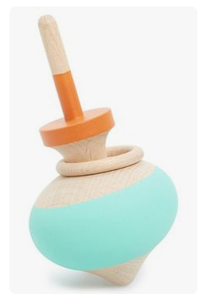
Something about leonardo's toys
The YO –YO
The SPINNING TOP
Leonardo has studied the physical laws of motion and flight through the help of these toys
The KITE

Slide 8
LET’S DESIGN LIKE LEONARDO
MATERIAL:
Wood
vinyl glue
colours
pin
nail
geometric shapes
pencil, ruler and rubber
INSTRUMENTS:
electric saw
Lathe
milling cutter
Hammer
drill

Slide 9
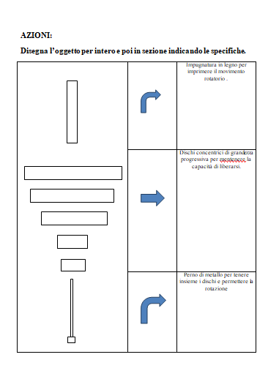
Actions:
Draw the object as a whole and then in section specifying the details.
Wooden handle to give the rotation movement
Spinning top body.
Metal pin to hold the discs together and allow rotation

Slide 10
Draw the in progressive size. Indicate the size.

Slide 11
Tornire il perno per decorarlo. Tornire il perno per decorarlo. Turn the pin to decorate it.

Slide 12
Design a soinner to try.

Slide 13
