Slide 1
ACTIVITY P2
Logo and mascot
contest of ideas
I
nnovating by
D
oing
E
xperiments
A
bout
L
eonardo

Slide 2
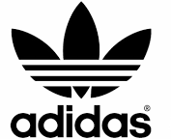
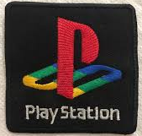
WHAT IS A LOGO?
A Logo is a design symbolizing an organization or a project.
By means of a Logo the organization or the project can easily be recognized

Slide 3
Selecting the concept
The most important part is to get the concept for the logo. It is almost the same process as selecting the name.
First you have to determine what your logo should say about your project:
You may come up with an image related to the main project’s objectives:
coding,
Leonardo da Vinci
inventions
You could use just an abstract image representing the project idea like:
innovating,
collaborating within the frame of Erasmus plus,
acquiring STEAM skills.

Slide 4
WHAT ARE THE MAIN FEATURES OF A LOGO?
The Logo can be a simple visual mark to identify a company product or service. Techniques as contrasting colors, simplified and yet stylish formats are useful to identify and attract more attention and convey information.
“Simpler is better", especially today when everything is moving so fast you have less and less time to impress your stakeholders. So it has to be done in a very stylish manner so that it`s easier for the eye to catch and the brain to memorize your logo design.

Slide 5
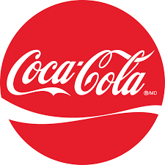
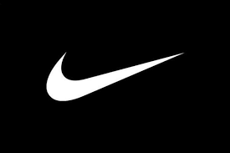
THERE ARE TWO TYPES OF LOGOS
Iconic Logo
Some kind of graphical element related to the business field or just an abstract image, for example: Nike, WWF, Apple.
Logotype
Logo based only on the company name. A unique font, or unique layout style can make a great logo, for example: Sony, Coca-Cola , Nintendo.

Slide 6
ICONIC LOGO
Iconic Logos can be very different. The classic variation is to make the symbol fit any of the basic geometrical shapes. For example:
The best shapes to use are symmetrical geometrical shapes They can be placed almost anywhere and still maintain the balance; they are very easy to handle.

Slide 7
BUT…
… there is no obligation in what kind of shape to use, you can use any free form shape you want, but you have to be very careful with the placement, so the logo doesn't look like it is falling apart or going to fall.
The perfect logo design will look great on a sign board as well as on a business card or on a pen for example.

Slide 8
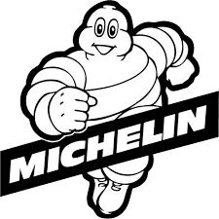
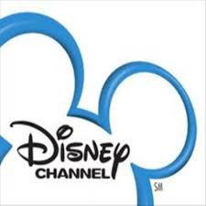
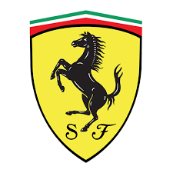
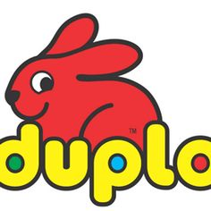
LOGOS CAN SHOW A MASCOT
People can easily memorize a simple logo design that have some kind of symbolic meaning. It could be a great idea to use a sort of mascot like the 'TireMen' of Michelin, Mikey Mouse for Disney Channel or the rabbit for Duplo.
The challenge with the mascot is that for it to be a good logo, and easily reproducible it should be very stylized and simplified as much as possible.

Slide 9
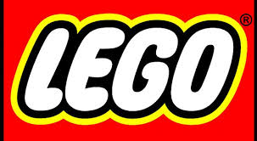
LOGOTYPE
A logotype includes only letters written in a custom-made or standard font. When looking at a logotype, you won’t find any graphic elements, symbols, marks, photos, etc.

Slide 10
Logotypes have some advantages:
Small size. A logotype doesn’t need extra space to fit an image or geometric shape.
Scalability. A logotype remains legible even when it’s scaled down.
Simplicity. A logotype is not cluttered with graphics and patterns.
Elements in logotypes are fonts, color schemes, layouts and graphic elements: they need to be carefully chosen in order to design a nice logotype to represent the project.

Slide 11
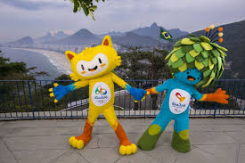
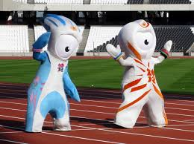
WHAT IS A MASCOT?
A mascot is any person, animal, or object thought to bring luck, or anything used to represent a group with a common public identity, such as a school, professional sports team, society, military unit, or brand name such as the Olympic Games mascots
Mascots are often living animals and have humanlike characteristics, they are often ironic and funny, further more they express feelings and emotions

Slide 12
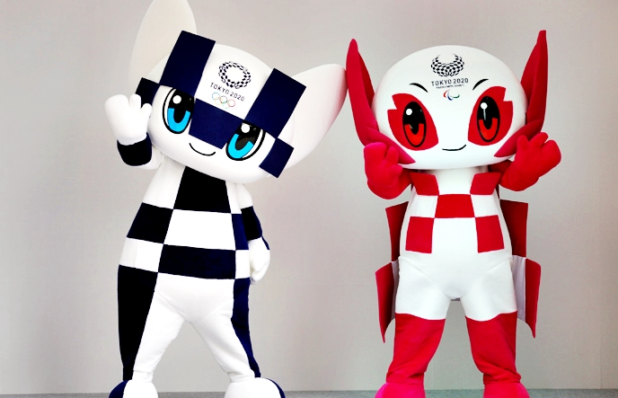
HOW TO CREATE A MASCOTTE
Think about character’s purpose
As for the logo we need to keep the concept of our project in mind: our Mascot should not only be original, it should nicely lead the pupils along the pathway to the discovery of Leonardo da Vinci, in this way it will identify the project in a unique way.

Slide 13
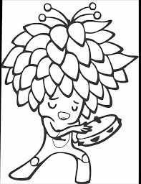
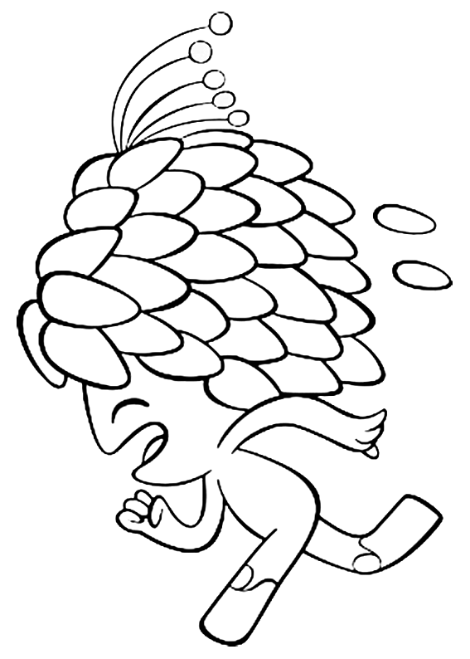
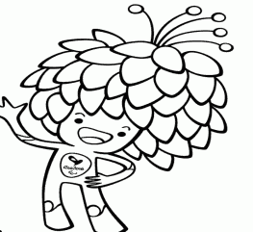
Give the Mascot a personality
There are so many ways to demonstrate a character’s personality: you can do this with the help of its face expression, posture and even shape.
Try to design a versatile character: draw it in different attitudes.

Slide 14
What shapes? What colours?
Character design is quite stereotypical: for example, round shapes are usually associated with softness, kindness and cuteness, while sharp lines and angled shapes can be associated with active, evil or creepy characters (though not necessary: everything depends on the context, after all).
Colours are important, dark colours usually stand for bad character, light colors suit better to positive characters. But it is important not to use too many colours.

Slide 15
Unleash your creativity
Successful
Interesting
Cheerful
Nice
Cool
Mascot
Wise
Brilliant
Funny
Clever
Creative

