Slide 1
math_sNakes@3e_pul_ladders

Slide 2
The rules

Slide 3
Each player puts their counter on the space that says 'START'.

Slide 4
Take it in turns to roll the two dices (number_dice and symbol_dice).
Move your counter forward the number of spaces shown on the number_dice.

Slide 5
Calculate add (+) or multiply (x) using the number you have landed and the number on the number-dice.
If your calculation is correct, stay there.
If your calculation is wrong, go back to the space you were before. Sorry!

Slide 6
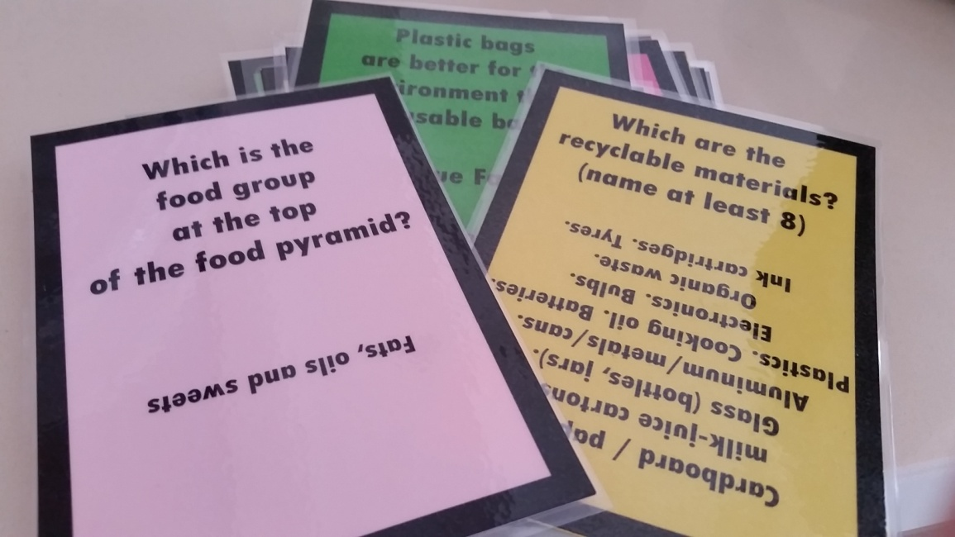
If your counter lands at the bottom of a ladder, the player before you asks a question.
If you answer it correctly, you can move up to the top of the ladder.
If you answer it wrongly, you stay where you are.

Slide 7
If your counter lands on the head of a snake, the player before you asks a question.
The first player to get to the space that says 'finish' is the winner.
If you answer it wrongly, you must slide down to the bottom of the snake.
If you answer it correctly, you stay where you are. The snake cannot bite you!

Slide 8
The first player to get to the space that says 'FINISH' is the winner.

Slide 9
Have fun!
powered by
the Hellenic team (Sophia, Jim, George, Andrew)

