Slide 1
GLOSES AND SANT ANTONI
Tomeu Vives Martínez

Slide 2
Introduction
The “gloses” are the lyrics of a typical song in a festivity in Mallorca called Sant Antoni. This festivity comes from an old legend where a man named Sant Antoni connected with God and he did what God said, but the demonds beat him. At the end the demonds disappeared.
Now, in the festivity the demonds dance always the same song in the main places in the town.

Slide 3
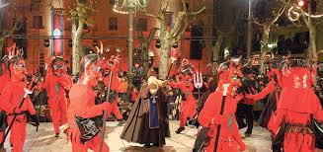
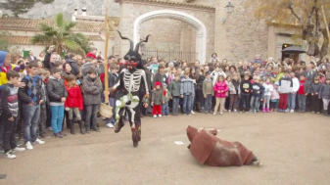
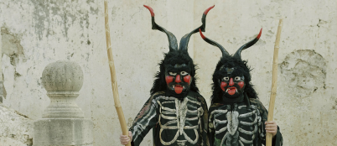
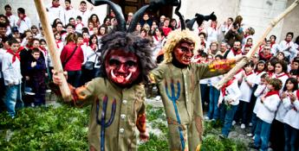
Sant Antoni is a festivity of Mallorca. In different towns of the island the festivity, the song and the demonds change a little.

Slide 4
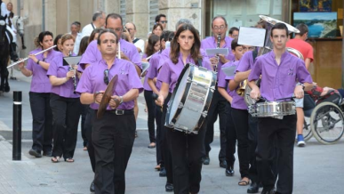
Song and instruments
The song begins with the trumpet and then the rest of the instruments continous it.
If you want to listen to a song from Artà:
https://www.youtube.com/watch?v=6UpjiSgjlpU

Slide 5
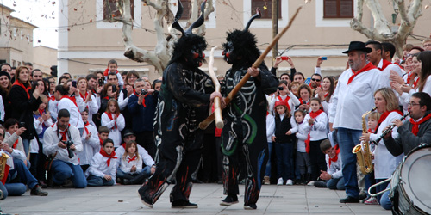
In this festivity there are lots of songs but the most important is the song in which you can change the lyrics, you can make gloses.
This is the song that the demonds use to dance.

Slide 6
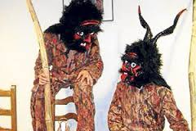
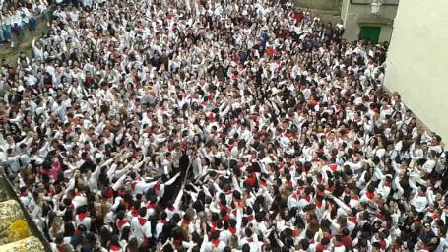
The demonds use a costume and a special mask. Each place has its typical mask and costume.
The day of the festivity
people wear a
white shirt and jeans.

Slide 7
Curiosities
This festivity is celebrated on 16th of January.
Sant Antoni is truly on 17th. These day people also participate in the party. But the big party is on 16th.
https://www.youtube.com/watch?v=h544KJ2USow

