Slide 1
European labour market
As a chance and job guarantor

Slide 2
The whole EU is a labour market where people can look for a job without any bureaucratic hurdles.

Slide 3
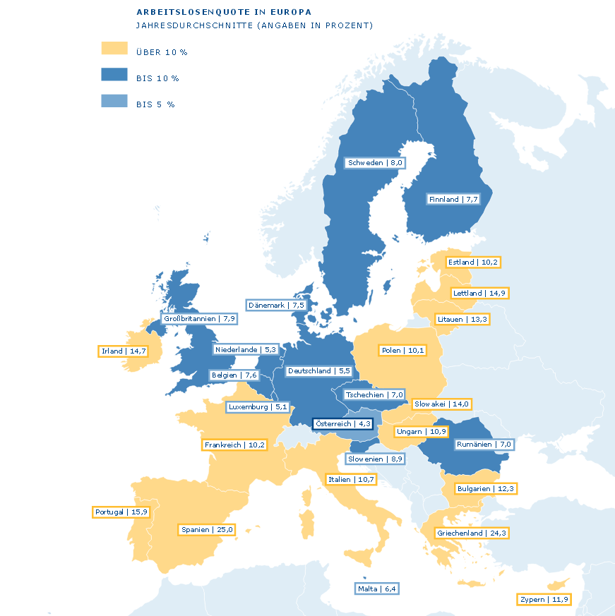
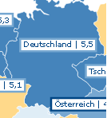
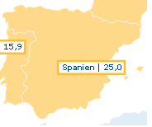
Unemployment rate in Europe
Germany(5,5%)
Denmark(7,5%)
Spain(25,0%)

Slide 4
Chances and job guarantor
through a higher mobility of the employees the problems of the crisis countries can be solved for a short period of time
for every unemployed citizen that finds a job in another country the domestic unemployment rate is reduced
the economy of the booming regions is supported

Slide 5
Chances and job guarantor
the citizens get the possibility to end up the unemployment earlier , to collect job experiences in foreign countries and with this to collect formal qualifications and cultural knowledge
lower rate of the lack of specialists
success factors for the European labour market are flexibility & mobility

Slide 6
Cons of the European labour market
from 2008 to 2013 the figure of unemployed steadly increased
single member states of the EU have the highest rates in case of unemployment such as Croatia, Greece and Spain
like the general unemployment rate the rate of youth unemployment also has raised

Slide 7
Cons of the European labour market
since 2014 the number of unemployed workers has gone back
nearly every fourth young human in the EU who is in the labour market is without work
Greece and Spain get quotes with 40% of youth unemployed people , so that they already call it “lost generation”

Slide 8
source
http://www.kas.de/wf/doc/kas_34466-544-1-30.pdf?140218161830

