Slide 1
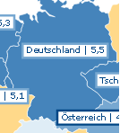
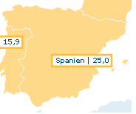
unemployment rate in europe
Germany(5,5%)
Denmark(7,5%)
Spain(25,0%)

